Slide 1
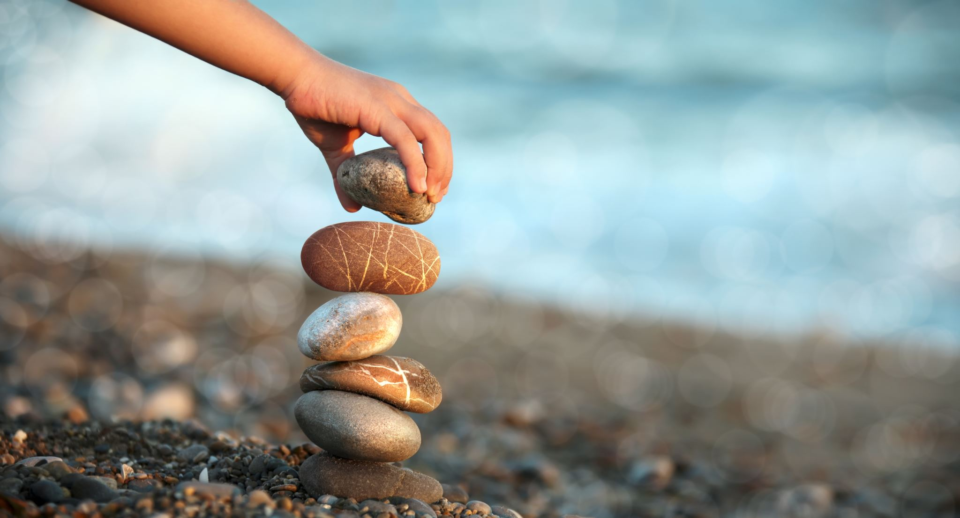
Primary Forest School
Online Learning – Mindfulness & Wellbeing KS1

Slide 2
The important bit for parents and teachers… but you can have a sneak peek at the activities too!
Activity | Resources Required | Potential Risks | Impact
Skill – Nature Threading | Nature materials to thread, pine needle or thin sharp stick, thread or wool, scissors. | Contact with harmful plants, use of sharp needle, | Children to use fine motor skills and dexterity to thread nature.
Main – Sensory Box | An array of nature or household items, bag or box, blindfold e.g., scarf. | Contact with harmful plants. | Children to use sense of touch to identify items.
Extended – Being me in my World | An outdoor area with boundaries, appropriate clothing, shelter resources if wanted | Uneven ground, contact with harmful plants, boundaries. | Children to be able to identify an area for mindfulness, some may be able to explain why.
Mindfulness – Watch a Sunrise or Sunset | A clear sky gives best results, a good viewpoint, sunglasses if needed, a sweet or warm treat makes it even better too! | An early/ late start, looking directly at sun. | Children to make goals or reflect on the day ahead/past.

Slide 3
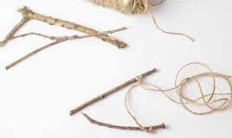
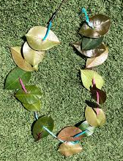
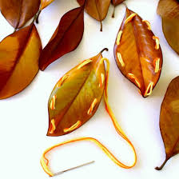
One leaf at a time…
Threading
You will need to collect nature items such as leaves, shells or nuts.
Using a thin sharp stick, skewer, or pine needle for leaves, and string or wool, can you thread your items together?
Why not turn your leaf threading into a necklace?
To make it easier use a hole punch to create the holes.
For an extra challenge see if you can thread the outline of the leaf!

Slide 4
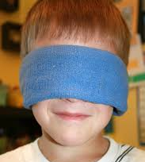
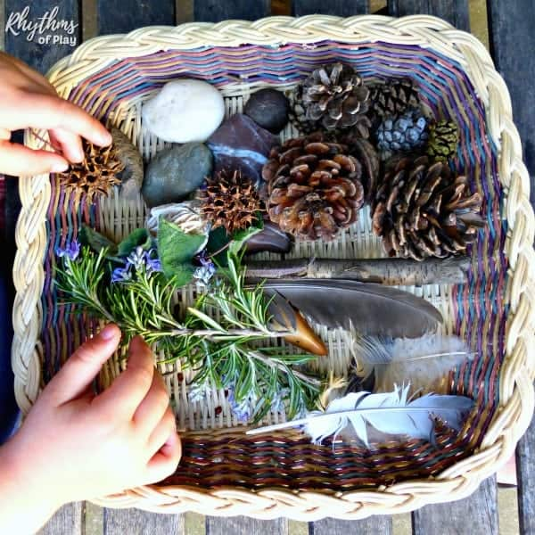
What am I?…
Sensory Box
You will need to collect different nature or household items and put into a box or bag.
Find yourself a blindfold (a scarf is great use) and cover your eyes… after reading what to do of course!
One at a time take an item from the bag, no peeking!, just by using your hands can you guess what the item is?
For an extra challenge ask someone else to fill your box/bag and see if you can still guess correctly!
Why not get the whole family to have a go?!
What words can you use to describe how the items feel?

Slide 5
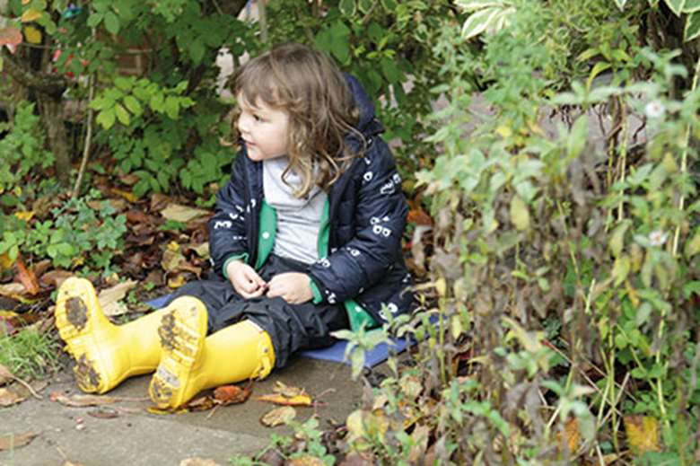
Being Me in My World…
When you go out for your daily exercise agree with your adult an area you can explore independently (by yourself!). Your challenge is to find an area that is just for YOU!
Maybe, you like watching the world go by so find a nice look out point?
Maybe, you like all the wildlife so have to hide so you don’t scare them when they visit?
Maybe, you like being tall so get some height by climbing a tree (make sure your adult is nearby for this though!)
For an extra challenge you can take resources to stay in your special area for a while… I’d recommend a snack, drink and something to sit on.
Why is your area special to you?

Slide 6
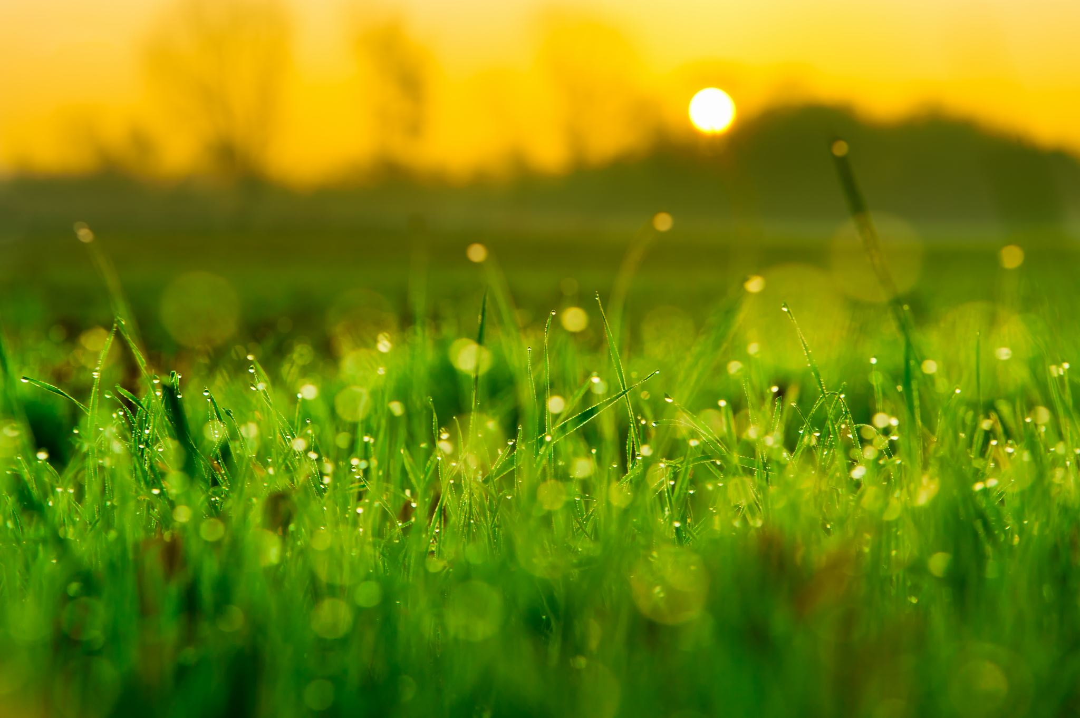
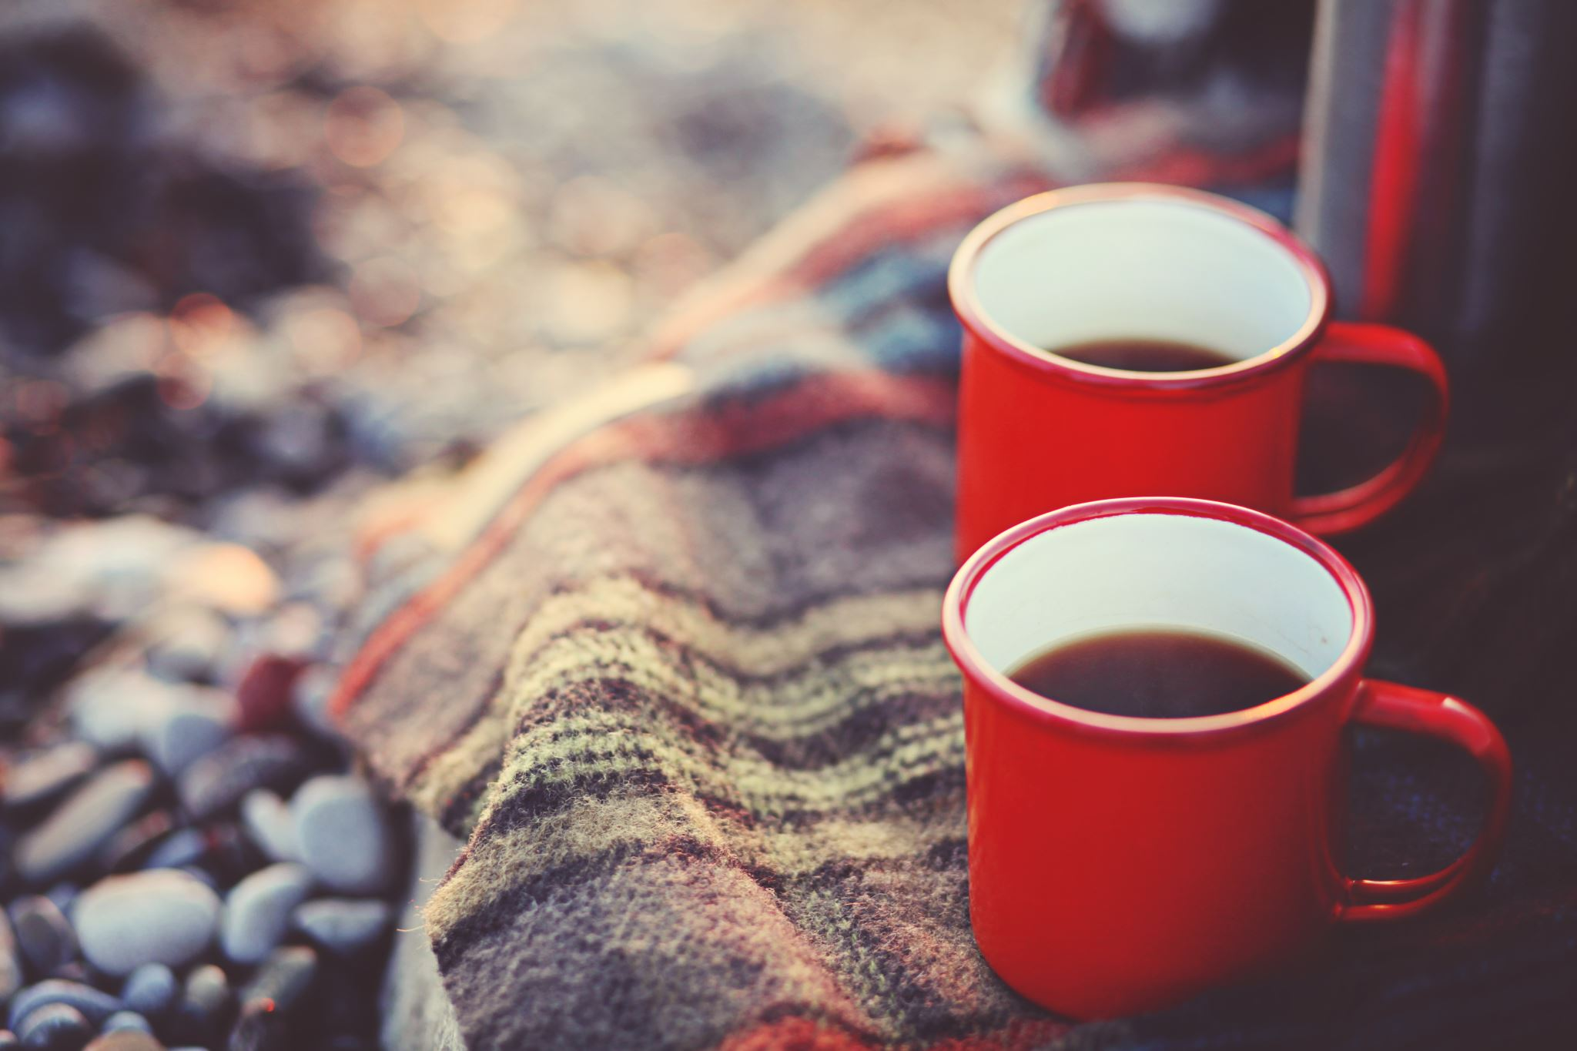
Mindfulness Moment
How did this activity make you feel?
Watch a Sunrise or Sunset
A sunrise or sunset marks the start or end of a day.
A sunrise is a great time to set goals or challenges for the day ahead!
A sunset is a perfect time to reflect on the day – good and bad and how we can make tomorrow even better!
Which viewpoint did you choose? What else could you see?
TOP TIP! A sweet or warm treat adds to the memories!

Slide 7
How did you get on?
What was your favourite activity?
Share your feedback by;
Emailing - ellen.blackwood@primary-forest-school.co.uk
Find us on Facebook or Instagram @PrimaryForestSchools

