Slide 1
Primary Forest School
Online Learning – KS1 Science Activities

Slide 2
The important bit for parents and teachers… but you can have a sneak peek at the activities too!
Activity | Resources Required | Potential Risks | Impact
Plants – name common plants & trees | Name cards | Contact with harmful objects | Children learn to identify some common nature around them
Animals – draw & label the human skeleton | Human skeleton cheat sheet | Germs in nature | Children start to understand the structure of the human body
Everyday materials –scientific adjectives | Lots of different natural resources | Contact with harmful objects | Children appreciate the variety of descriptive words that can be used in nature
Seasonal changes – look at this season and think about the others |  |  | Children know the 4 season names and start to think about the differences between them

Slide 3
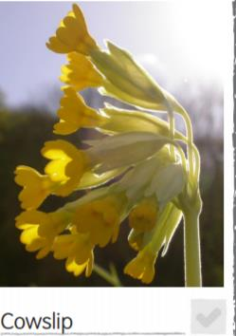
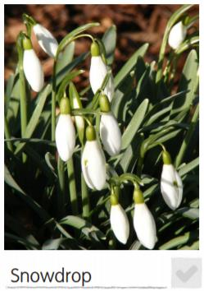
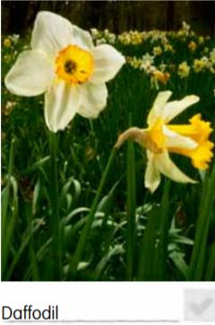
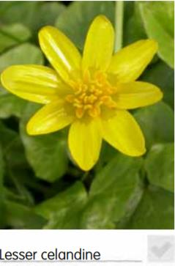
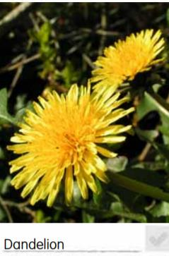
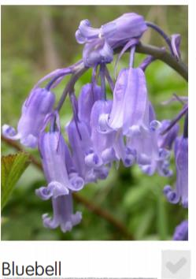
Plants – name common plants & trees
Plants and trees exist all around us and they all have their own names. How many do you know?
Use the ID images on the next pages to try and identify some of the plants and trees on your next walk
Tick them off when you find them. How many can you find?

Slide 4
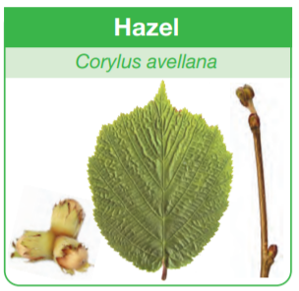
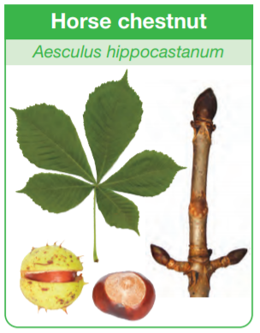
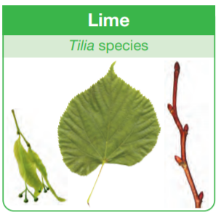
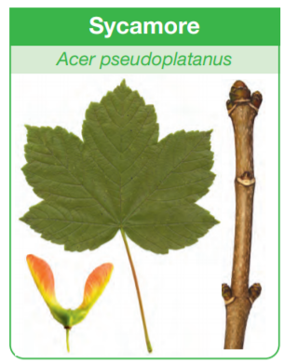
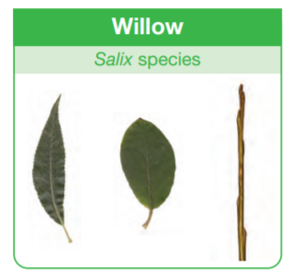
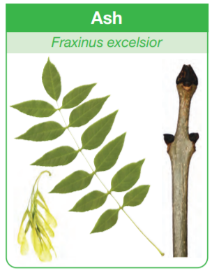
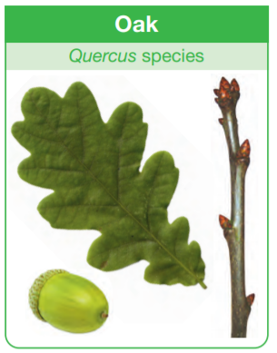
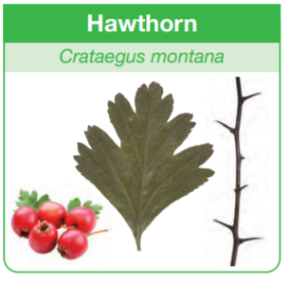
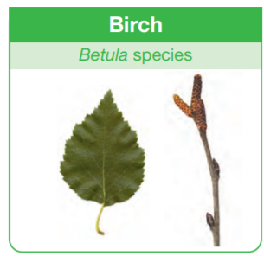
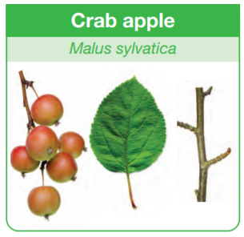
Plants – name common plants & trees
Plants and trees exist all around us and they all have their own names. How many do you know?
Use the ID images on the next pages to try and identify some of the plants and trees on your next walk
Some trees look very similar. Try to find the small details that make them different

Slide 5
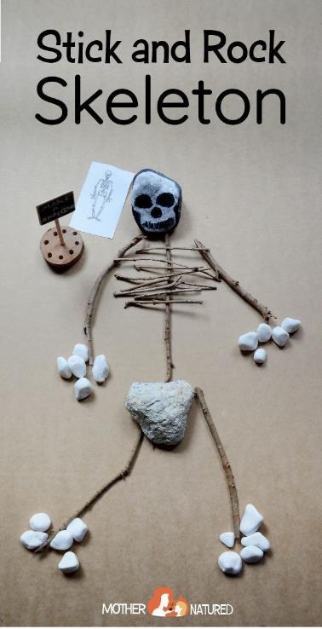
Animals – draw & label the human skeleton
All of our bones, together, make up the skeleton. Our skeleton holds us upright and in shape.
Using natural items, can you re-create the human skeleton?
Can you remember any of these bone names?

Slide 6
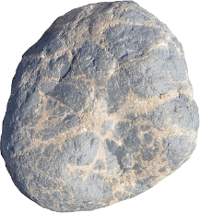
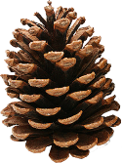
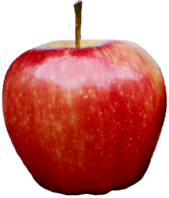
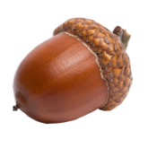
Everyday materials –scientific adjectives
In science, we need to describe objects and the best way is to use adjectives. Can you use the adjectives below to describe natural objects you find on a walk?
Can you find the opposites in this list?
e.g. hard / soft
hard
absorbent
waterproof
shiny
bendy
soft
smooth
stiff
stretchy
rough
dull
opaque
transparent

Slide 7
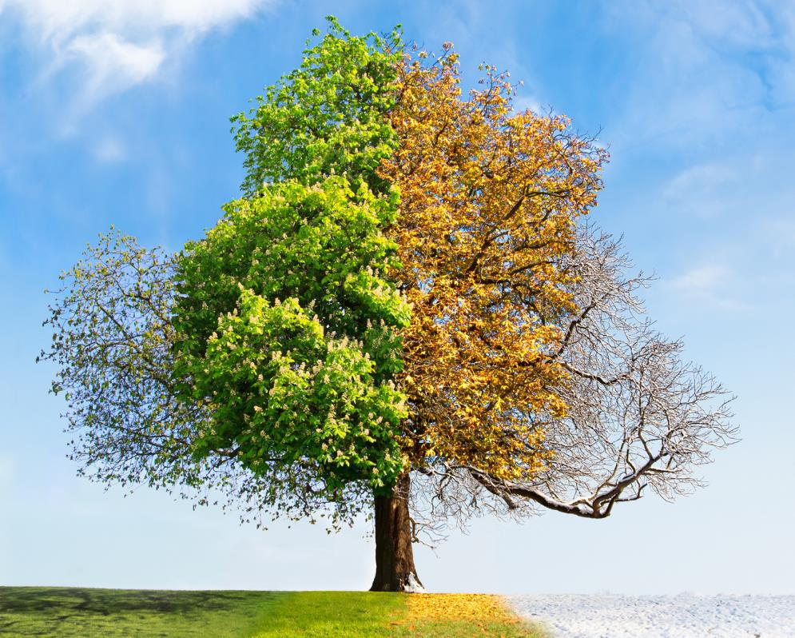
Seasonal changes – look at this season and think about the others
Everything changes around us throughout the year. The weather, the colours, the trees and flowers.
We can describe these as the changes of the seasons
Do you know the 4 seasons?
Look around outside.
What can you see that is different to the Summer?
What about the Autumn?
What makes this season unique?
Keep a diary of this season and take notes or draw pictures on the other seasons throughout the year to document the changes

Slide 8
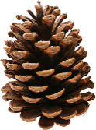
How did you get on?
What was your favourite activity from this pack?
Share your feedback by:
Emailing - ellen.blackwood@primary-forest-school.co.uk
Find us Facebook or Instagram @PrimaryForestSchools

