Slide 1
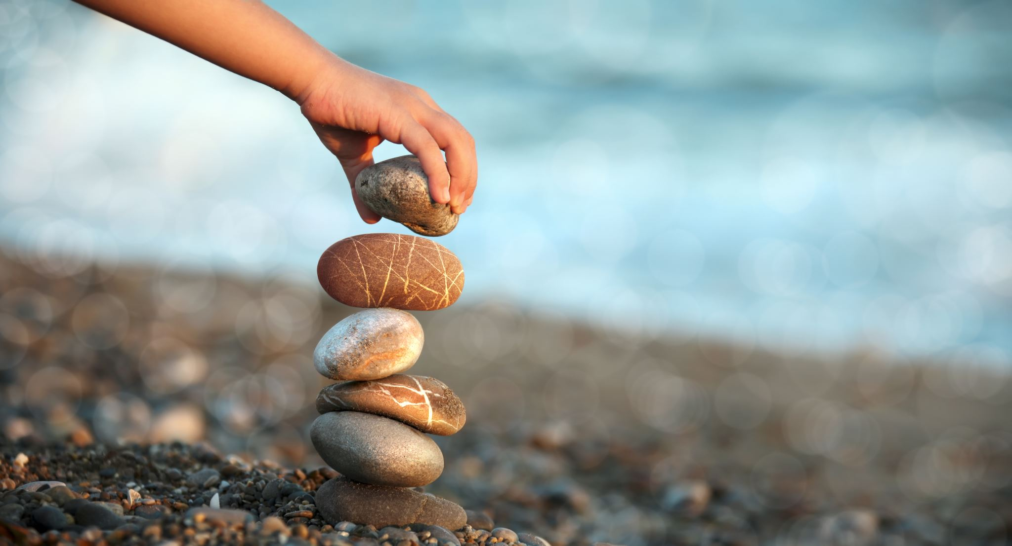
Primary Forest School
Online Learning – Mindfulness & Wellbeing KS2

Slide 2
The important bit for parents and teachers… but you can have a sneak peek at the activities too!
Activity | Resources Required | Potential Risks | Impact
Skill – Rock Painting | Rocks, Sharpies, acrylic paint or paint pens | Throwing rocks can increase chance of breakages, use of paint, permanent markers on clothes | Children to use their art skills to decorate rocks and inspire with motivational messages
Main – Blindfold Trail Game | Items for an obstacle course e.g., plant pots, chairs, buckets, blindfold, partner | Miscommunication and bumping into obstacles, | Children to trust partner to direct them safely around an obstacle course while blindfolded
Extended – Being me in my World | An outdoor area with boundaries, appropriate clothing, shelter resources if wanted | Uneven ground, contact with harmful plants, boundaries. | Children to be able to identify an area for mindfulness and be able to explain why the are is special to them.
Mindfulness – Watch a Sunrise or Sunset | A clear sky gives best results, a good viewpoint, sunglasses if needed, a sweet or warm treat makes it even better too! | An early/ late start, looking directly at sun. | Children to make goals or reflect on the day ahead/past.

Slide 3
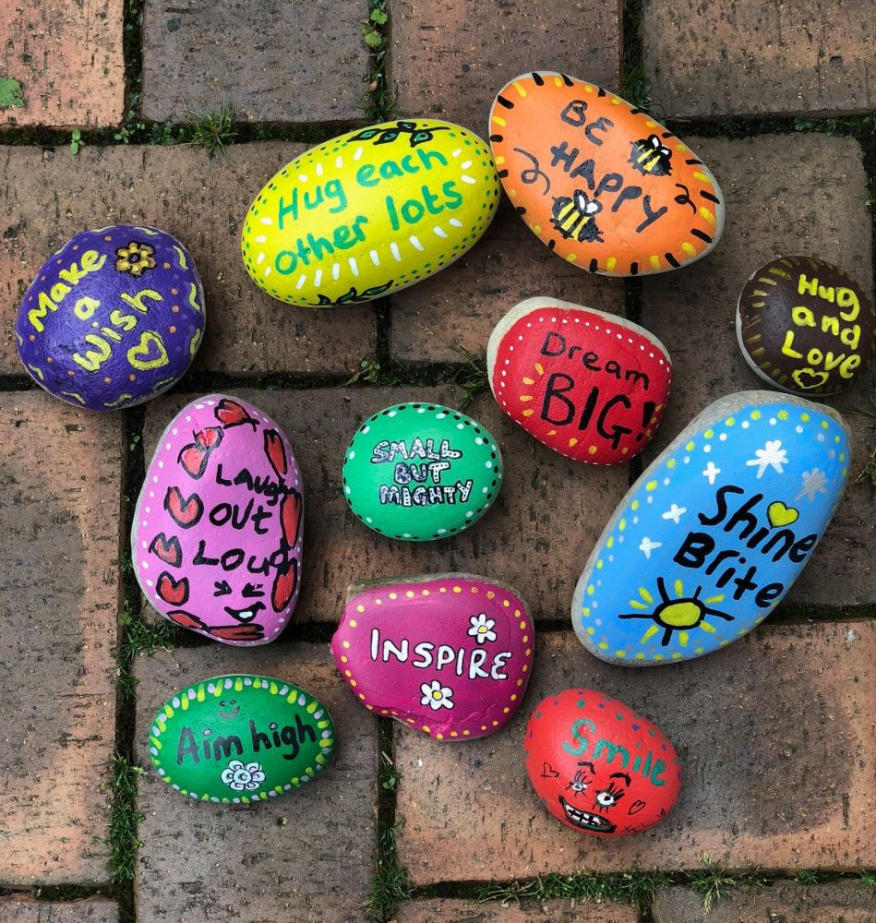
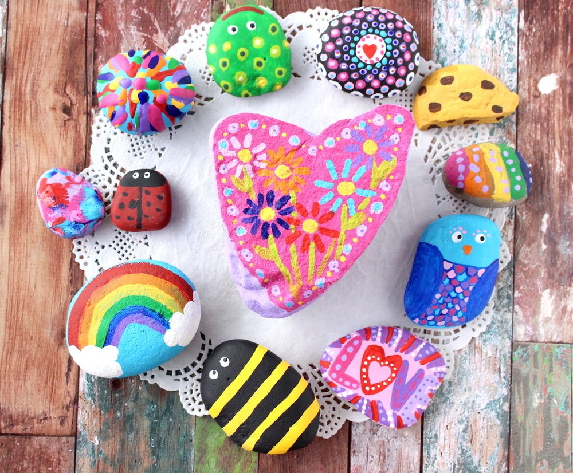
Let the painting begin…
Be aware of where you take your rock as some areas are prohibited!
Rock Painting
You need to collect smooth rocks and sharpies, acrylic paint or paint pens.
Using your arts materials can you decorate your rocks in all different patterns. Take a look for inspiration…
For an extra challenge make kindness rocks with a nice or motivational message
Keep your rock or put it out for others to see. What will you do?

Slide 4
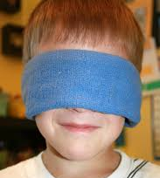
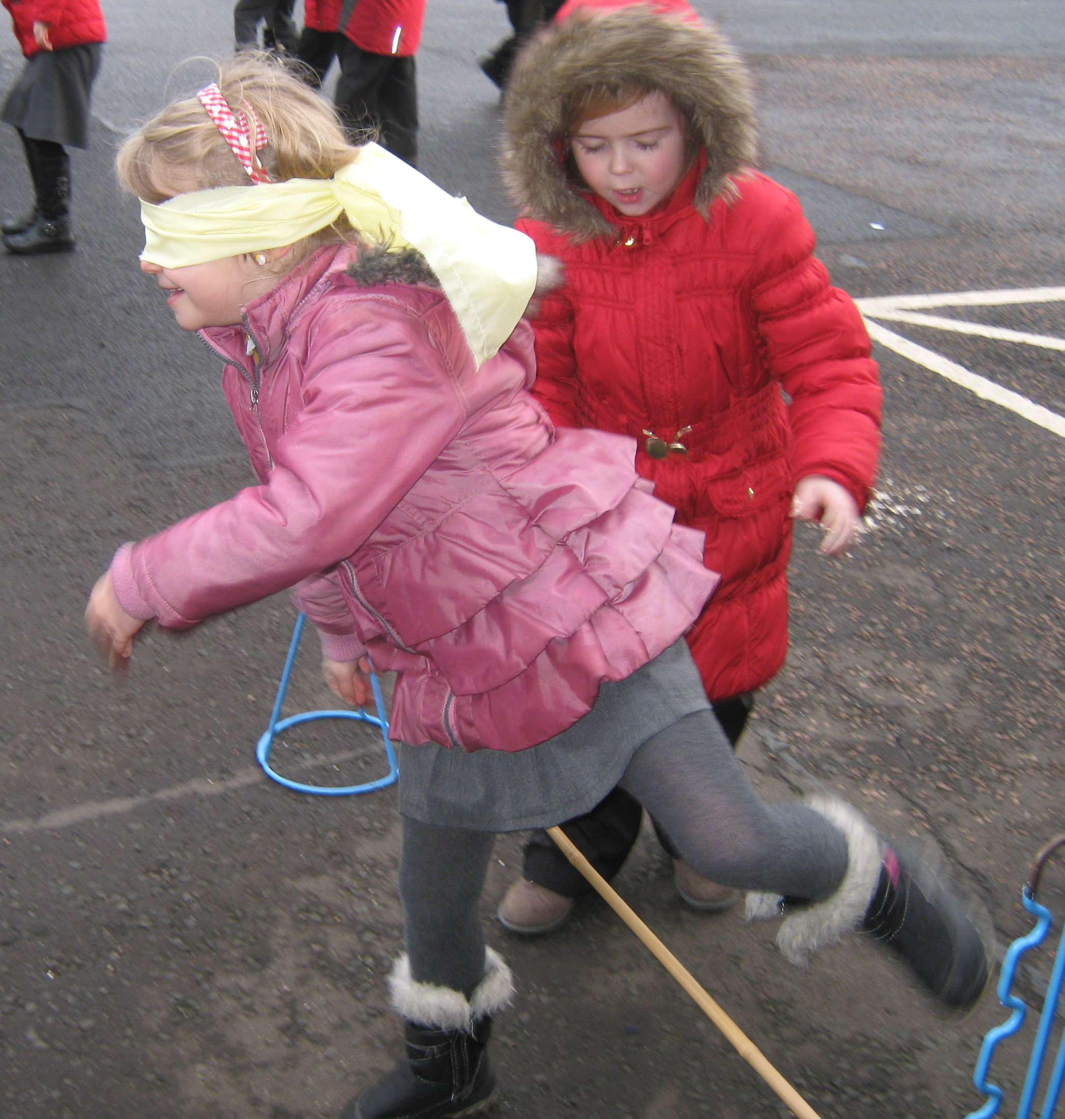
Go that way!…No not that way!... That way!
Blindfold Trail Game
You will need to set up an obstacle course (inside or outdoors) using items such as plant pots, buckets, rope and chairs.
Find yourself a blindfold (a scarf is great use), cover your eyes… after reading what to do of course!
You will also need a partner to direct you. You can use hands on shoulders to help and then try only using your voice, no peeking!
For an extra challenge think about making the course harder by having to go over or under an obstacle!
Why not get the whole family involved! Which pair can make it round the course in the quickest time?
What words are helpful/ not helpful to know to help with directions?

Slide 5
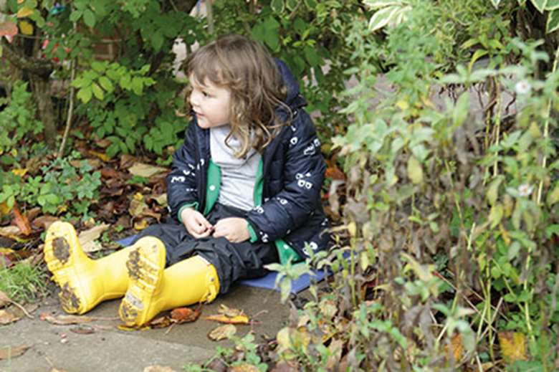
Being Me in My World…
When you go out for your daily exercise agree with your adult an area you can explore independently (by yourself!). Your challenge is to find an area that is just for YOU!
Maybe, you like watching the world go by so find a nice look out point?
Maybe, you like all the wildlife so have to hide so you don’t scare them when they visit?
Maybe, you like being tall so get some height by climbing a tree (make sure your adult is nearby for this though!)
For an extra challenge you can take resources to stay in your special area for a while… I’d recommend a snack, drink and something to sit on.
Why is your area special to you?

Slide 6
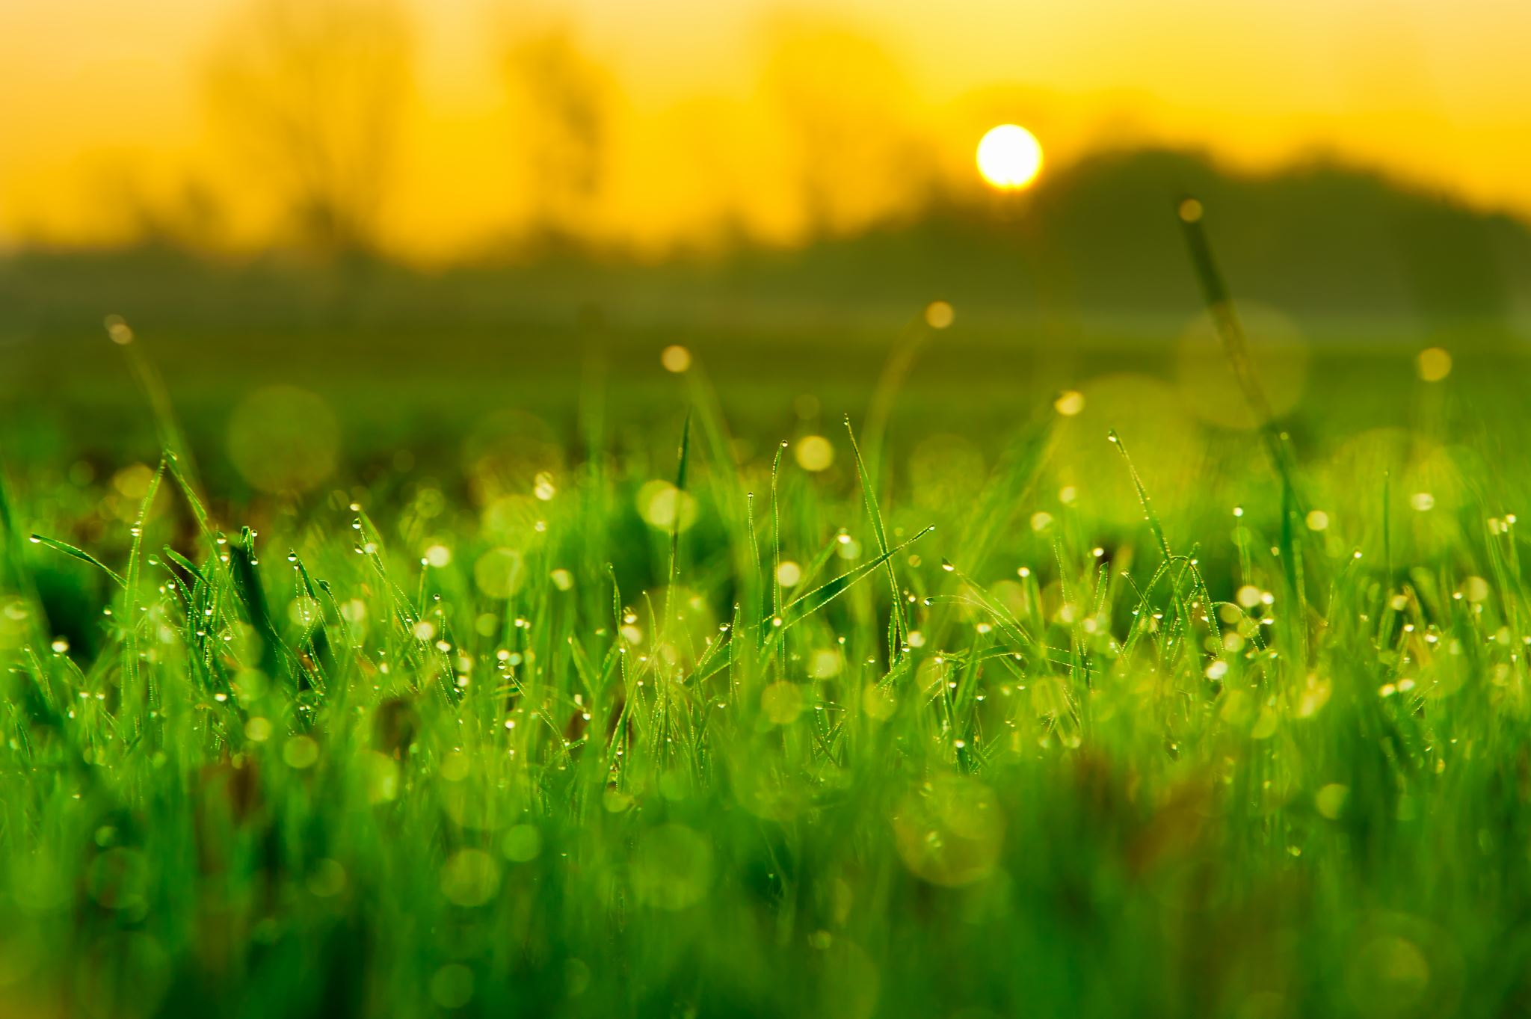
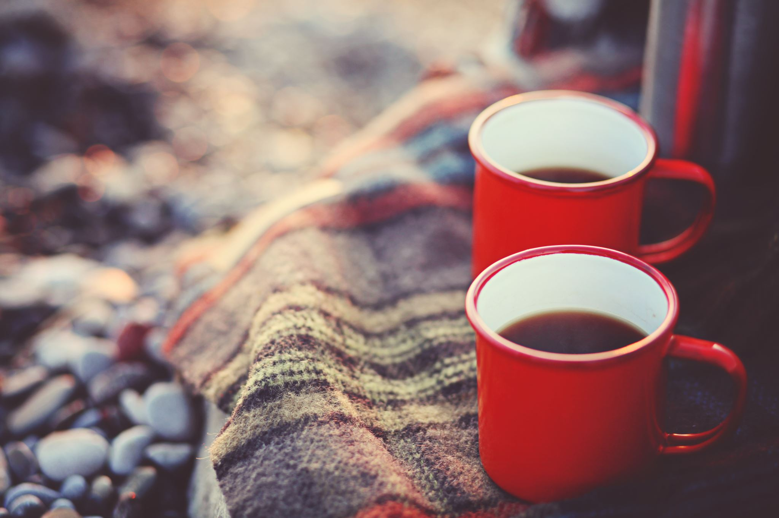
Mindfulness Moment
How did this activity make you feel?
Watch a Sunrise or Sunset
A sunrise or sunset marks the start or end of a day.
A sunrise is a great time to set goals or challenges for the day ahead!
A sunset is a perfect time to reflect on the day – good and bad and how we can make tomorrow even better!
Which viewpoint did you choose? What else could you see?
TOP TIP! A sweet or warm treat adds to the memories!

Slide 7
How did you get on?
What was your favourite activity?
Share your feedback by;
Emailing - ellen.blackwood@primary-forest-school.co.uk
Find us on Facebook or Instagram @PrimaryForestSchools

