Slide 1
Primary Forest School
Online Learning – KS2 Science activities

Slide 2
The important bit for parents and teachers… but you can have a sneak peek at the activities too!
Activity | Resources Required | Potential Risks | Impact
Mass – It’s a Matter of Matter! | Various natural items | Contact with harmful objects, Use and movement of heavy or sharp items | Children to identify the objects with the most similar and most different mass
Digestion – It’s all about the poo! | Poo identification sheets | Germs in digestive byproduct | Children to appreciate the differences in byproduct from a variety of diets
States of matter – Hot flush or cold shoulder? | Water A bowl A marker pen or ruler | Ice can be harmful if touched | Children understand about the different states of matter of water
Buoyancy – Something that should float your boat! | Paper, foil, fruit and other materials you have around – anything goes! A bowl, bucket or bath of water | The floor might get wet! | Children understand the term ‘buoyancy’ and appreciate the different buoyancies of objects
The Eye – Eat your carrots! | None | Don’t look directly at the sun | Children appreciate the different ways the eye works in various lights

Slide 3
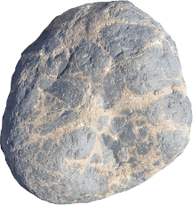
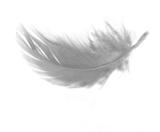
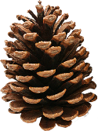
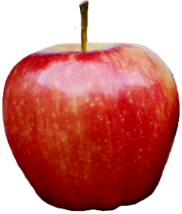
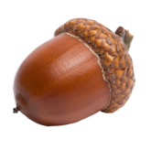
Mass – It’s a Matter of Matter!
Mass is how much material an object has in it so it doesn’t matter how big it is. It can be as big as an elephant, but if it’s hollow, it will have a low mass. A tiny object that’s really tightly packed will have a high mass. We might say it’s ‘heavier’.
Find a variety of natural objects of all shapes and sizes
To test the mass, see how quickly they fall to the ground
Ensure it’s a fair test by dropping them all from the same height
The larger the mass, the faster they fall (in general)
Which has the largest mass? Which has the smallest?
Did anything surprise you?
Which 2 objects have the greatest difference in mass?

Slide 4
Digestion – It’s all about the poo!
The final stage in digestion, sees the body left with the waste that it cannot digest. There’s only one way to get rid of it!
Because different animals eat different diets, their poo looks different too
On the next page, can you match up the animal name to their poo? Answers in 2 pages time…don’t cheat!
The scientific word for poo is faeces (pronounced fee-sees)
Drinking plenty of water and eating fibre keeps you regular (at least 4 times a week but normally every day)

Slide 5
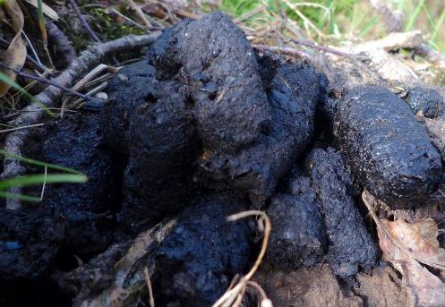
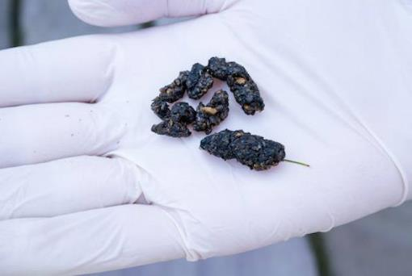
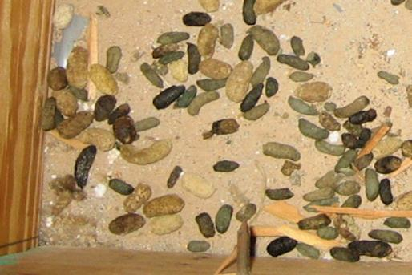
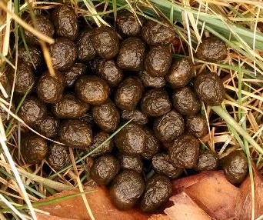
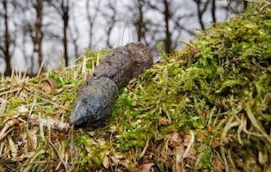
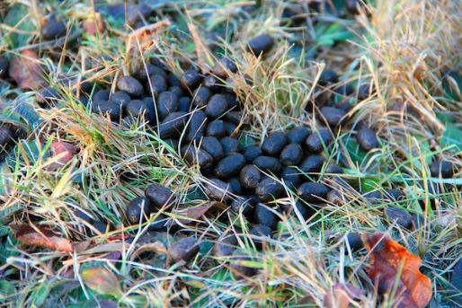
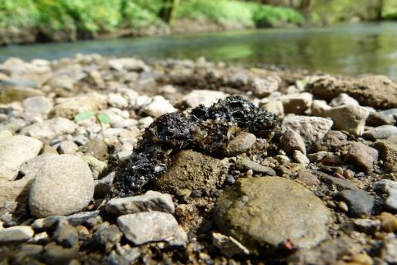
Match the poo to its animal…
Rabbit
Badger
Fox
Squirrel
Hedgehog
Otter
Deer

Slide 6
Answers
Badger
Hedgehog
Squirrel
Rabbit
Fox
Deer
Otter
The next time you go for a walk, keep an eye of for some poo.
Can you identify it?

Slide 7
States of Matter – Hot flush or cold shoulder?
There are 3 states of matter – solid, liquid and gas
Every compound can be in all 3 states of matter but some need to be extremely cold or extremely hot to get there
What do we call the solid and gas states of water? (answers at the bottom of this page)
Water can be found in all 3 states of matter around us
If you leave a bowl of water out overnight and the temperature goes below 0⁰C, the water will freeze.
This is the change from liquid to solid
Why not try this experiment?
Evaporation is when a liquid changes to a gas
If you leave a bowl of water out on a hot (or not so cold) day, some of it will evaporate
Pour an exact amount of water into a bowl using a measuring jug. After a day, pour it back into the jug and remeasure the volume.
Is it the same?
Solid state of water = ice gas state of water = steam

Slide 8
Buoyancy – Something that should float your boat!
Water pushes upwards on objects. This is called upthrust. Objects have a weight to them. If the water has more force pushing upwards than the weight of an object, it will float. This means it is buoyant.
Experiment 1
Find lots of natural items around the house or bring them home from your next walk.
Estimate (best guess) whether they will float or sink. Then place them in a bowl, bucket or a bath of water and see.
Try a lemon and a lime or a pear and an apple.
Did you estimate correctly?
Did any surprise you?
Experiment 2
Make a ‘boat’ out of tin foil, card or paper. Place it in your water.
Estimate which objects you think you can place in the boat and keep it afloat.
Place the objects into the boat. Did it stay afloat? Can you add any more objects?

Slide 9
The Eye – Eat your carrots!
At night, your eyes use different cells to see. These rods can’t see colour so a lot of things will seems grey in the dark. The cones see colour but they need a lot of light to work properly.
We often think we can’t see at night in the dark but actually the moon and stars give us enough light to be able to see quite well.
Our eyes need a minute to adjust to the low light but they are very clever organs.
Go outside when it’s dark and turn off all the house lights. If you can, find a really dark spot where artificial light can be seen.
After a minute, you should start to be able to see the stars.
The best place to see the stars is in the middle of a field, well away from the lights of the town so that your eyes can adjust to no light.
On a really clear night, you might even see the Milky Way galaxy!
Can you find any of the constellations of stars on the next page?

Slide 10
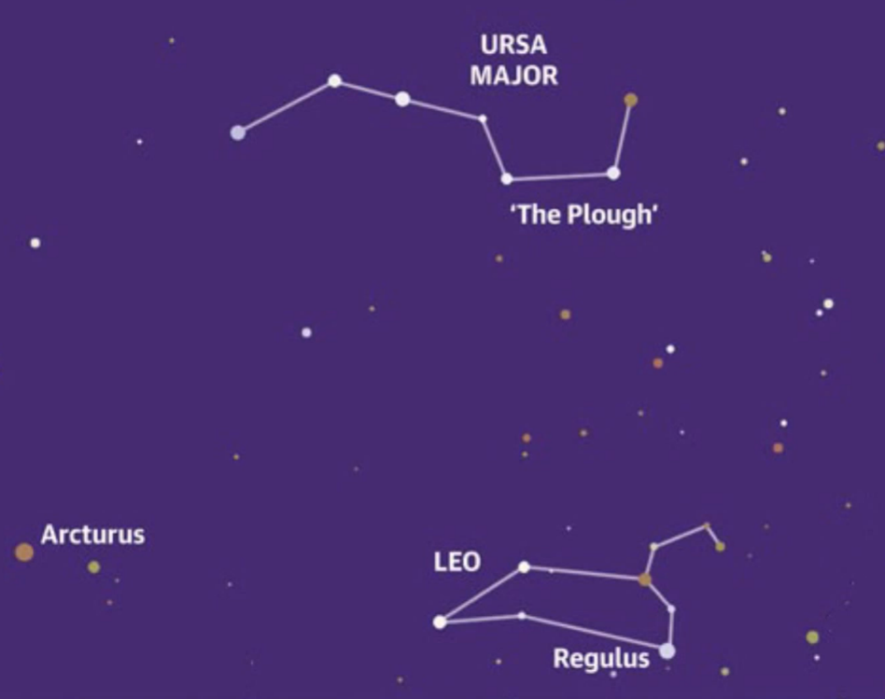
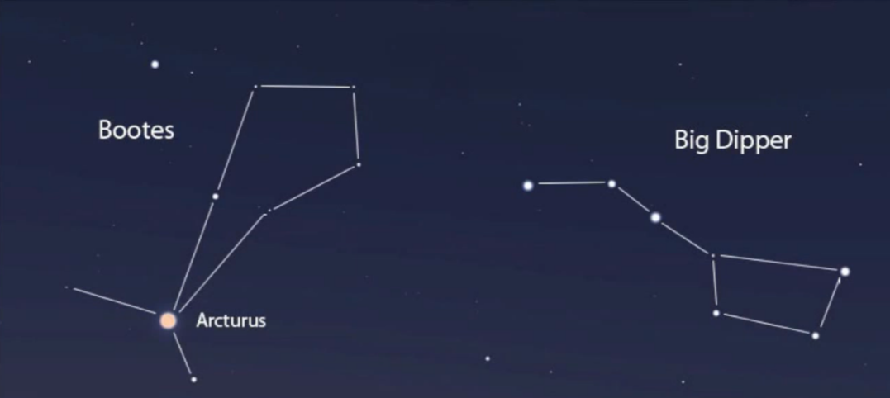
The Eye – Eat your carrots!
These constellations should be visible now at night if you’re in a dark place.
Use ‘The Plough’ or ‘Big Dipper’ (different names for the same constellation) as your guide.
Try looking North…

Slide 11
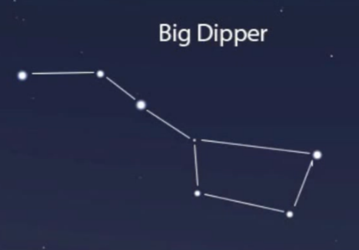
How did you get on?
What was your favourite activity from this pack?
Share your feedback by:
Emailing - ellen.blackwood@primary-forest-school.co.uk
Find us Facebook or Instagram @PrimaryForestSchools

