Slide 1


How can I support reading at home?
Parent workshop
September 2023

Slide 2
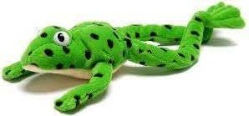
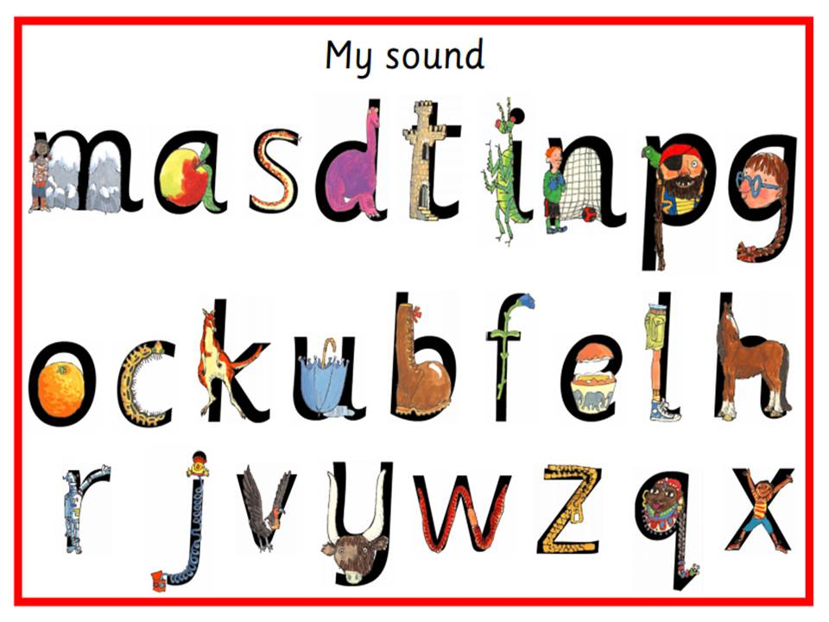
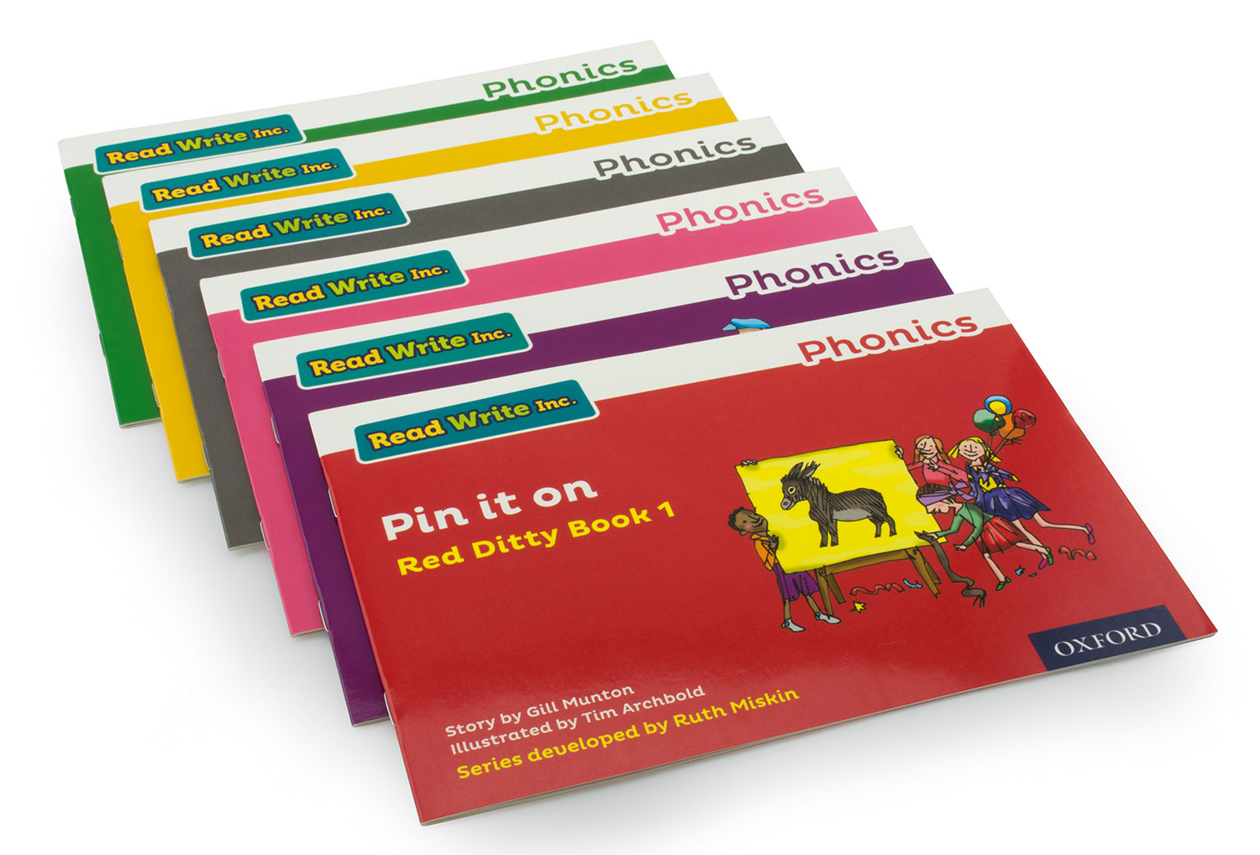
What is Read Write Inc?
Read Write Inc (RWInc) is a phonics complete literacy programme
it helps all children learn to read fluently and at speed so they can focus on developing their skills in comprehension, vocabulary and spelling.
The programme is designed for children aged 4-7 – Reception, year 1 and Year 2 – it adopts a stage not age thematic approach.

Slide 3

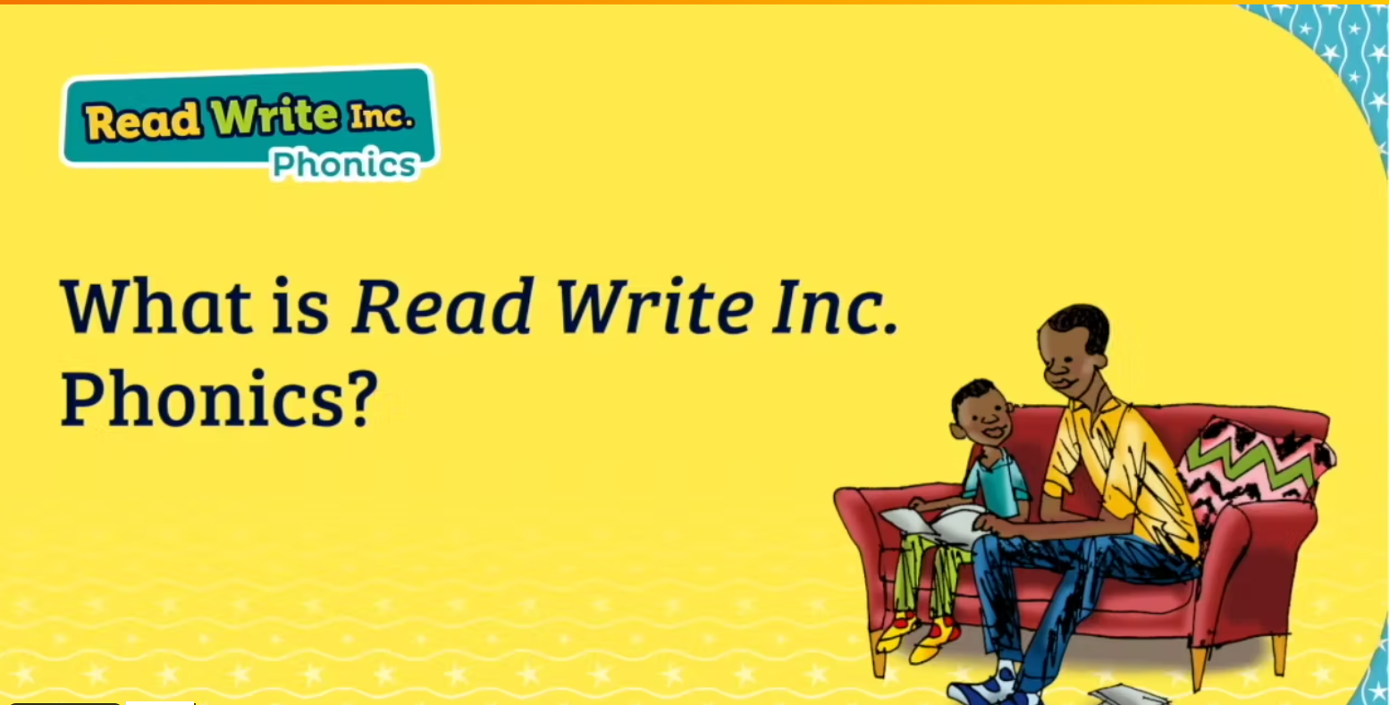

Slide 4
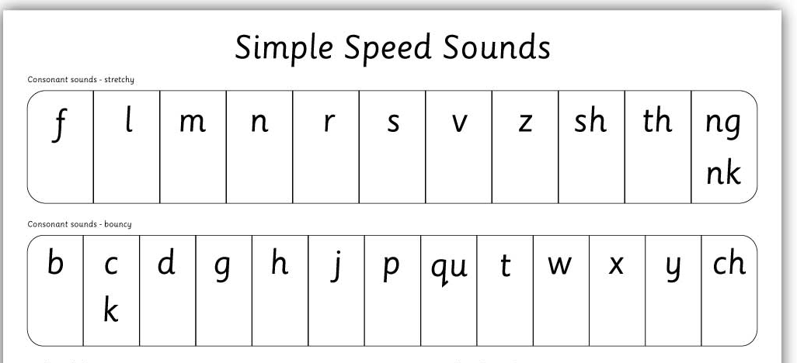


Teaching the phonics sounds
To begin with children are taught the first 26 sounds.
These are the singular sounds.
Some sounds are stretchy sounds.
Some sound are bouncy sounds.

Slide 5
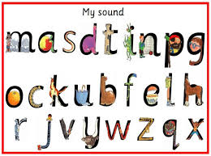
Pronouncing the sounds
We don’t like adding the schwah! (uh at the end of a sound)
How to say the sounds

Slide 6

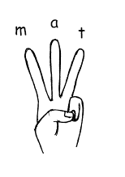
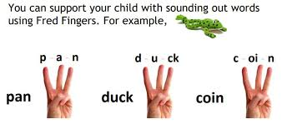
Say hello to Fred
Fred can only talk in sounds
The children are taught to Fred Talk to help them sound out and read words
Once the children become more fluent with identifying sounds when blending words there are encouraged to Fred in you Head – sound out silently in their head.
Fred fingers – is how Fred helps us to spell words.
Let`s have a go!

Slide 7
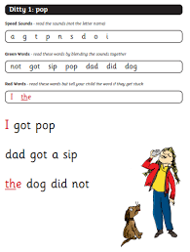
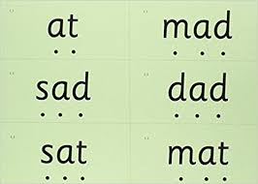

Slide 8
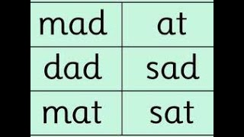
Learning to blend
Once the children have learnt the first 5 sounds the participate in word time.
Word time teaching the children to sound out the sounds using “Fred talk” and blending them together.
Fred games help us to understand the method of blending

Slide 9
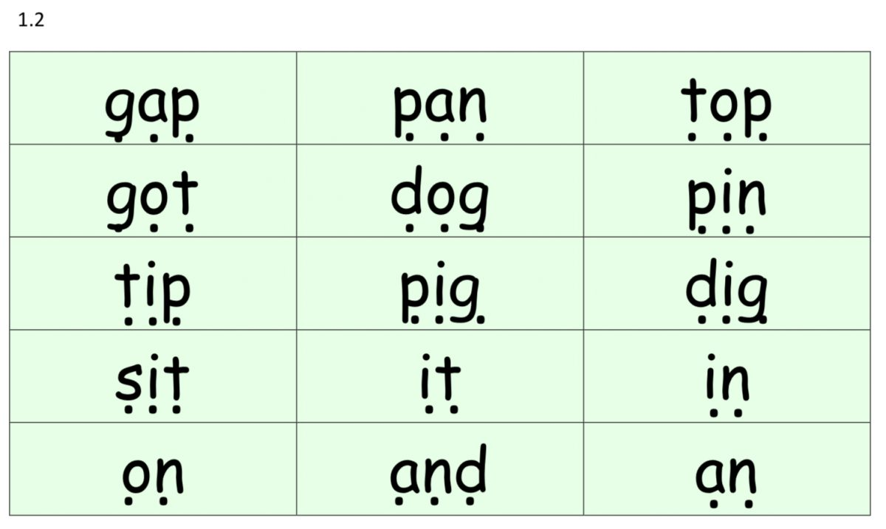
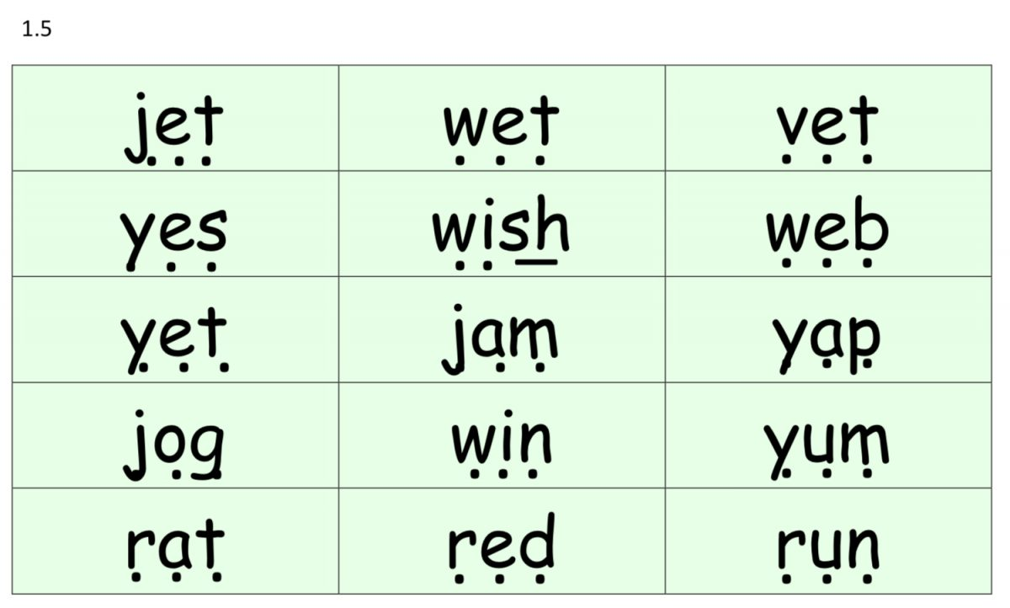
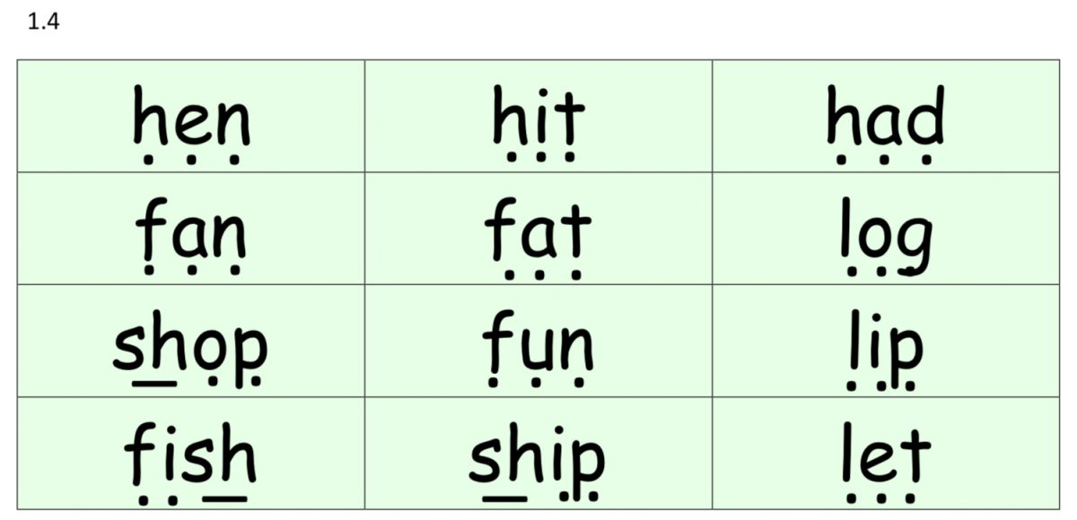
Word time
Word time continues as the children develop their sound knowledge.
Each set of word time words features the most recent sounds taught.
There are 7 sets of word time words which feature all the set 1 sounds taught.
Children are encouraged to “Fred talk” the sounds and blend them back together e.g g-a-p = gap.

Slide 10
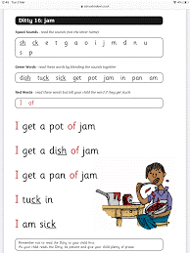
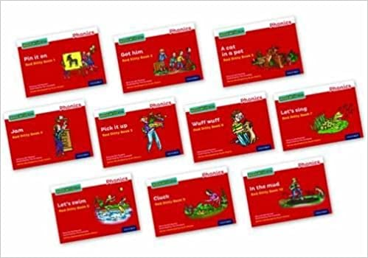
Beginning to read
Once the children are confident with sounding out and blending they will begin to read ditties.
Ditties come in 2 forms:
Sheets
Red books
The ditty sheets and books will introduce
Children to the tricky red words (sight words).
These words are hard to sound out as they
Include tricky sounds. The children learn these
Through repetitive recall.

Slide 11
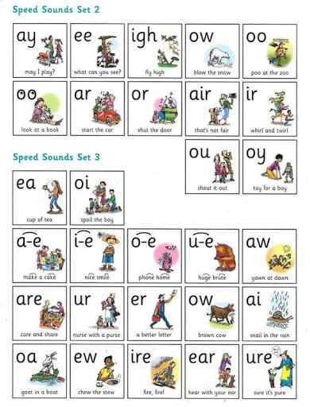
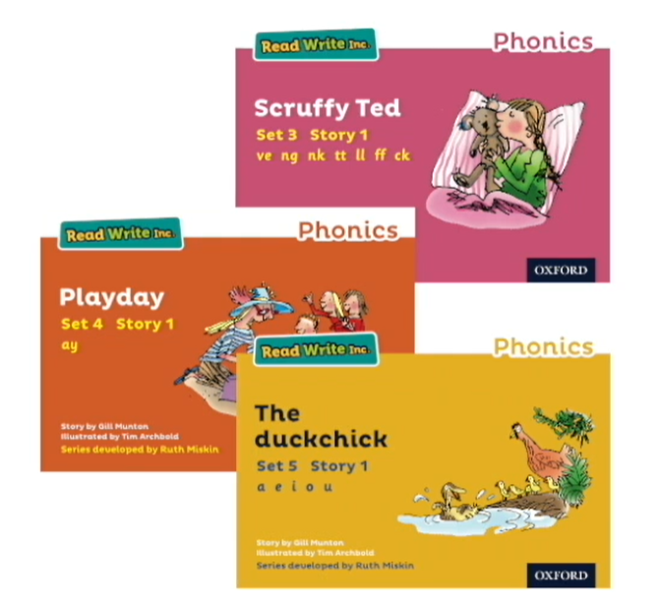
Special friends
Once children have learnt all of the set 1 sounds and are confident identifying them we move on the set 2 and set 3 sounds.
The set 2 and 3 sounds are digraphs/trigraphs or as the children know them “Special Friends”
The special friends are accompanied by a rhyme to help children recall the sound.

Slide 12
What can my child read?
Mrs Treble will carry out a simple reading assessment every 6 weeks to determine your child`s individual progress.
The assessment looks at what sounds they can confidently identify and what words they can read.
Once your child is reading yellow books your child`s fluency and pace of reading will be determined.
Your children are then grouped based on the sounds they need to be taught and the book level they are reading at.
Read Write Inc works with a stage not age approach.

Slide 13
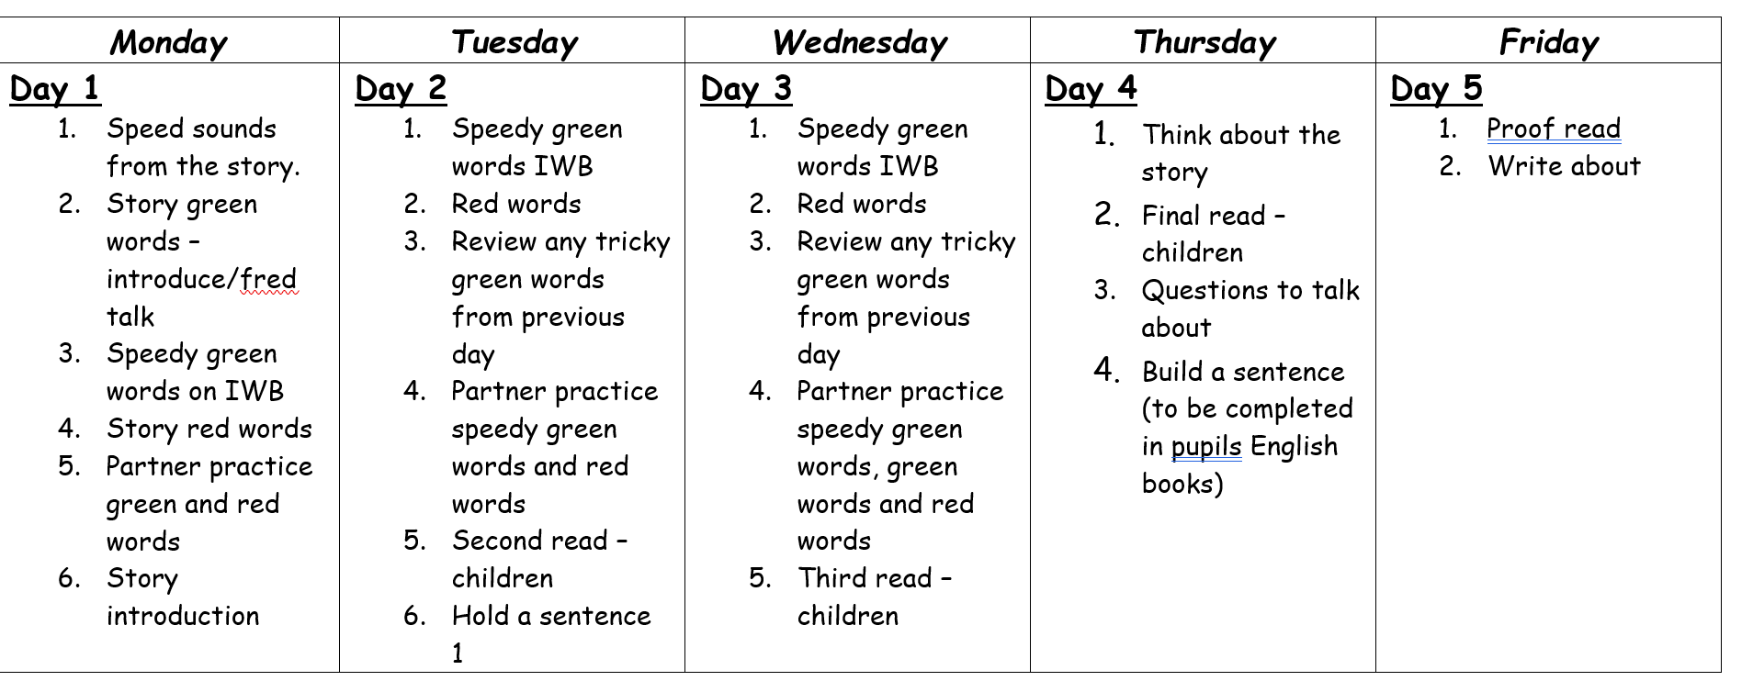
How does Read Write Inc look?
9.00 – 9.15 daily children join in with their daily speed sounds sessions. We learn a sound a day.
9.15 – 10.00 in 3 small groups pupils practice writing the speed sound and identifying the sounds in words.
Funky finger activities – fine motor based activities daily to support the fine motor skills including threading, using pegs, tweezers, drawing and cutting.
Once pupils are reading books:

Slide 14
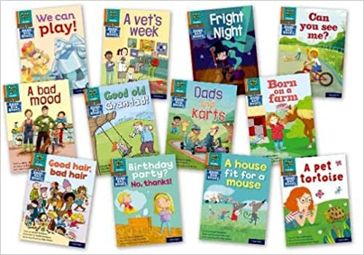
Reading at home
Your child will never bring home a book they cannot read
Through 6 weekly assessments your child will be grouped on their individual phonic knowledge and ability to blend.
Your child will read a book 3-4 times at school before they bring it home to read with you.
This means your children are equipped with the word understanding and knowledge to be able to read this with you at home.
Along with the text we have read in school they will being home a supporting book bag book which features the same words as the in school book.

Slide 15

How can you help?
Ensuring sounds are pronounced correctly – not adding uh!
Encouraging children to sound out words using “Fred talk” before saying the word.
Practicing reading the sight words.
Reading enjoyment books daily to promote reading.
Playing games in the car or at home using the sounds
I spy something with a mmmmm sound
Fred talking simple words for your children to say back e.g. there is a d-o-g/ the sky is –b-l-ue. Exposing children to words and how they can be sounded out is great.

Slide 16
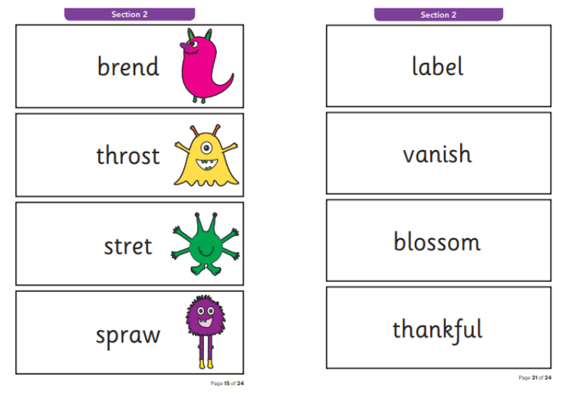
Year 1 Phonics screening
40 words including all taught graphemes
Some non-sense made up words
Children need to read 32 to pass
Regular testing checkpoints

Slide 17

Any Questions

Slide 18

Tapestry
Useful videos will be posted on tapestry which will offer additional support for reading at home.

