Slide 1
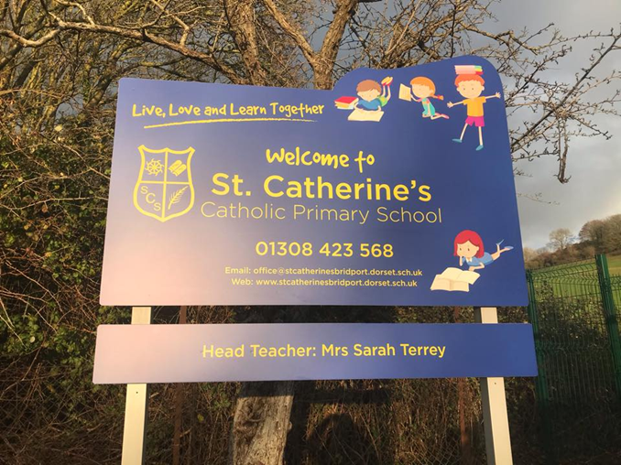
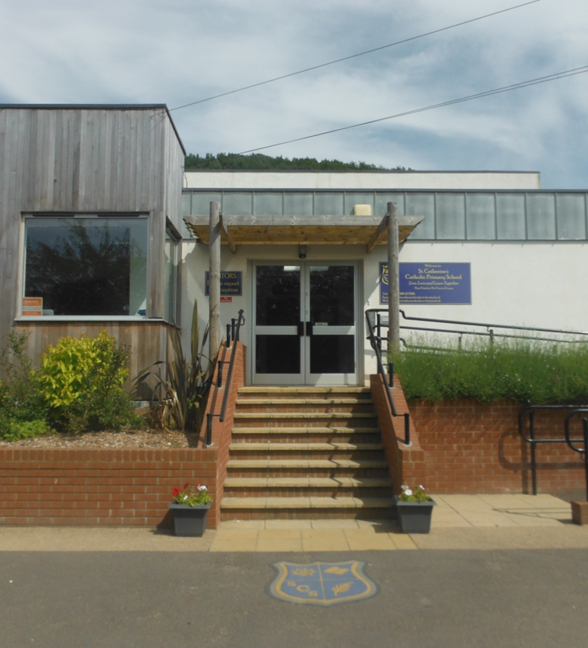
Moving to Reception Class

Slide 2
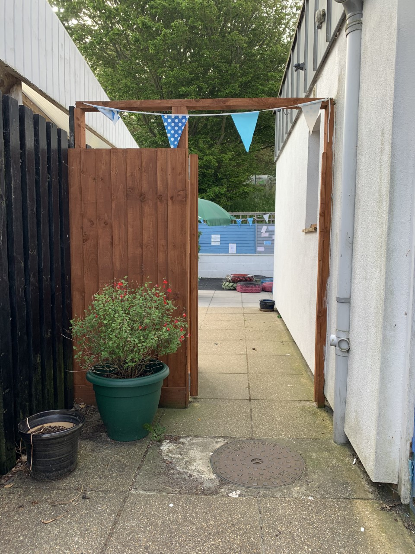
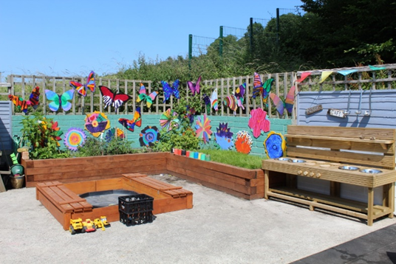
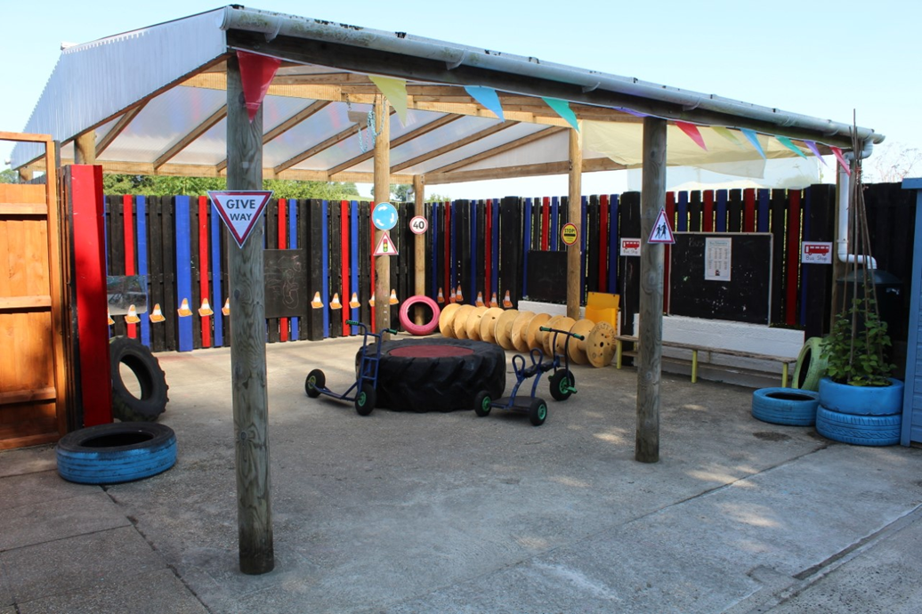
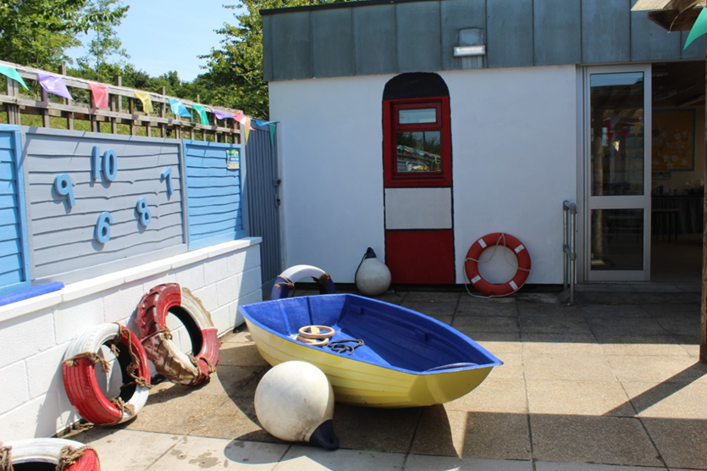
After the Summer holidays I will be going back to school. I will be in Reception.
Some things will be the same and some things will be different.
I will line up by the EYFS gate. I will wait with my Grown Ups until my teacher collects me.
I will walk through the outside area and into my classroom.

Slide 3
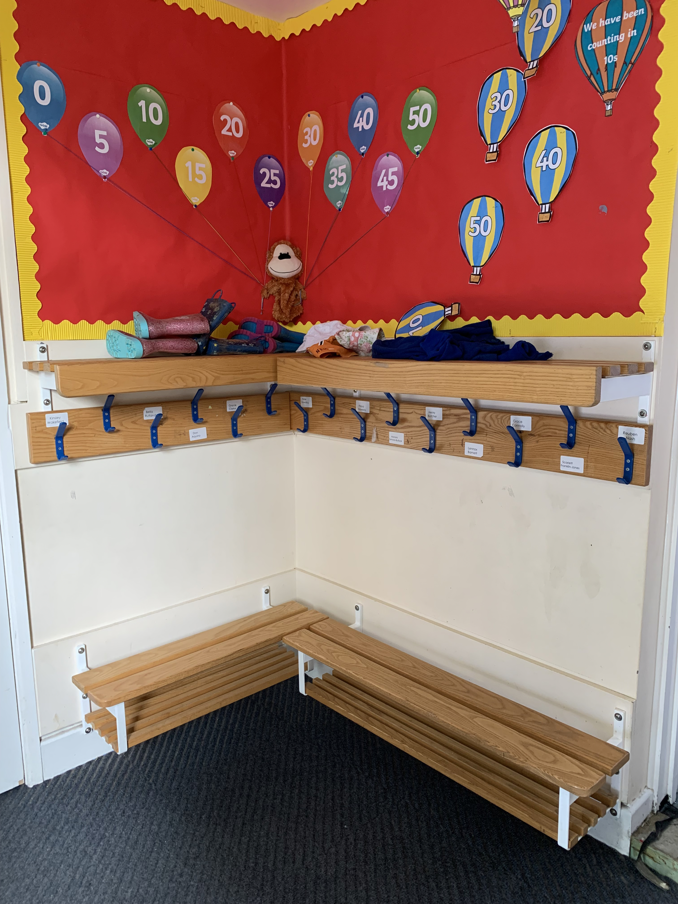
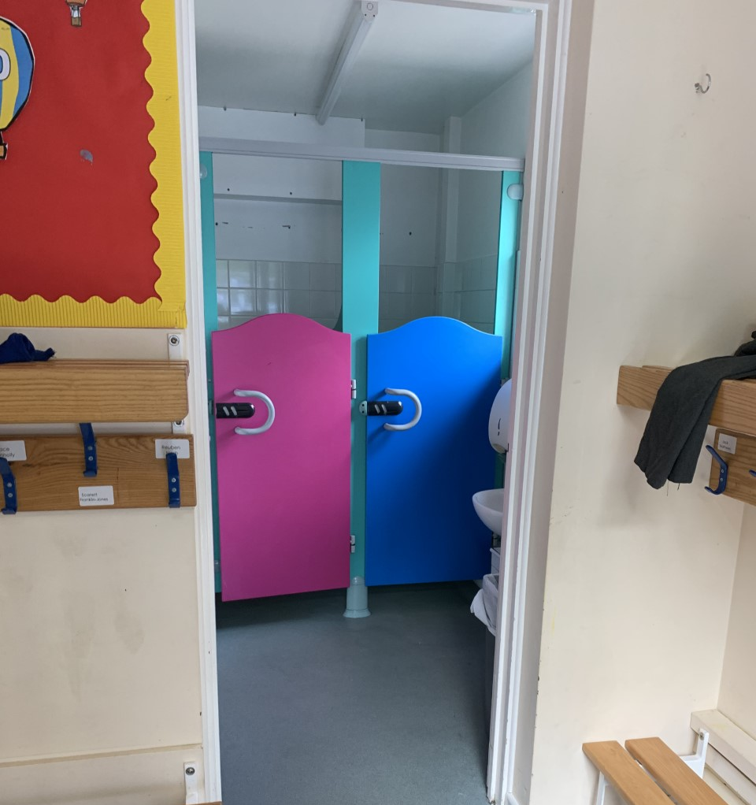
This is where we will hang up our coats.
The toilet is just next to the coats.

Slide 4
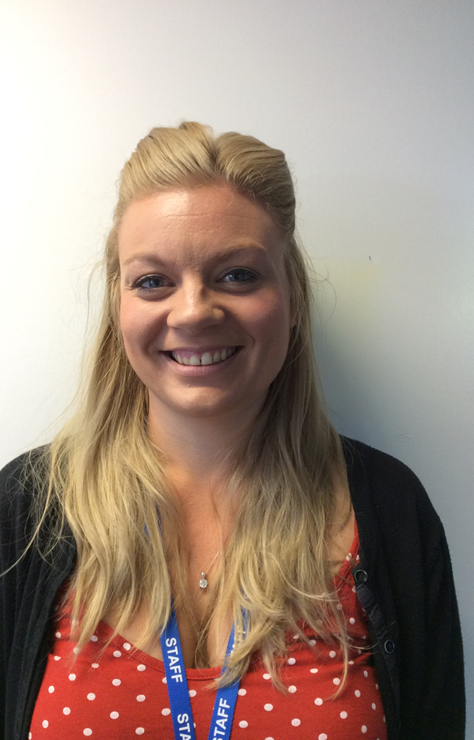
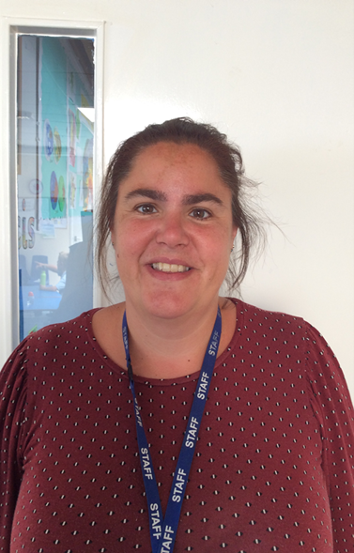
My Teachers
This is Mrs Treble. She is my new teacher. We will learn lots of fun things together. This is her classroom.
This is Mrs Pirus she is another one of my teaching assistants. She will help me with my activities

Slide 5
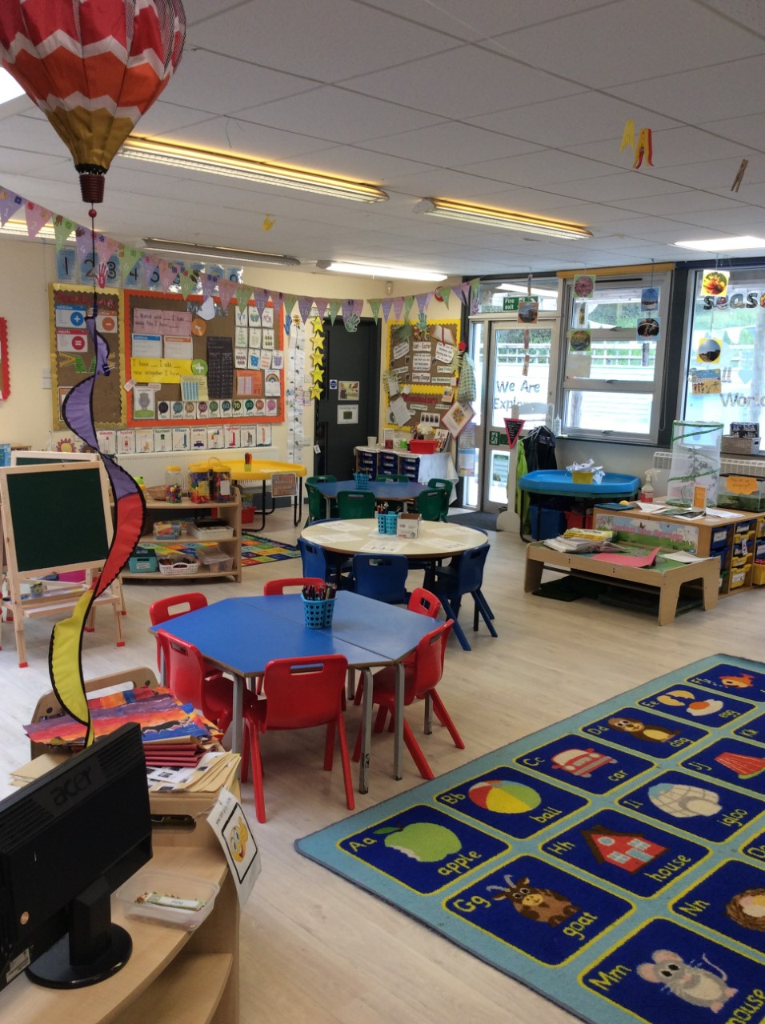
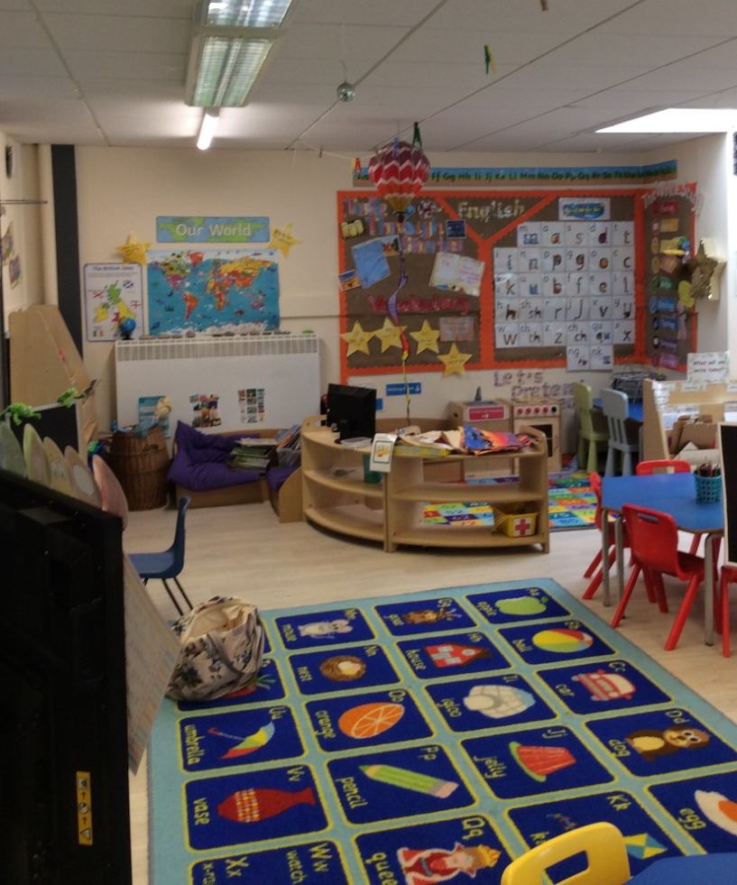
My Classroom
The classroom is very colourful with lots of lovely things – just like Pre-School.
There are lots of areas for us to explore.

Slide 6

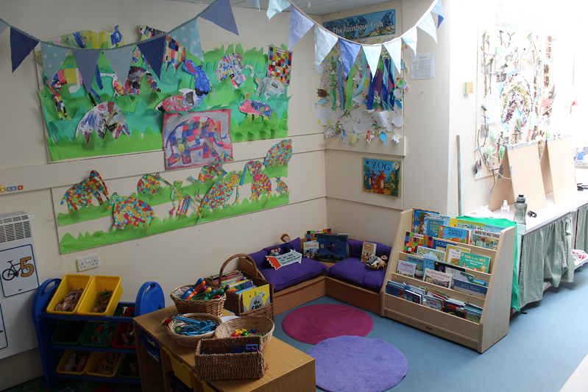

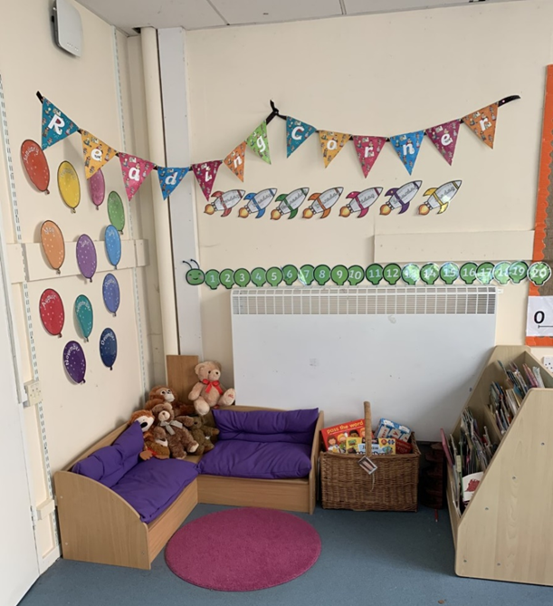
I can also choose to learn outside, just like Nursery. Things are different outside, there are new things to explore.
The book corner is full of lovely books that I can read.

Slide 7
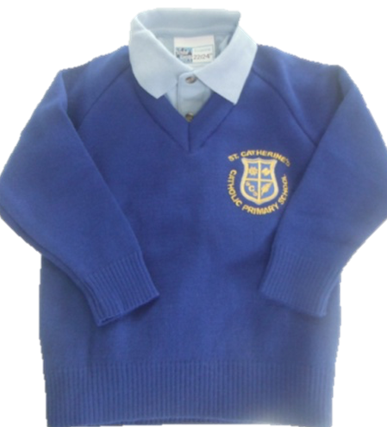
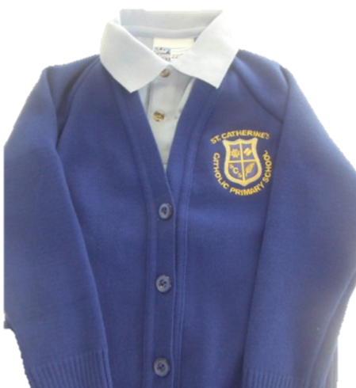
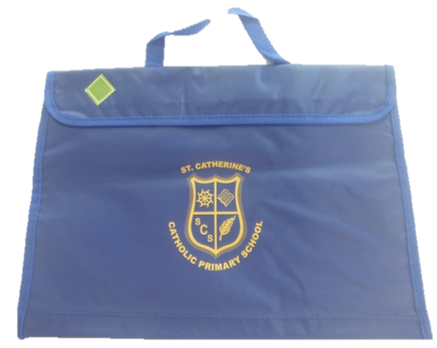
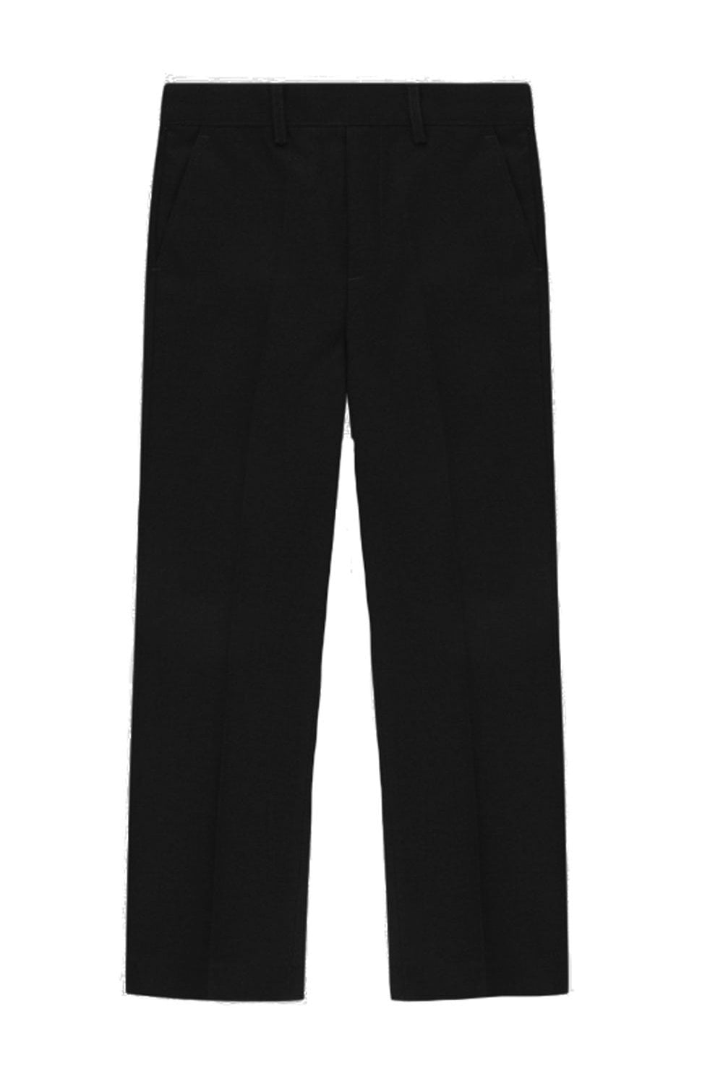
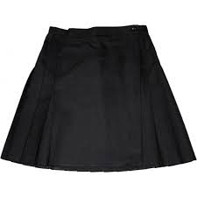
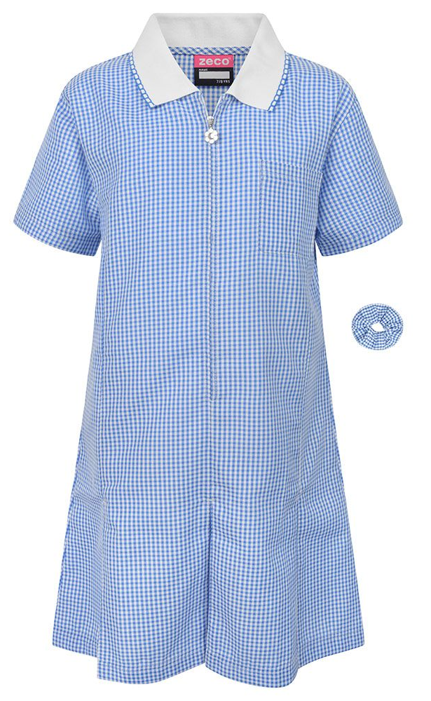
My Uniform
This is our school uniform. We have school jumpers, trousers or skirts. Remember to put your name on them.
This is the book bag we bring to school everyday. Letters and books come home in in.

Slide 8
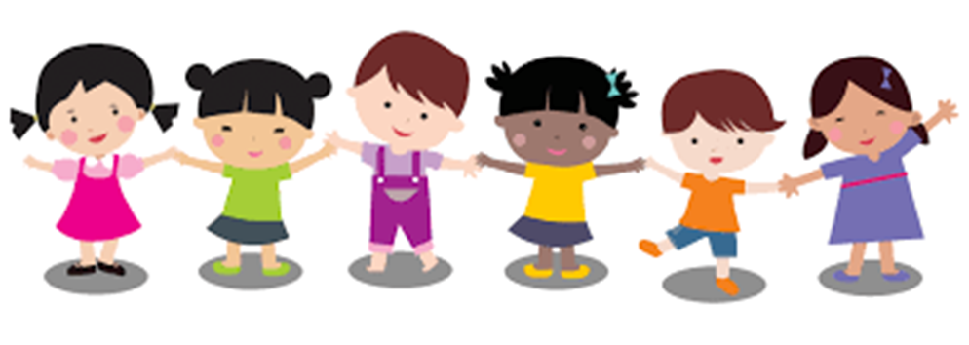
When I get back to school I will be in Reception Class. Some things will be the same and some things will be different and that’s OK!
I am very excited about coming back to school.

