Slide 1
Welcome to Oak Class
Your child`s learning adventure begins here!
2023-2024 Intake

Slide 2
What your child will be learning in Reception
Read Write Inc Phonics
Local Food Links
The structure of our school day
Extra-curricular opportunities
Questions

Slide 3
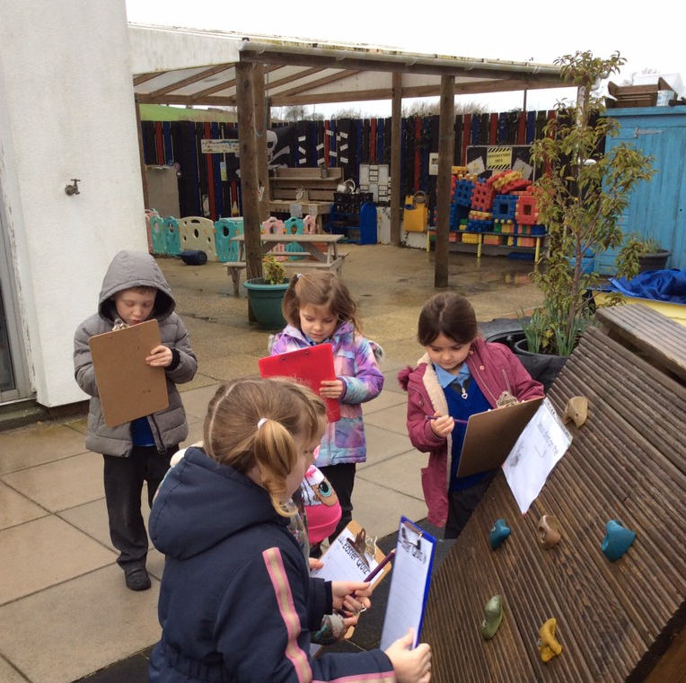
Early Years
At St Catherine`s we believe that your child`s Early Years experience lays the foundation for a thriving education. Which is why we seek to create a safe and inspiring learning environment that enables your children to flourish through exploration, creativity and play

Slide 4

What will my child be learning?
Through exciting topics, book hooks and creative activities your children will develop within 7 areas.
The prime areas:
Communication and language
Personal, social and emotional
Physical development
Specific areas
Literacy
Mathematics
Understanding the world
Expressive arts and design

Slide 5
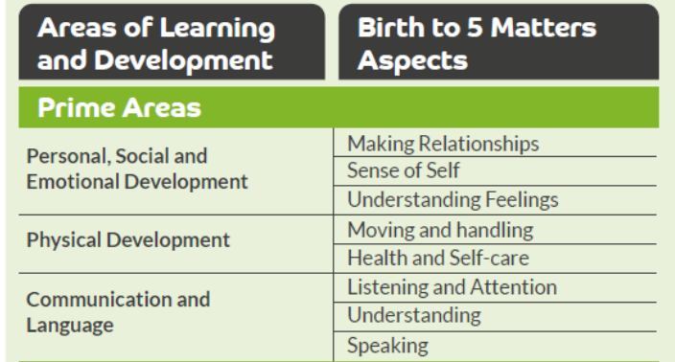
The Prime Areas
The prime areas are important because they lay the foundations for children's success in all other areas of learning and of life

Slide 6




Literacy
Developing comprehension, word reading and writing.
Talk Through Stories
Drawing club
Story of the week
Read Write Inc Phonics

Slide 7

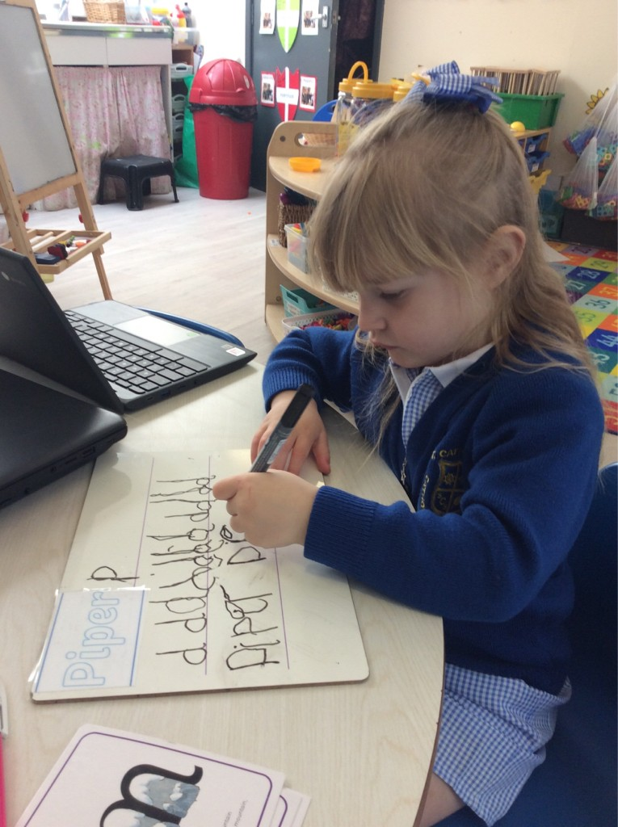
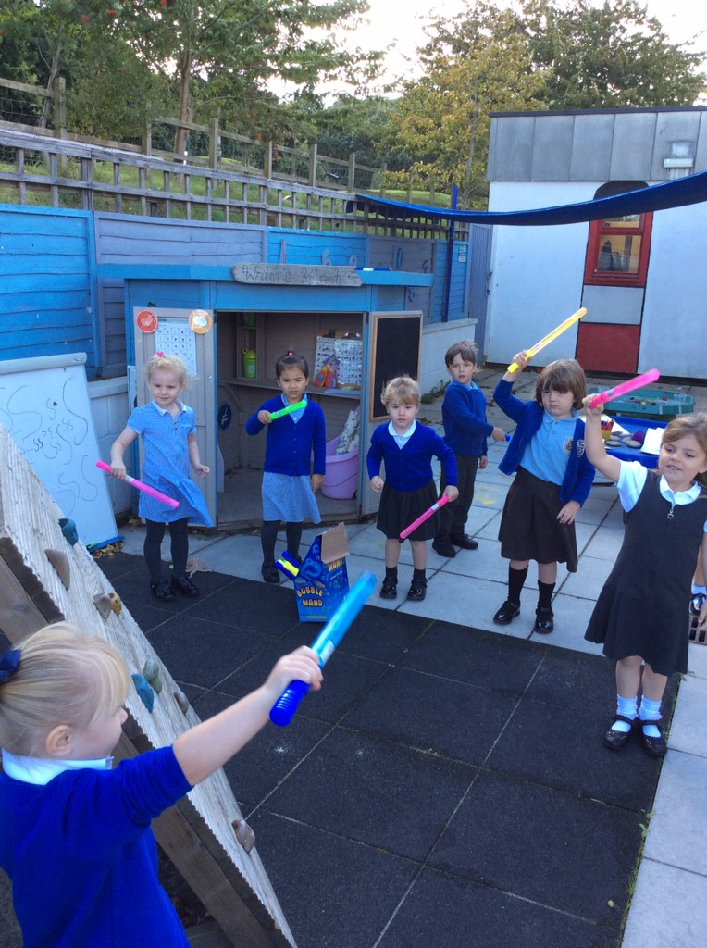
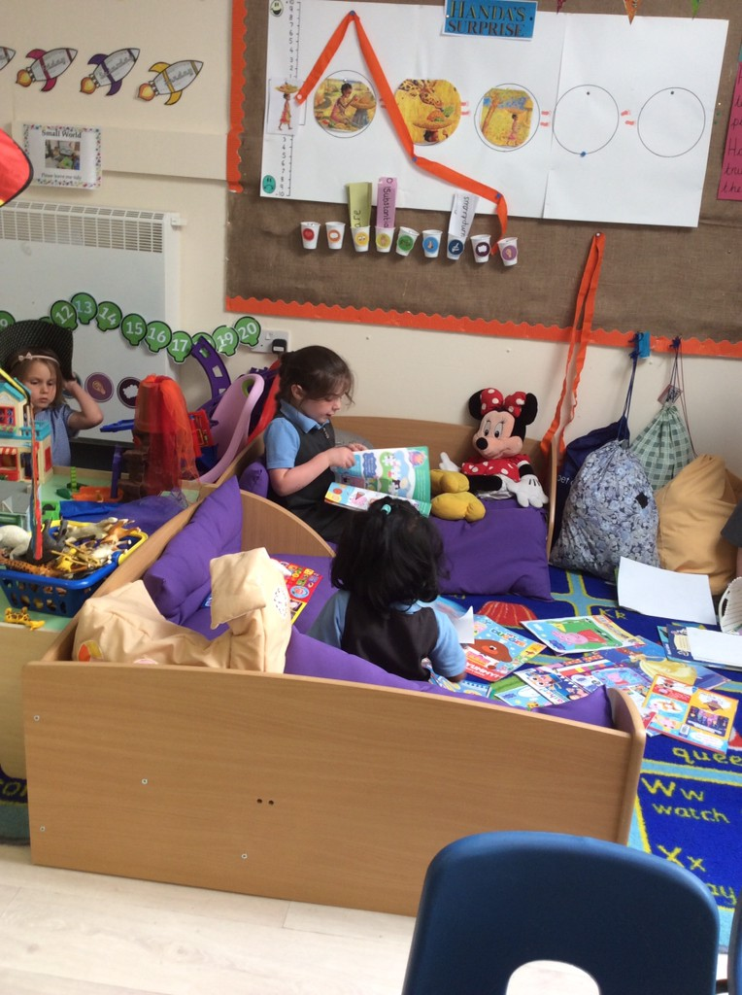
Read Write Inc. is a government backed phonics scheme designed by Ruth Miskin, which through systematic teaching and consistent routines, enables children to achieve high levels of reading success.

Slide 8

The 5 principles
1. PACE – no time is wasted during teaching sessions! Children are active and involved in a fun and creative way. The aim is for the children to complete the programme as quickly as possible.
2. PRAISE – teachers praise the children constantly throughout the teaching sessions. Children learn more quickly when they are praised for what they do well, rather than nagged for what they do wrong. The children are encouraged to praise each other and as a school we have developed several ‘Praise Phrases’ and ‘Praise actions’. Ask your child to demonstrate!
3. PURPOSE – each activity has a very clear purpose. The teacher will set this purpose at the beginning of the lesson so that the children know exactly what they will be learning.
4. PARTICIPATION – all children take part in all parts of the lesson. Full participation is gained through partner work and choral response.
5. PASSION – as a staff we are passionate about our teaching and the benefits of the Read, Write Inc. programme! We love teaching the sessions and this enthusiasm rubs off onto the children.

Slide 9
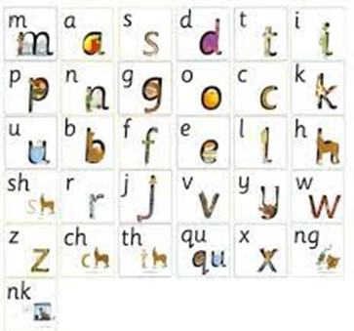
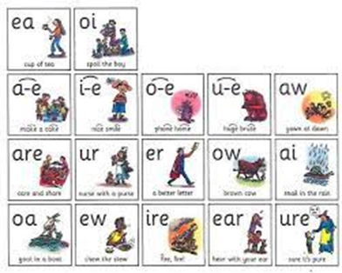
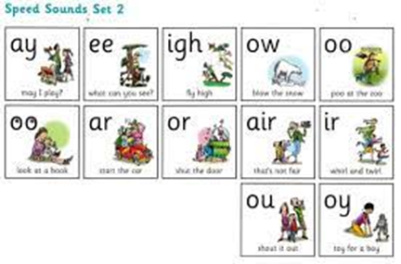
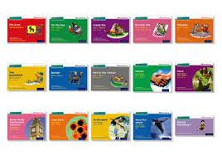


Slide 10

RWInc Workshop in September
Introduction to the program
How your child will learn to read
Resources to use at home
Support the school can offer you

Slide 11

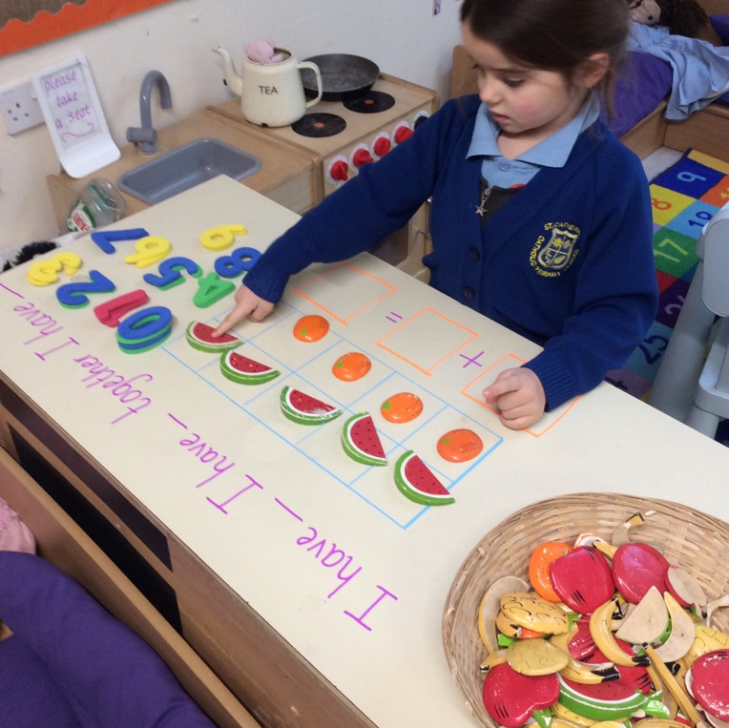
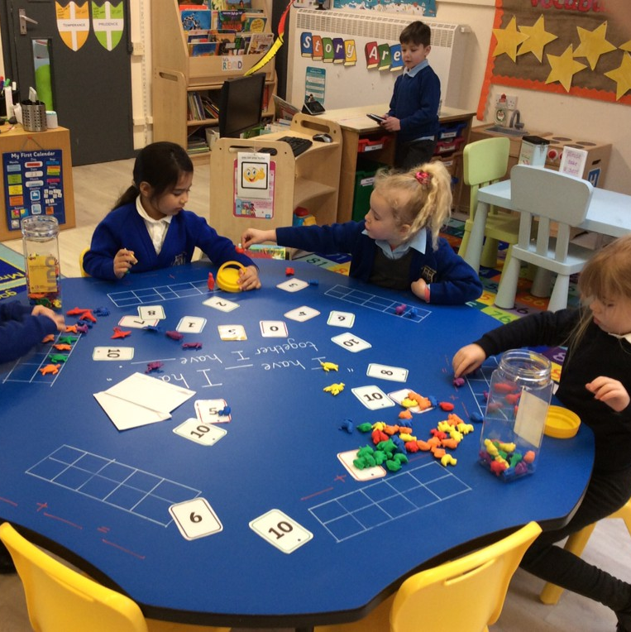
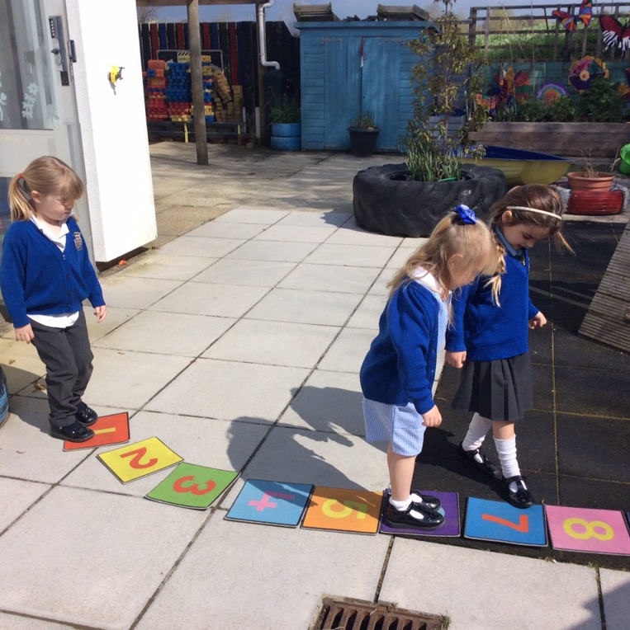
Mathematics
Power Maths - making maths an adventure, the whole-class mastery approach that works for every child
Practical learning
Exploration of various mathematical methods

Slide 12





Free schools meals entitlement from Reception – Year 3

Slide 13
Our school day
Morning activity Fine motor Dough disco Funky fingers Threading | Read write inc phonics Daily speed sounds (learn a new sound) Drawing club | Whole school assembly 10am daily | Playtime and snack time 10.15-10.30 (whole school) | Power maths focused learning activity Maths exploring time | Lunchtime 12.00-12.30 (whole school in the hall) | Playtime 12.30-1.00 (whole school) | Topic RE History Science PE Art DT | Exploration time *continuous provision/ learning challenges | Story time and home time
School begins at 8.30am and finishes at 3pm
(we have breakfast club available from 7.30am and after school club until 5pm)

Slide 14
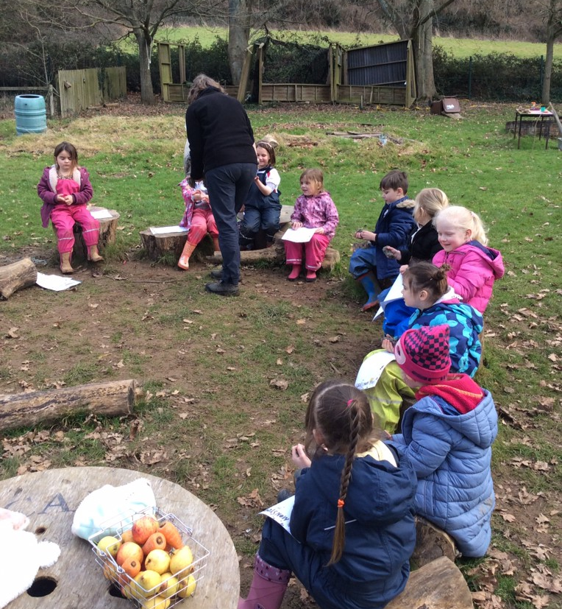
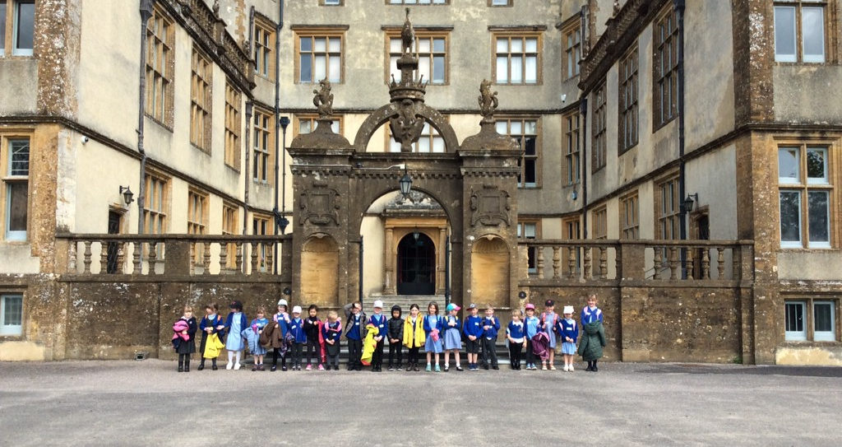
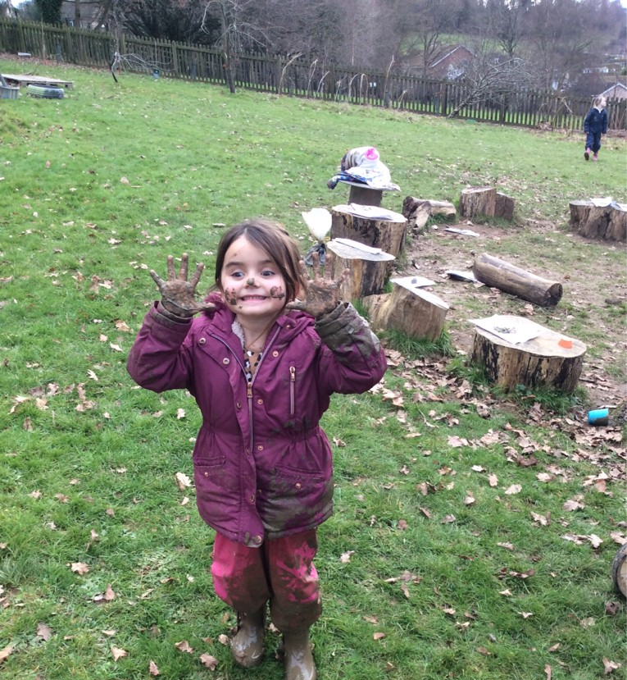
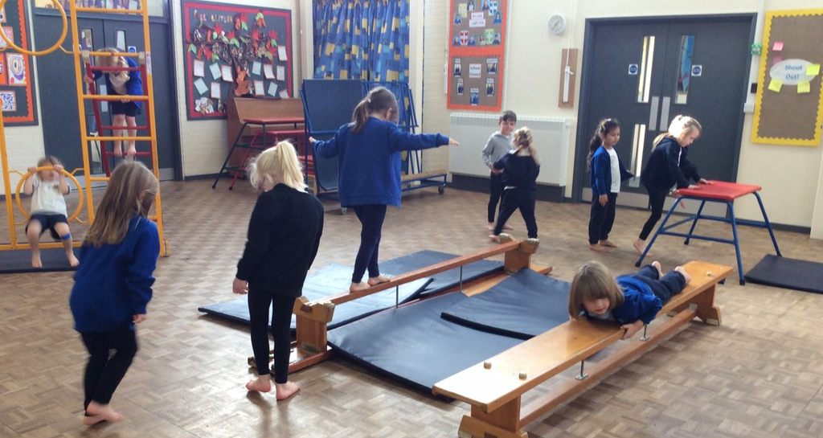
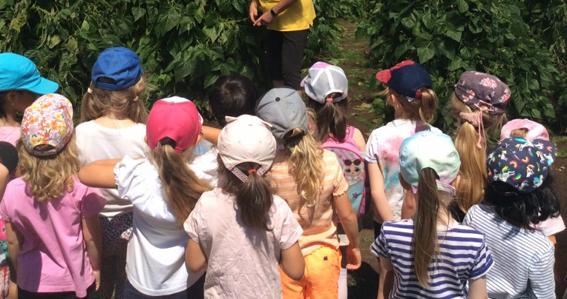
Extra Curricular opportunities

Slide 15
What does my child need?
Spare set of school clothes to remain in school with spare underwear
Waterproofs (not essential but if you have them brilliant!)
Wellies
PE Kit – indoor (black shorts, white plain t-shirt, plimsoles) outdoor (black joggers, black jumper, white t-shirt, trainers)
Book back / backpack
Named water bottle in school daily
PLEASE NAME ALL ITEMS INCLUDING SOCKS!

Slide 16


