Slide 1
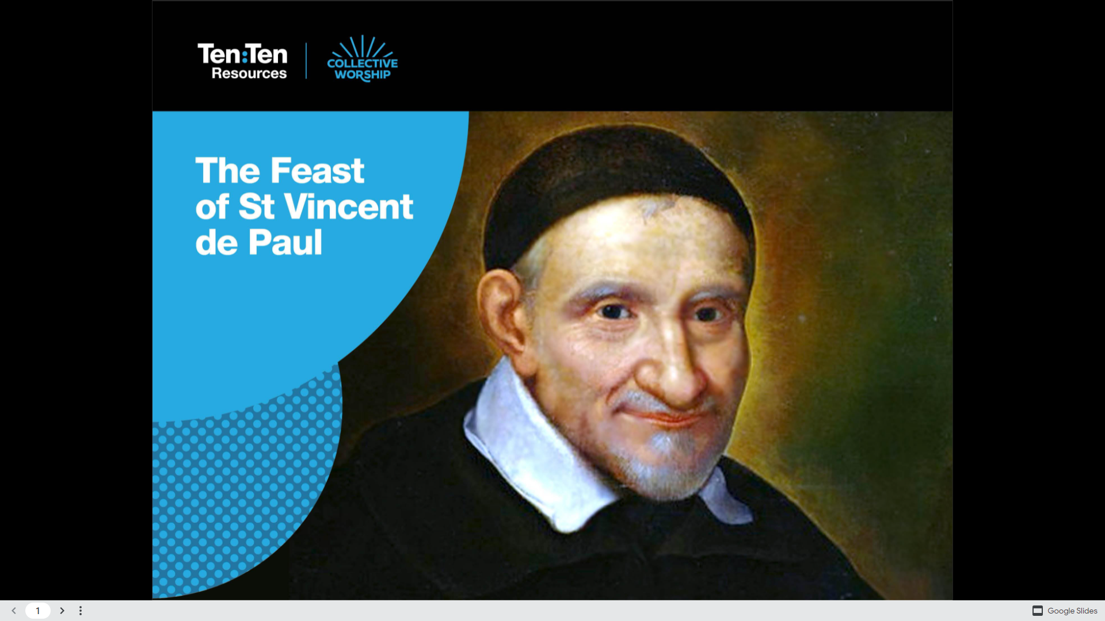

Slide 2
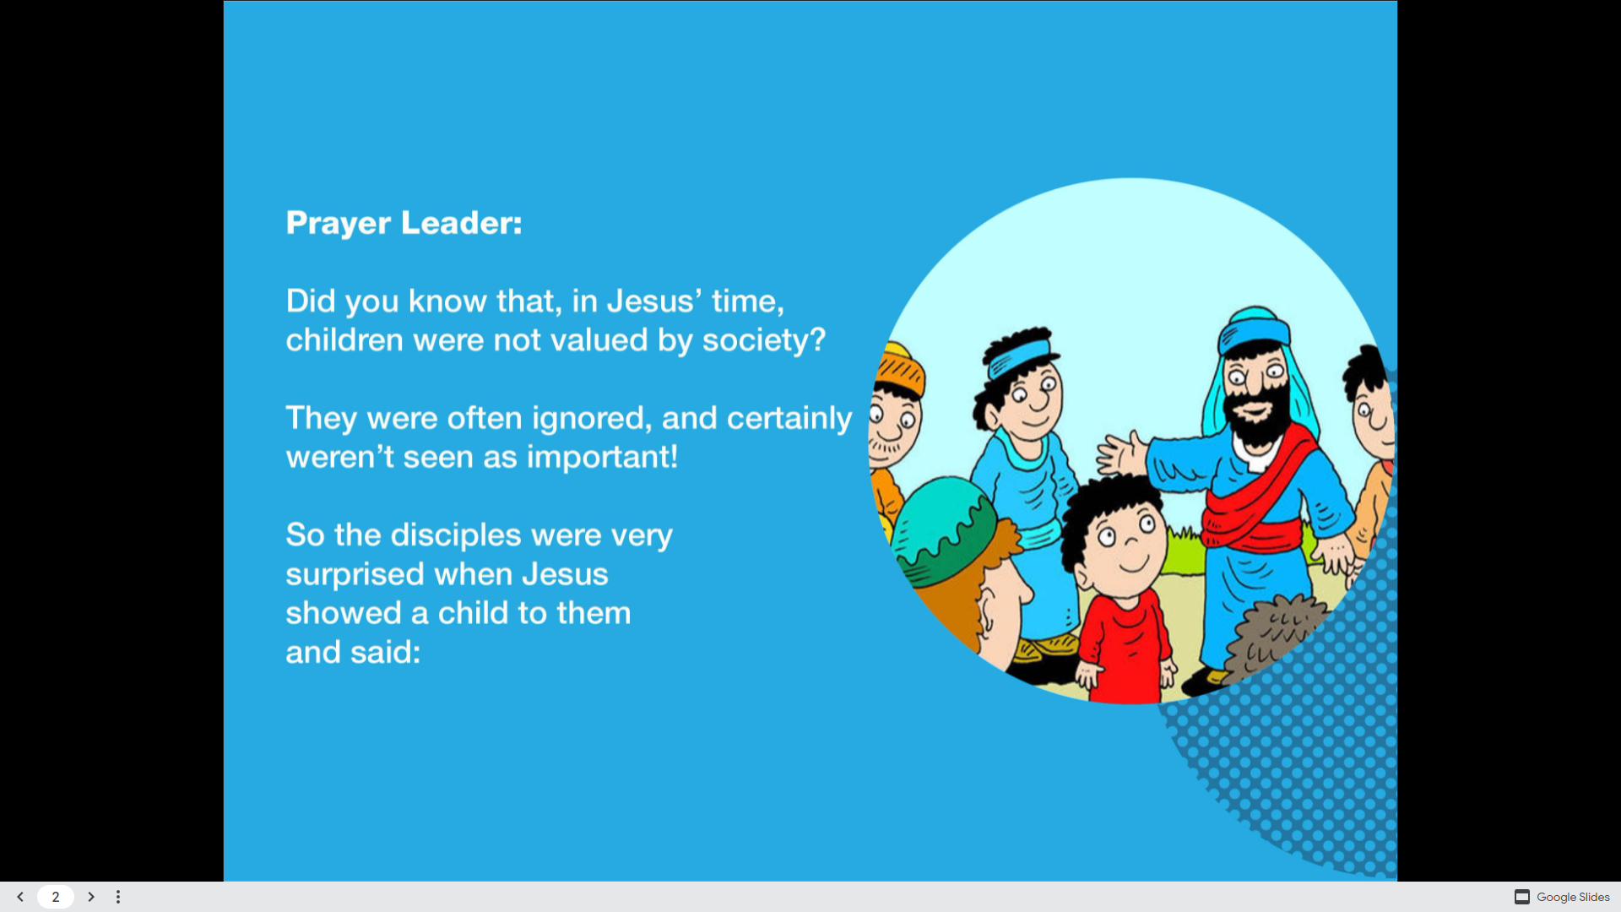
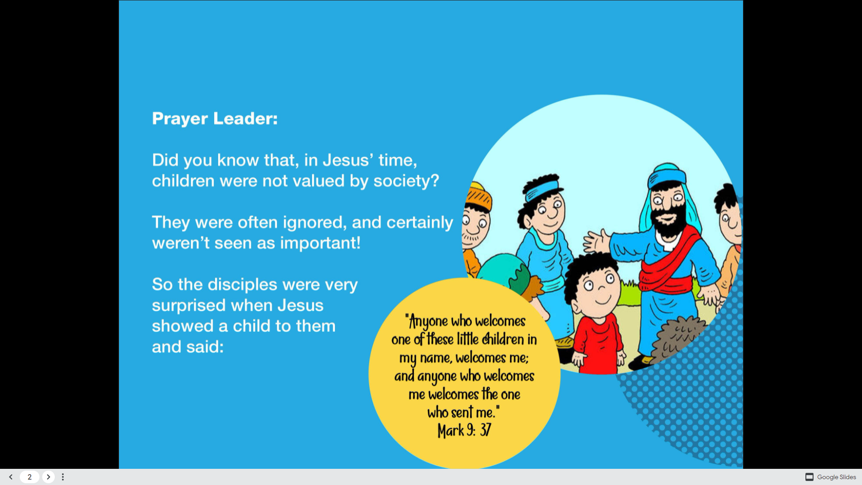

Slide 3
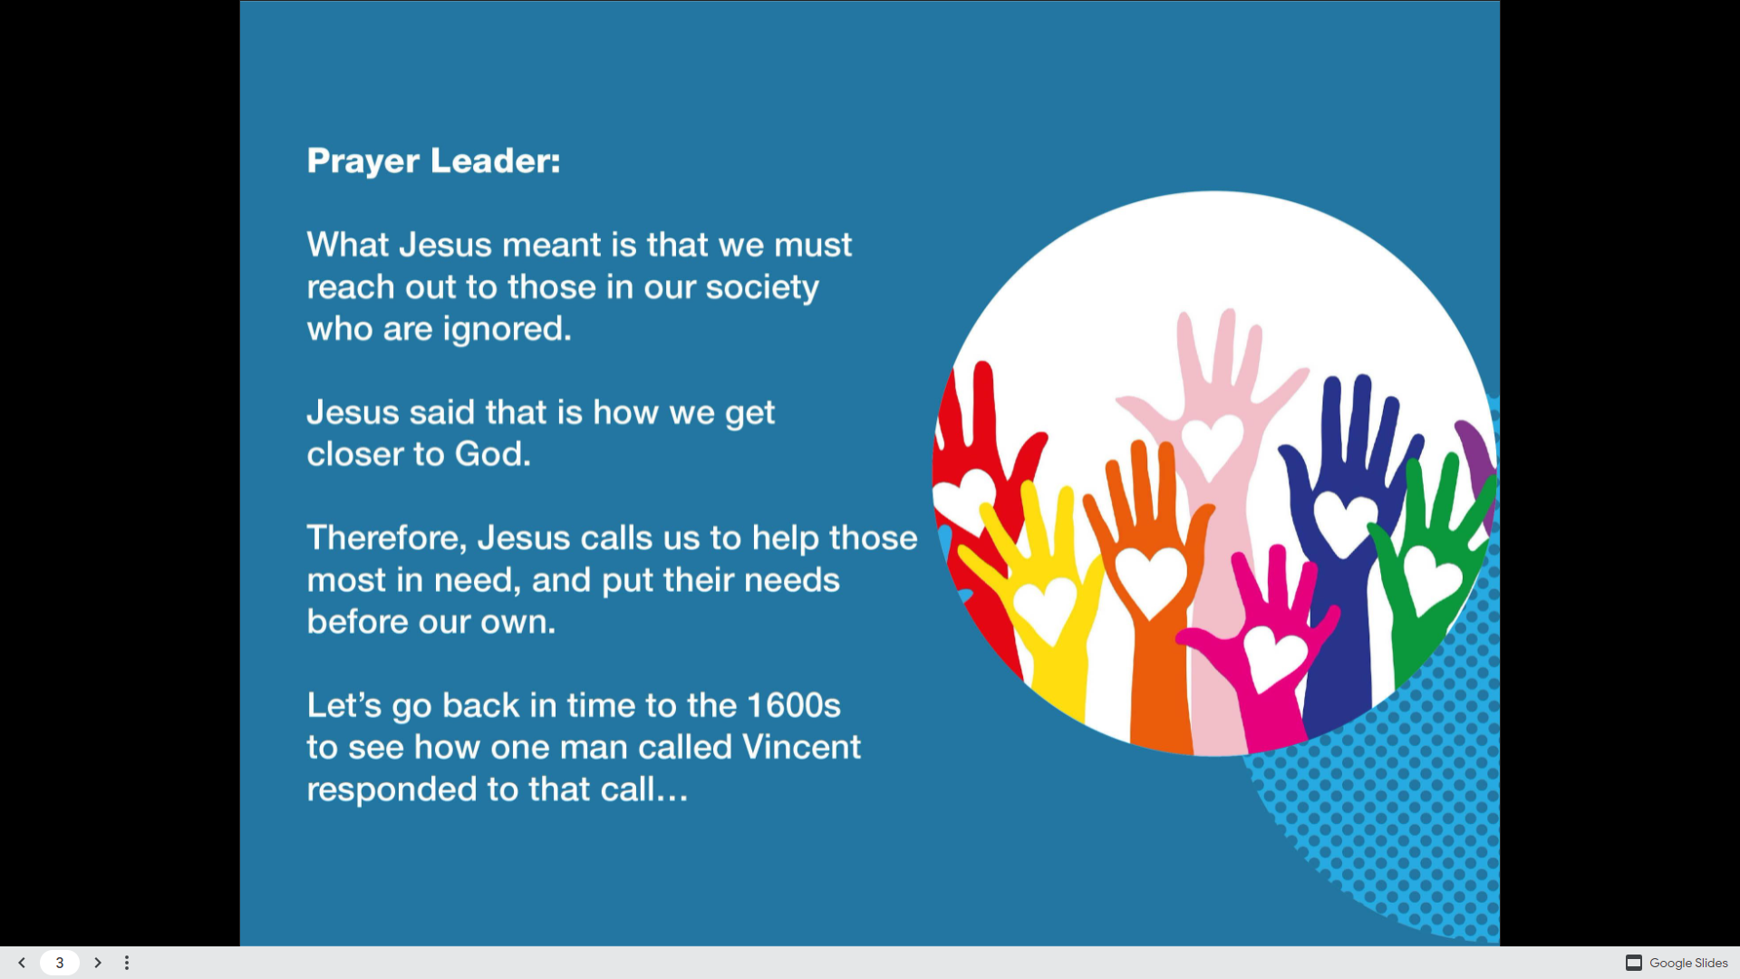

Slide 4
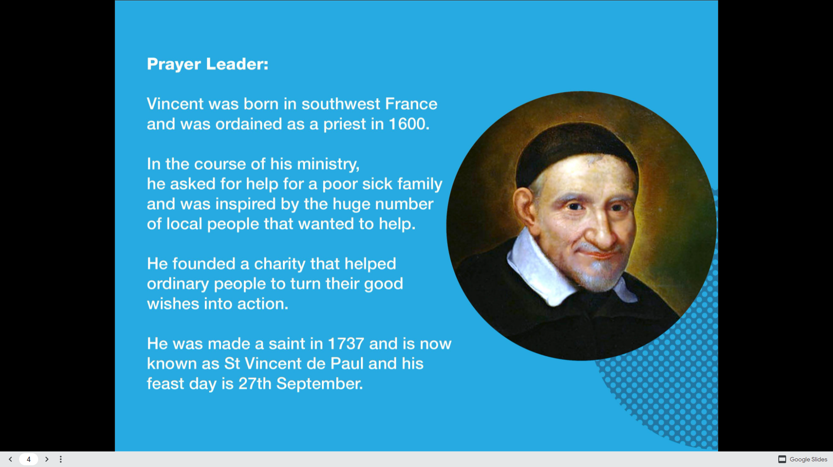

Slide 5
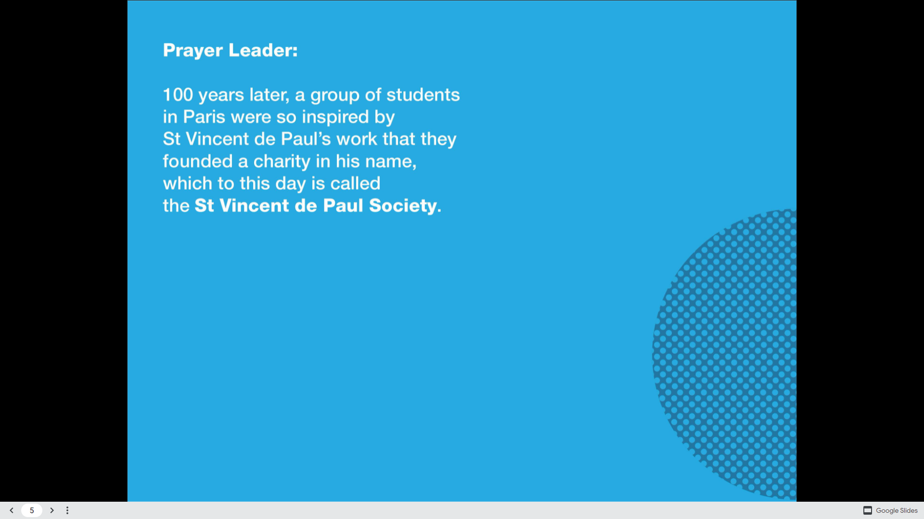
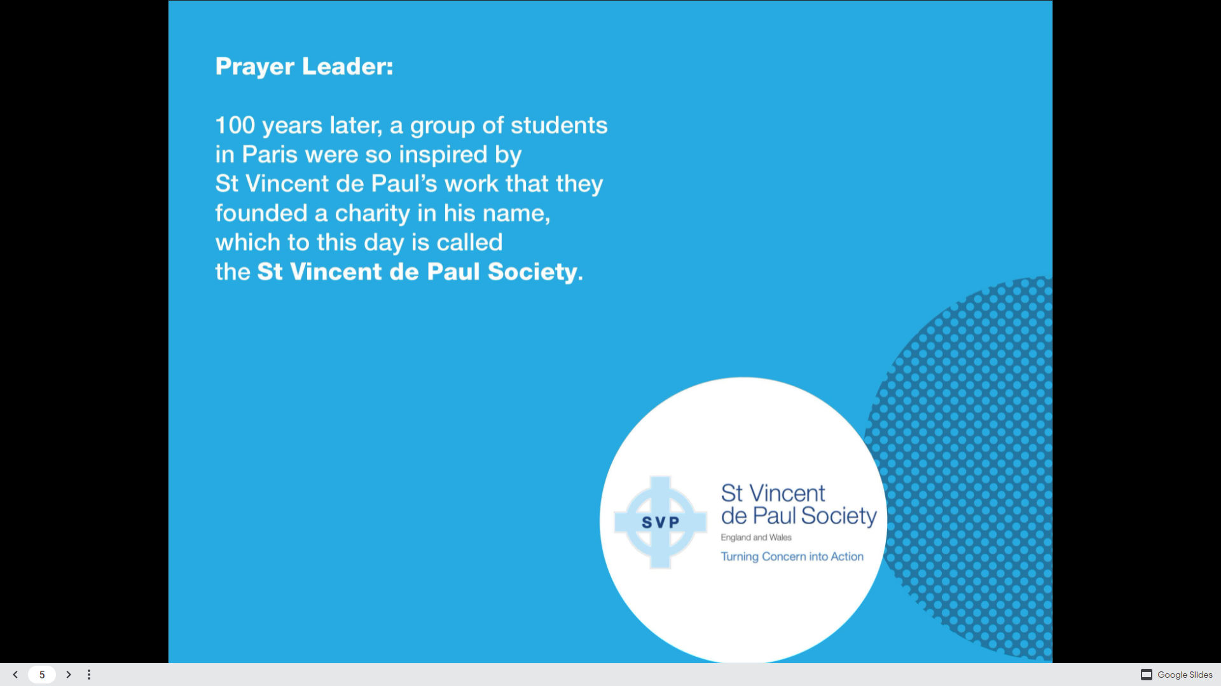


Slide 6
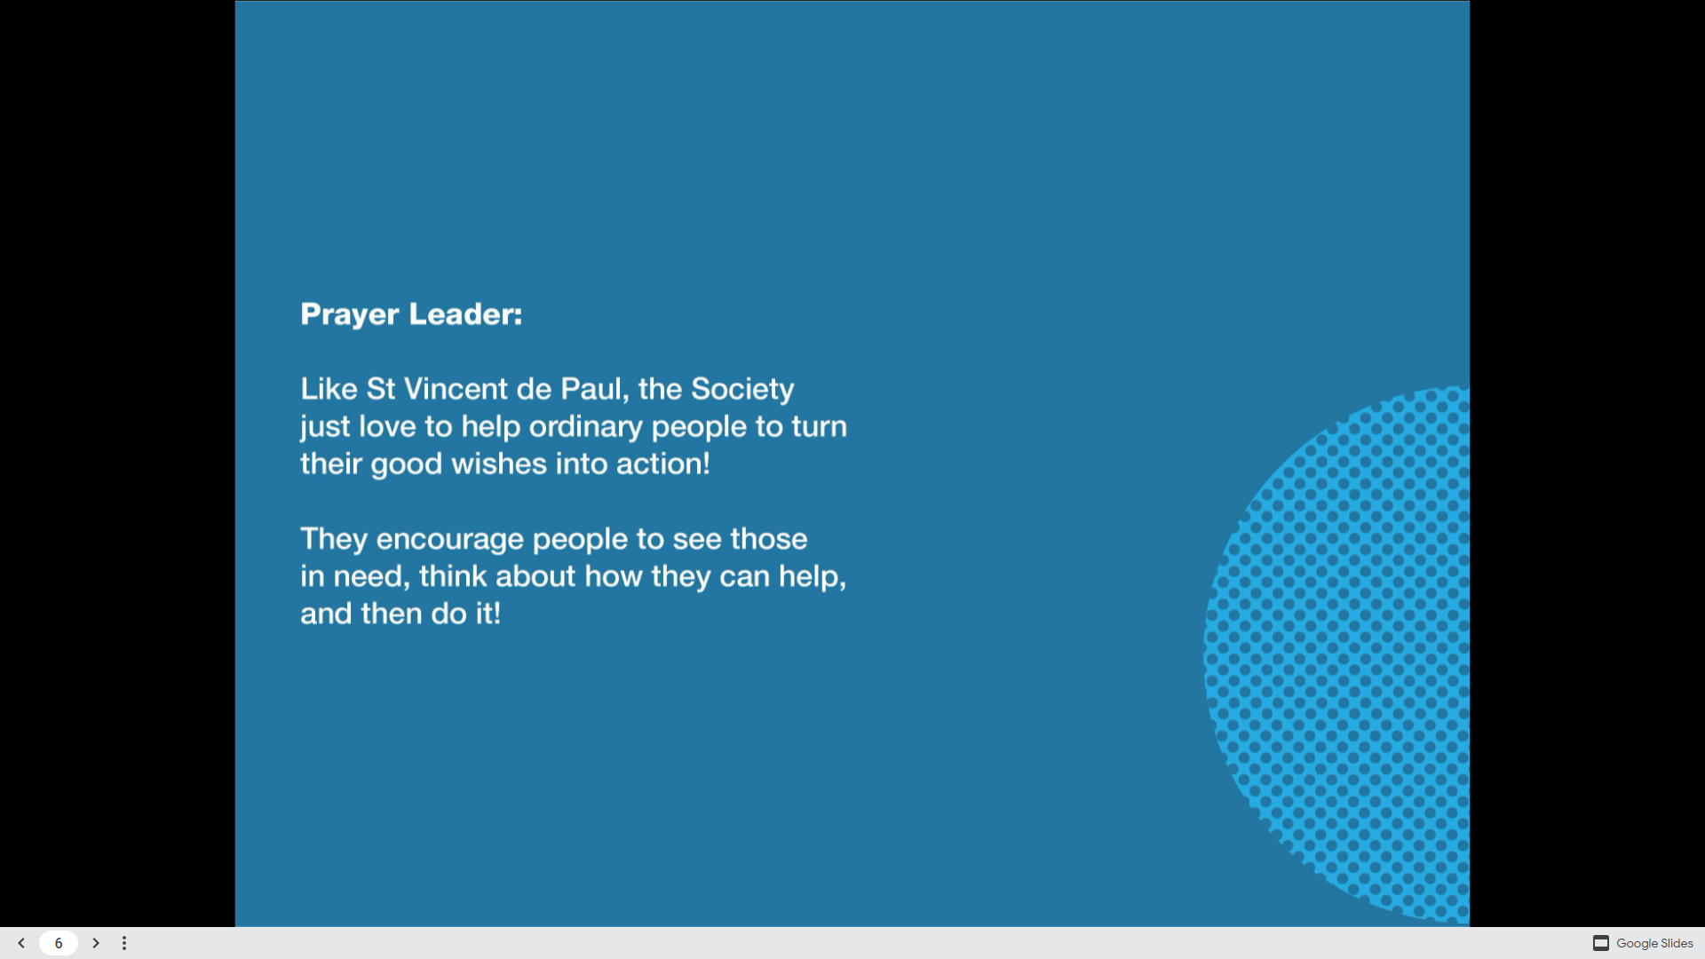


Slide 7
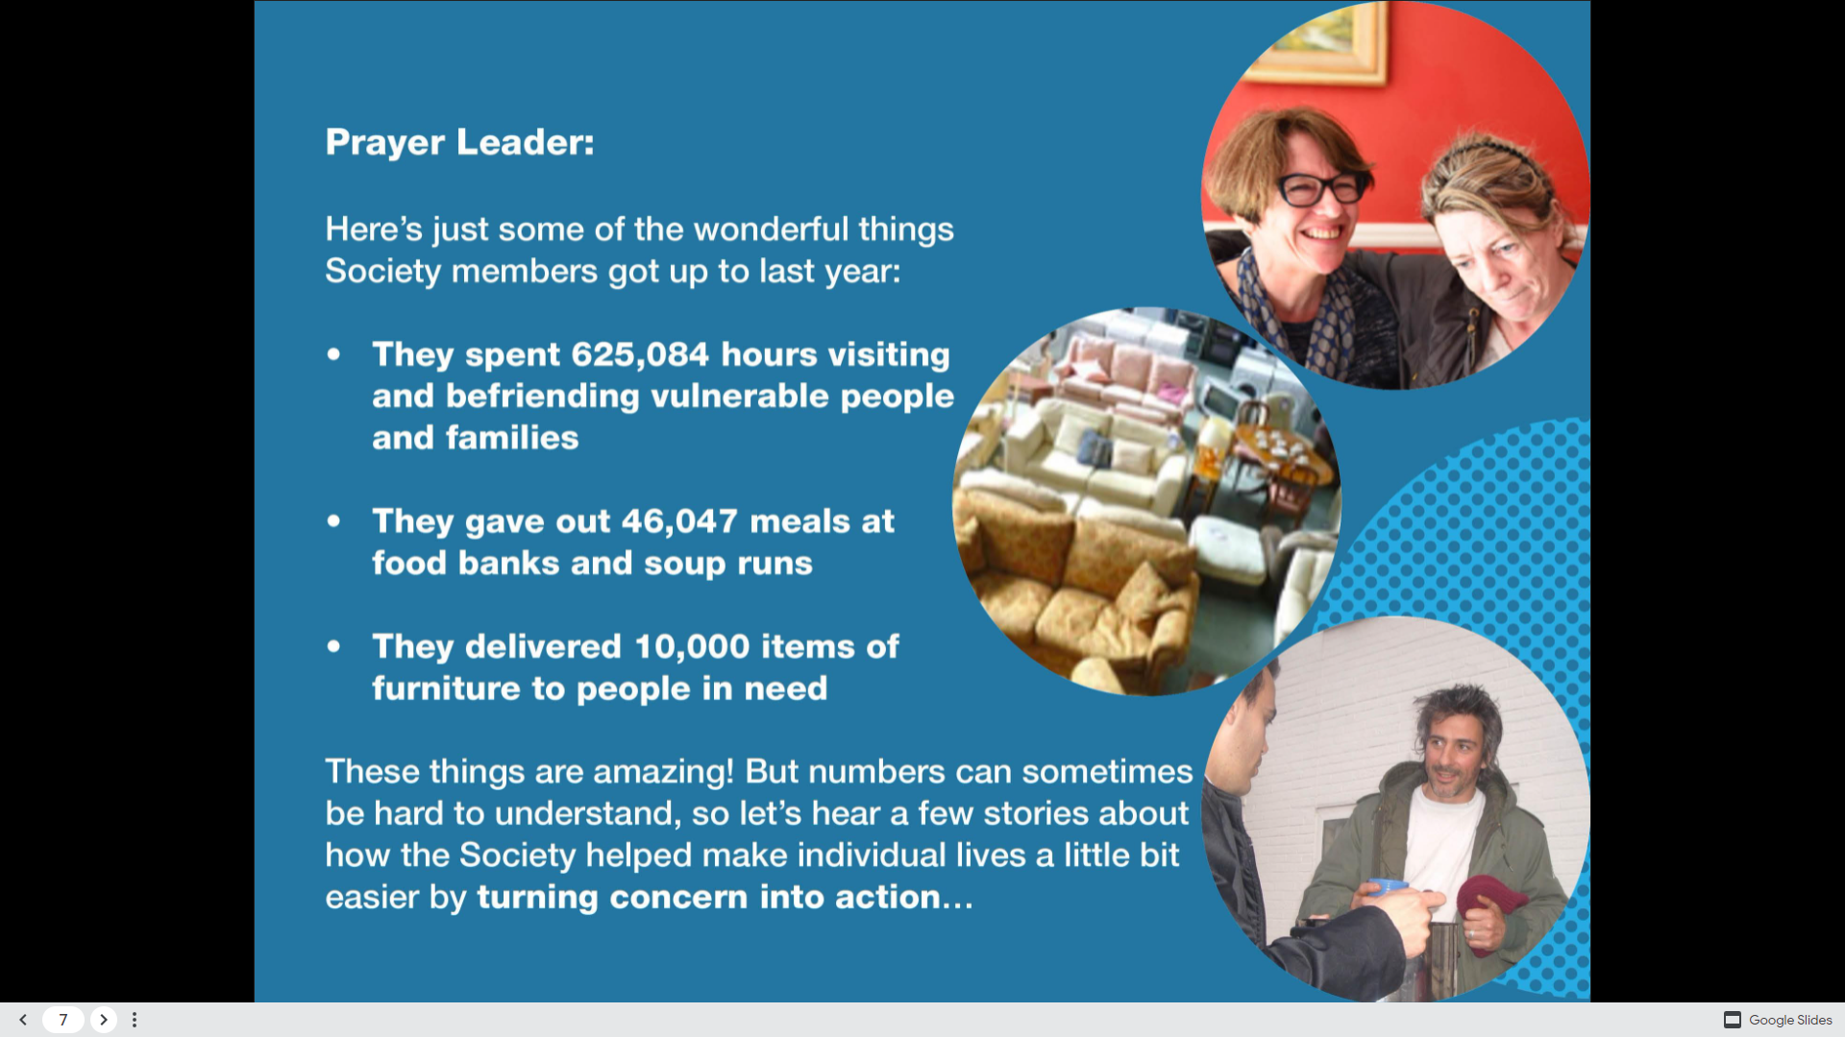

Slide 8


Slide 9
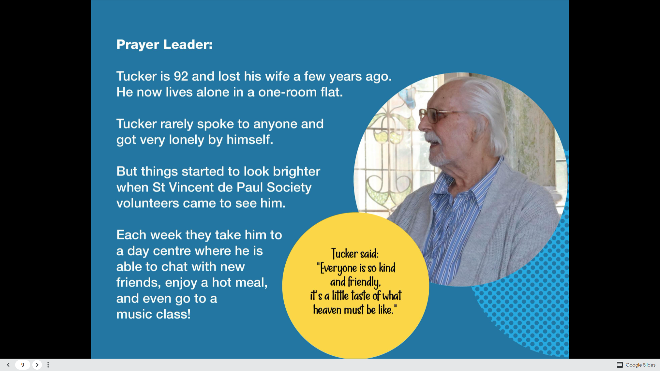

Slide 10


Slide 11


Slide 12


Slide 13
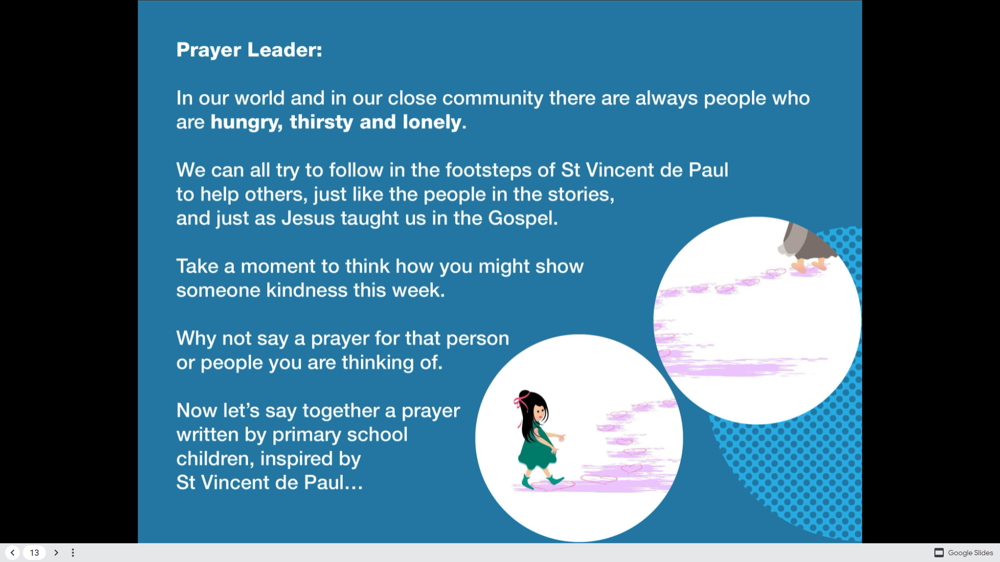

Slide 14
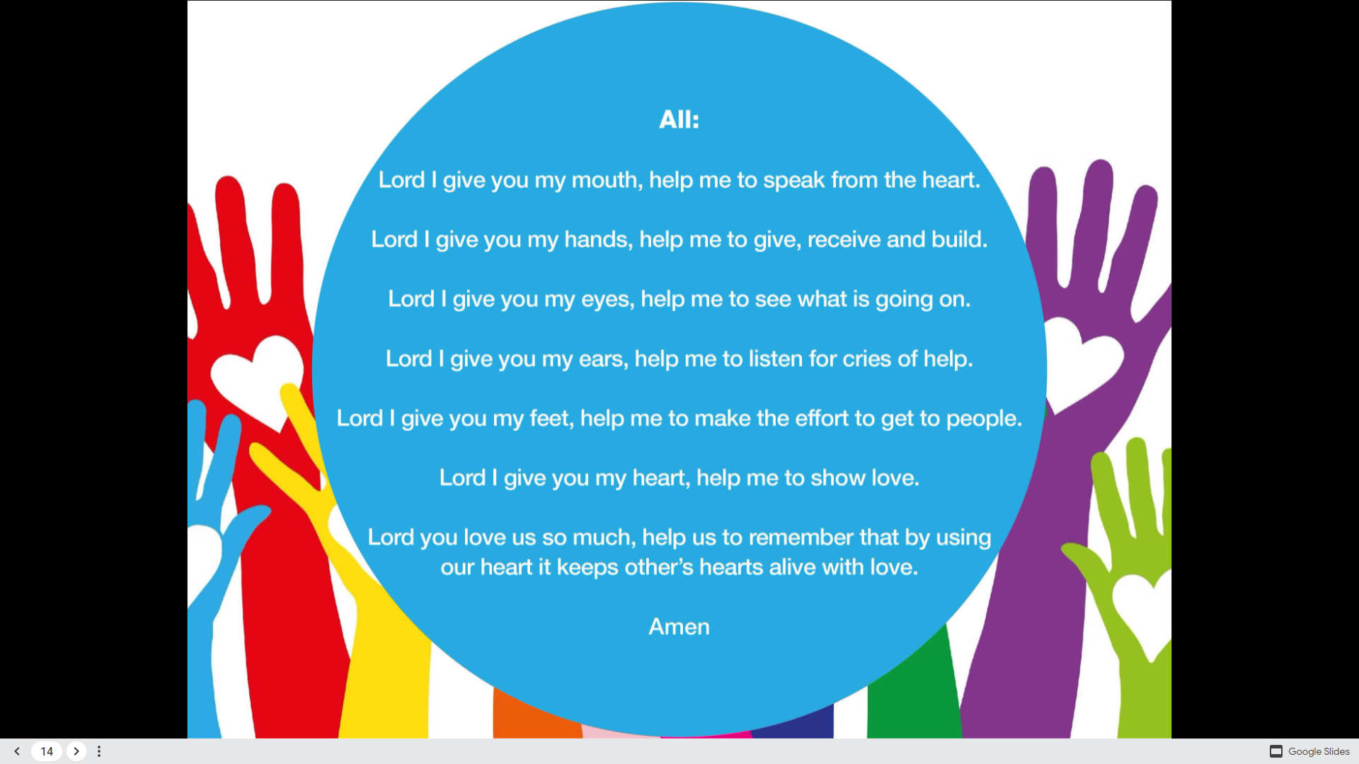

Slide 15
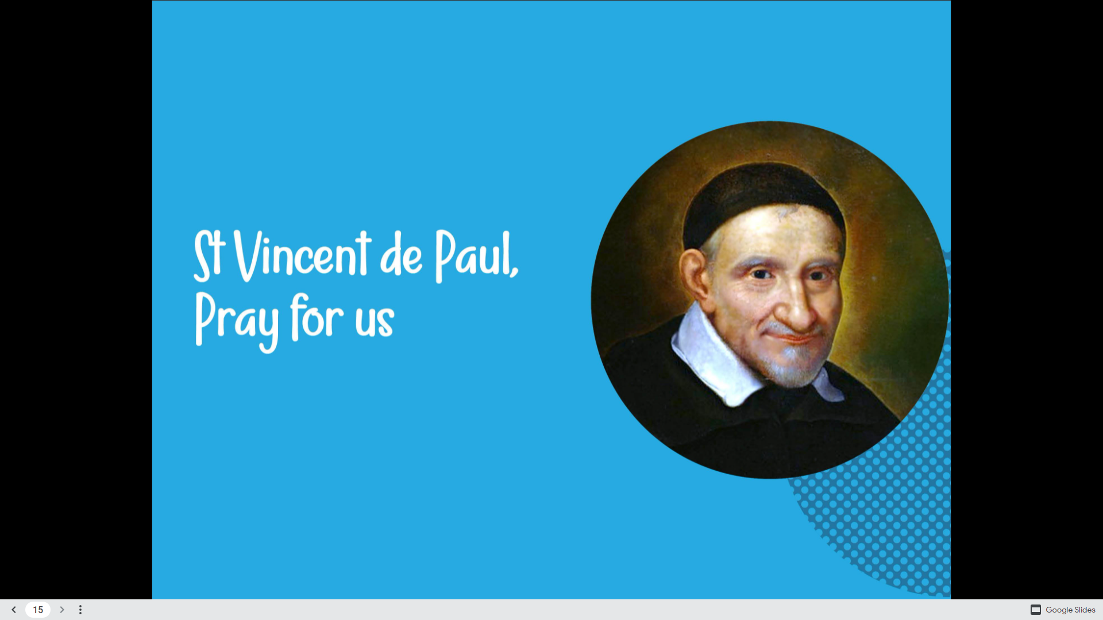

Slide 16
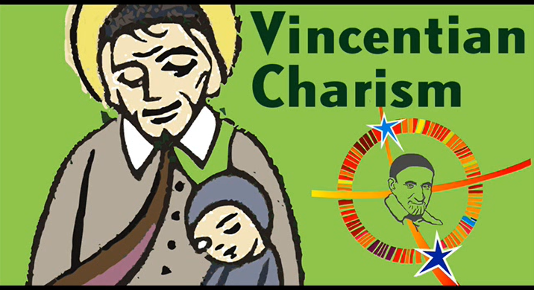
Let’s now watch this tribute sung in Malayalam, a language spoken in the state of Kerala, India.
On the occasion of 4oo Jubilee of Vincentian Charism from 1617-2017. This Malayalam song is sung by Fr Yesudas Karakkat.
Charisms are the Holy Spirit’s work through the faithful. We faithfully try to follow Jesus’ footsteps teachings.
St. Vincent de Paul is one of the faithful.

