Slide 1
How can I support reading at home?
Parent workshop
Tuesday 18th October

Slide 2
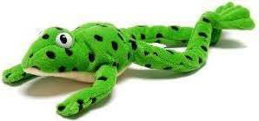
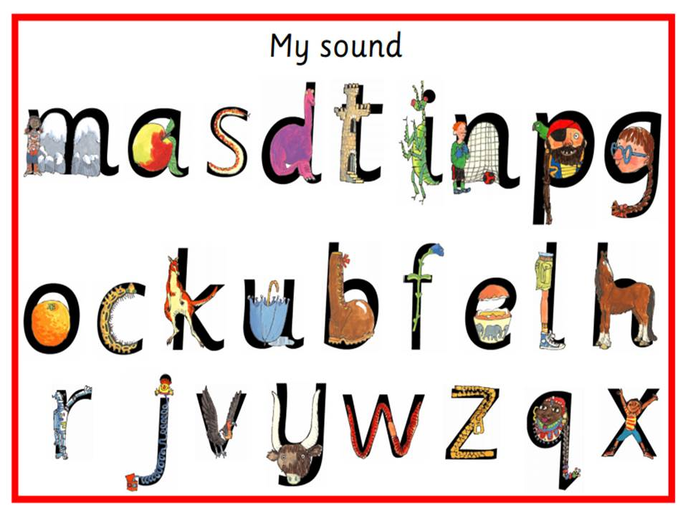
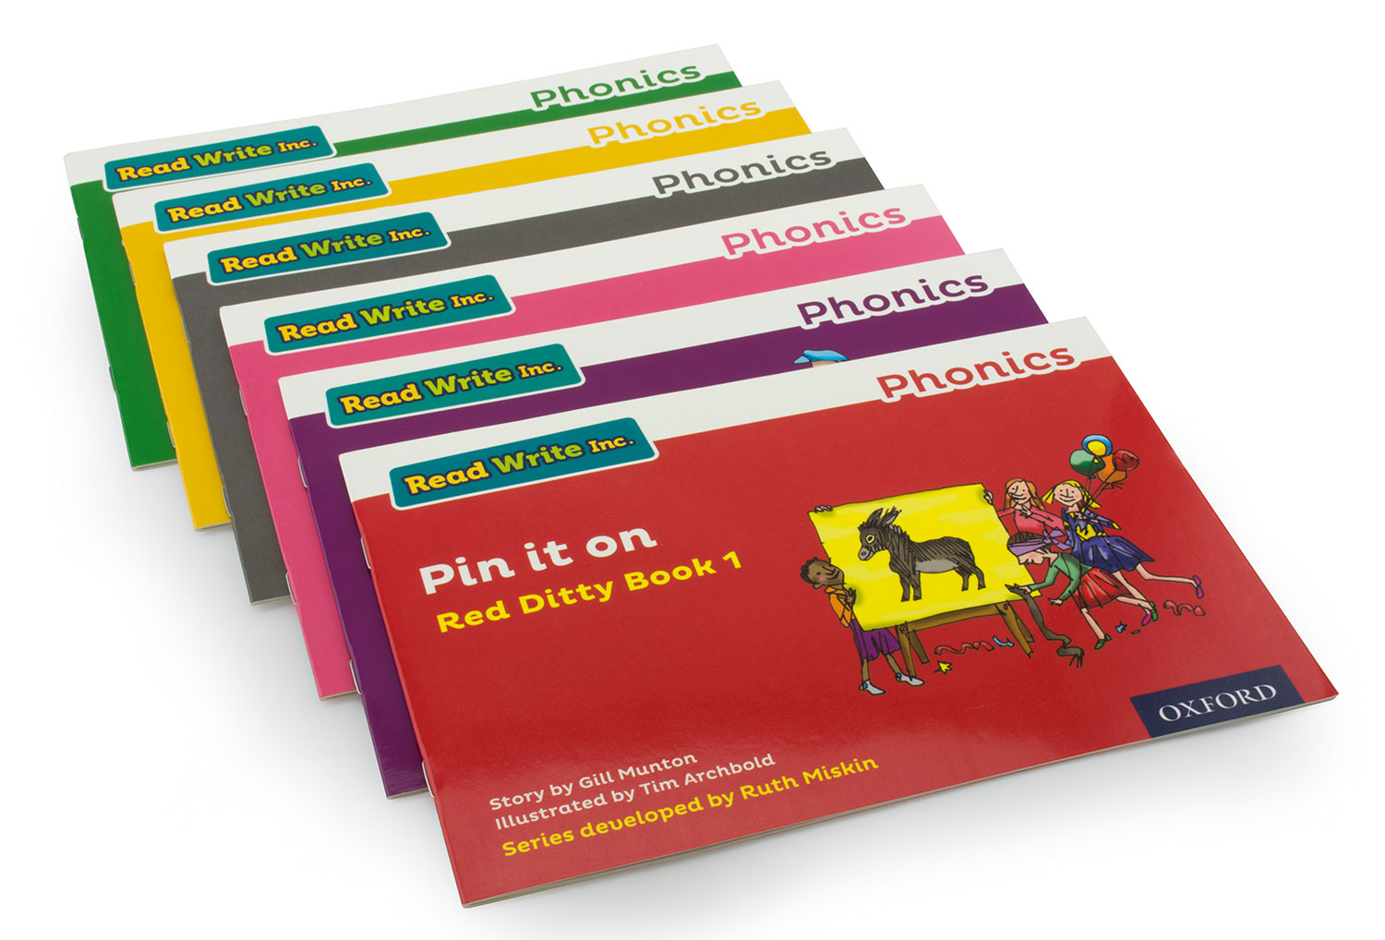
What is Read Write Inc?
Read Write Inc (RWInc) is a phonics complete literacy programme
it helps all children learn to read fluently and at speed so they can focus on developing their skills in comprehension, vocabulary and spelling.
The programme is designed for children aged 4-7 – Reception, year 1 and Year 2

Slide 4
Teaching the phonics sounds
To begin with children are taught the first 26 sounds.
These are the singular sounds.
Some sounds are stretchy sounds.
Some sound are bouncy sounds.

Slide 5
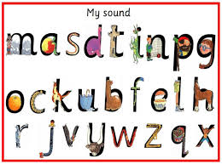
Pronouncing the sounds
We don’t like adding the schwah! (uh at the end of a sound)
How to say the sounds

Slide 6
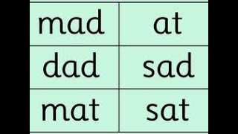
Learning to blend
Once the children have learnt the first 5 sounds the participate in word time.
Word time teaching the children to sound out the sounds using “Fred talk” and blending them together.
Fred games help us to understand the method of blending

Slide 7
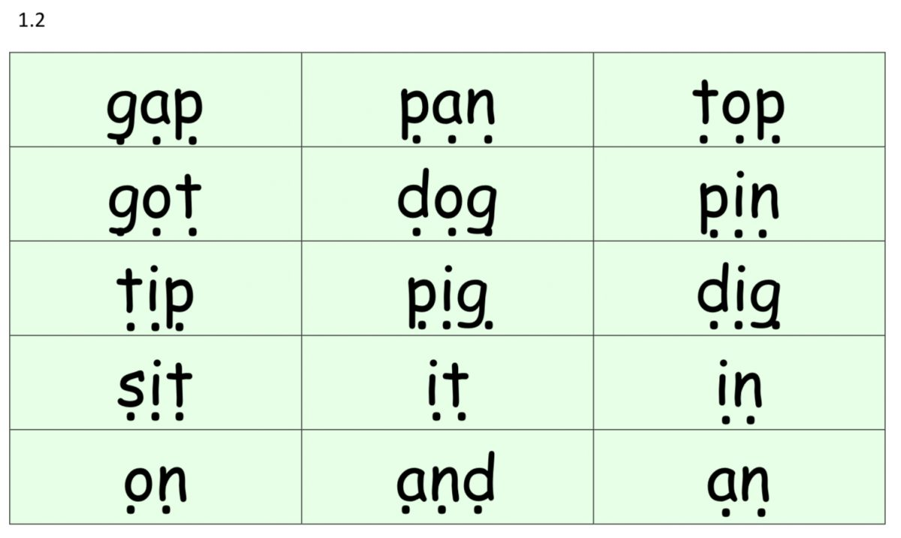
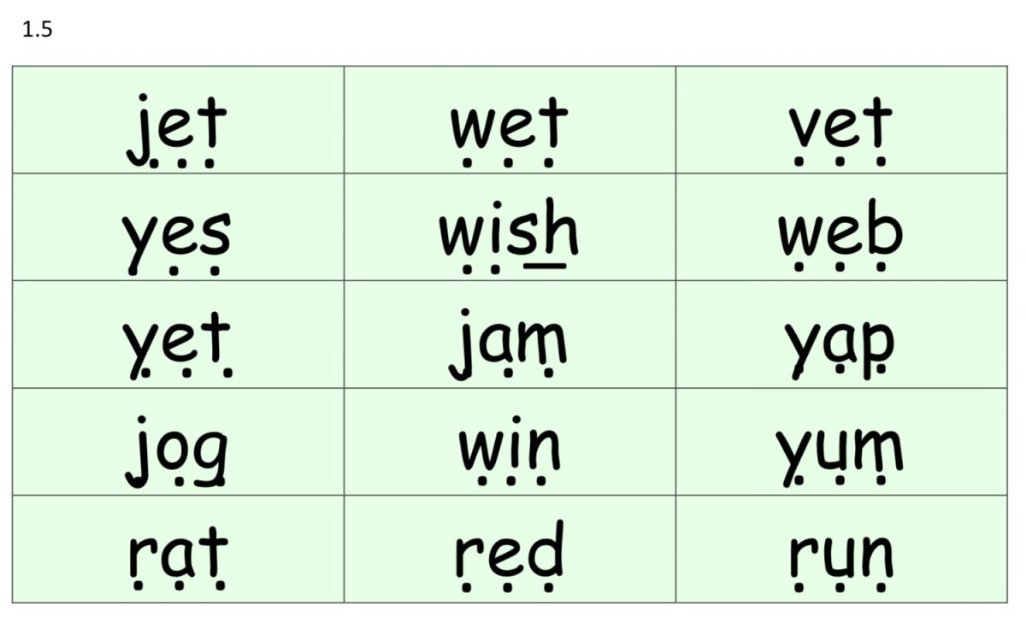
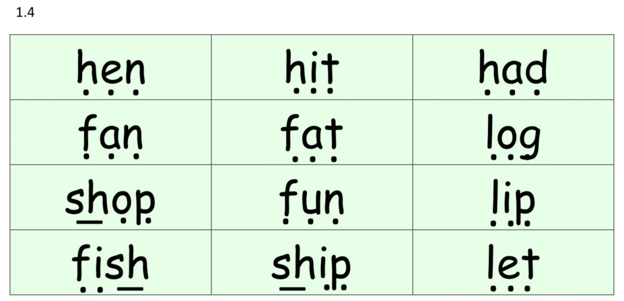
Word time
Word time continues as the children develop their sound knowledge.
Each set of word time words features the most recent sounds taught.
There are 7 sets of word time words which feature all the set 1 sounds taught.
Children are encouraged to “Fred talk” the sounds and blend them back together e.g g-a-p = gap.

Slide 8
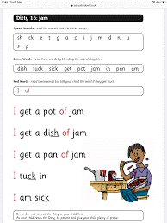
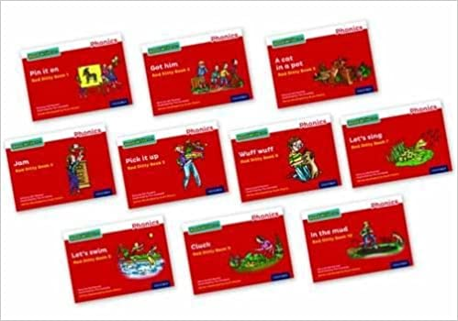
Beginning to read
Once the children are confident with sounding out and blending they will begin to read ditties.
Ditties come in 2 forms:
Sheets
Red books
The ditty sheets and books will introduce
Children to the tricky red words (sight words).
These words are hard to sound out as they
Include tricky sounds. The children learn these
Through repetitive recall.

Slide 9
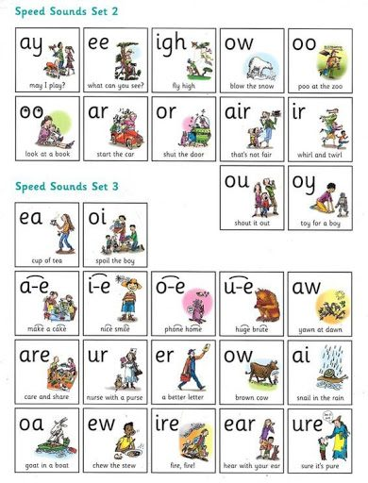
Special friends
Once children have learnt all of the set 1 sounds and are confident identifying them we move on the set 2 and set 3 sounds.
The set 2 and 3 sounds are digraphs/trigraphs or as the children know them “Special Friends”
The special friends are accompanied by a rhyme to help children recall the sound.

Slide 10
What can my child read?
Mrs Treble will carry out a simple reading assessment every 6 weeks to determine your child`s individual progress.
The assessment looks at what sounds they can confidently identify and what words they can read.
Once your child is reading yellow books your child`s fluency and pace of reading will be determined.
Your children are then grouped based on the sounds they need to be taught and the book level they are reading at.
Read Write Inc works with a stage not age approach.

Slide 11
How does Read Write Inc look?
10.30 – 11.15 daily children join in with their book reading activities. A book lasts 1 week and children engage in reading and writing activities linked to that book.
(Reception pupils during this time are enjoying Funky Finger fine motor activities as they are not yet reading books)
11.15 – 11.30 pupils go to their speed sounds group. We have a set1 sounds group, a set sounds group and set 3 sounds group.
11.30 – 11.45 Talk Through Stories

Slide 12
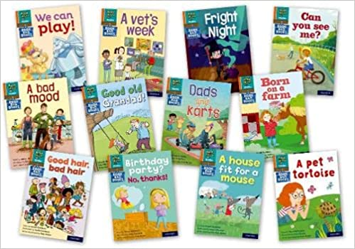
Reading at home
Your child will never bring home a book they cannot read
Through 6 weekly assessments your child will be grouped on their individual phonic knowledge and ability to blend.
Your child will read a book 3-4 times at school before they bring it home to read with your.
This means your children are equipped with the word understanding and knowledge to be able to read this with you at home.
Along with the text we have read in school they will being home a supporting book bag book which features the same words as the in school book.

Slide 13
How can you help?
Ensuring sounds are pronounced correctly – not adding uh!
Encouraging children to sound out words using “Fred talk” before saying the word.
Practicing reading the sight words.
Reading enjoyment books daily to promote reading.
Playing games in the car or at home using the sounds
I spy something with a mmmmm sound
Fred talking simple words for your children to say back e.g. there is a d-o-g/ the sky is –b-l-oo. Exposing children to words and how they can be sounded out is great.

Slide 14
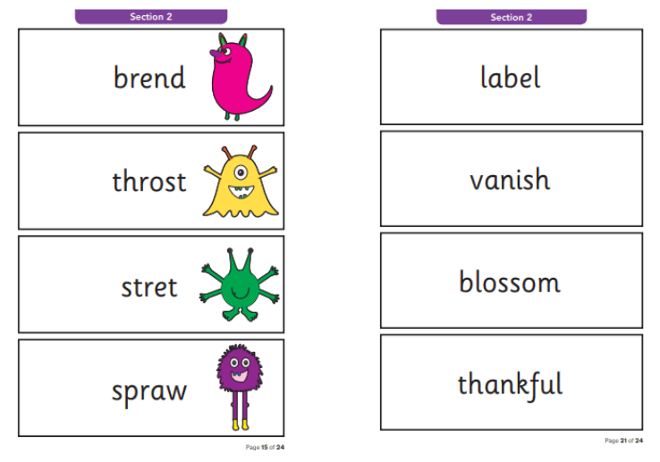
Year 1 Phonics screening
40 words including all taught graphemes
Some non-sense made up words
Children need to read 32 to pass
Regular testing checkpoints

Slide 15
Any Questions

Slide 16
Tapestry
Useful videos will be posted on tapestry which will offer additional support for reading at home.

