Slide 1
Mathematics
Number and Algebra
Year One
Mathematics | Year 2 | Number and Algebra | Fractions and Decimals | Lesson 2 of 3: Quarters

Slide 3
Aim
I can find of a quantity.
1
4
Success Criteria
I can share into four equal groups to find .
I can explain that is one of 4 equal sized pieces.
I can name .
1
4
1
4
1
4

Slide 4
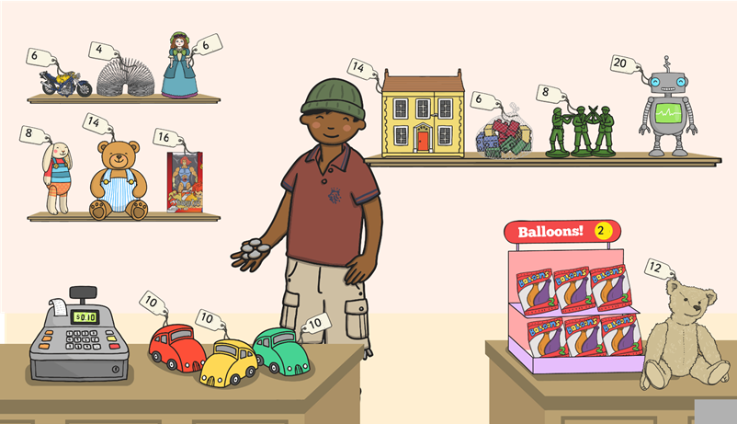
Half-Price Sale
I’m having a sale! Can you make everything half price?
c
c
c
c
c
c
c
c
c
c
c
c
c
c
c

Slide 5
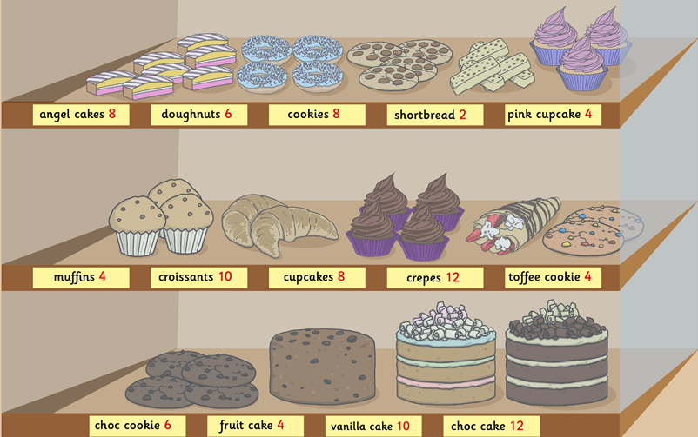
Half-Price Sale
I have just halved my prices. Can you tell me what each item used to cost?
angel cakes 8p
doughnuts 6p
c
c
cookies 8p
c
shortbread 2p
c
c
pink cupcakes 4p
c
c
c
muffins 4p
croissants 10p
cupcakes 8p
crepes 12p
c
c
toffee cookies 4p
c
c
choc cookies 6p
fruit cake 4p
vanilla cake 10p
c
choc cake 12p

Slide 6
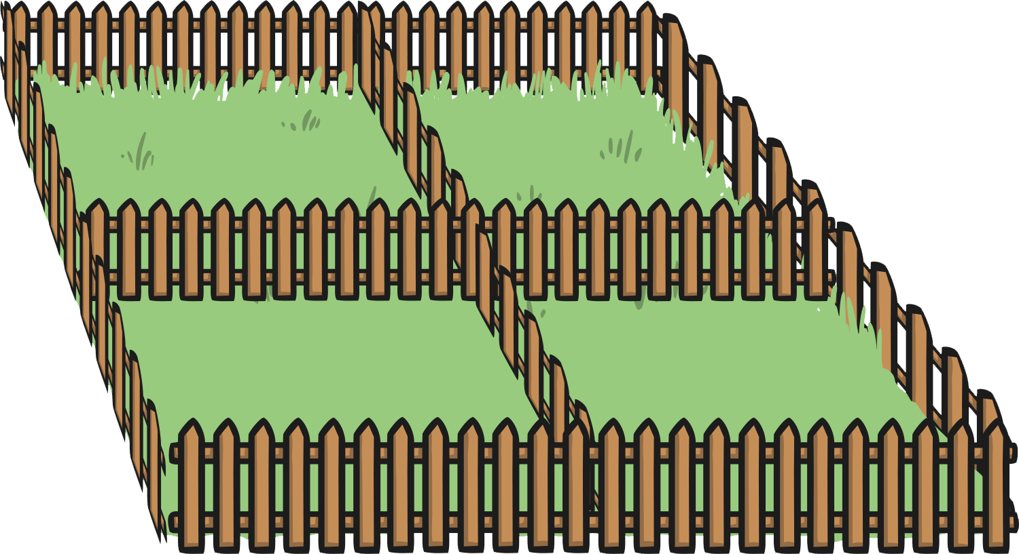
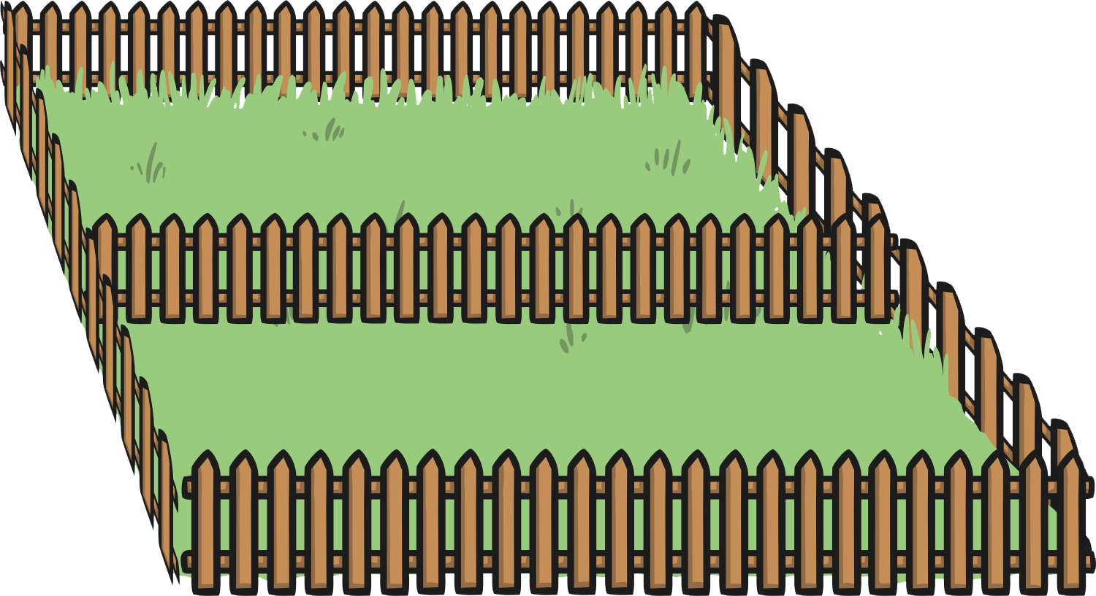
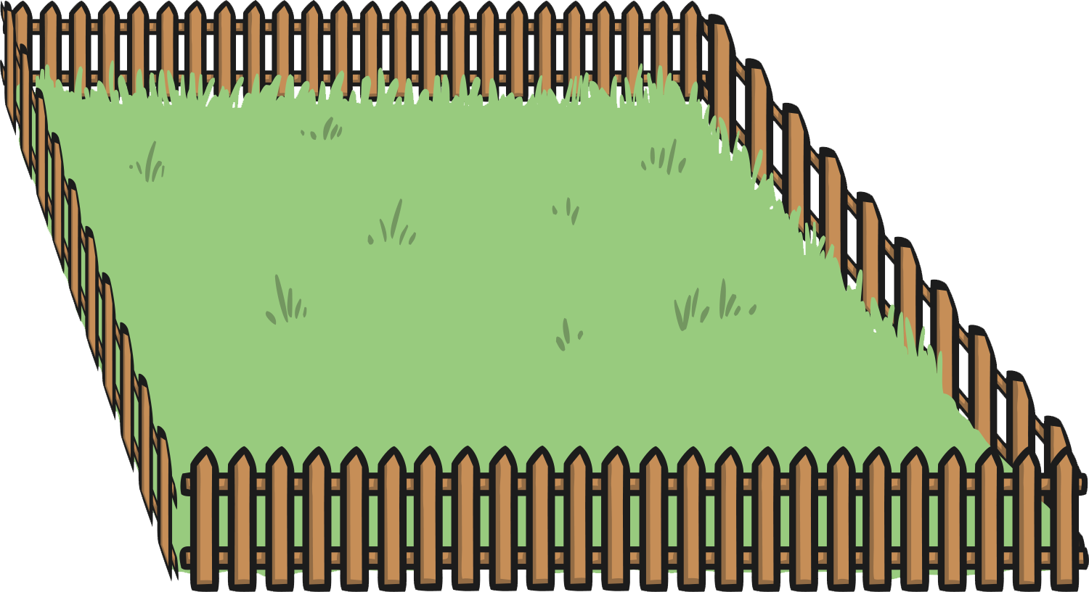
Finding Quarter of a Shape
Farmer Jake wants to find a quarter of his field.
How can we find a quarter of a shape?
By finding half, and then finding half again.

Slide 7
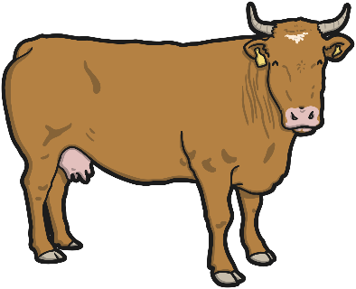
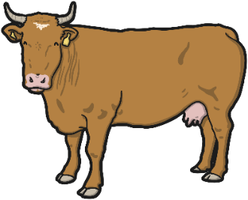
Can We Do This With a Number?
Farmer Jake wants to put of the cows in each field.
Can he do this the same way, by halving and halving again?
1
4

Slide 8
Can We Do This With a Number?
You can also share things into quarters by putting 1 item into each section, then adding another to each section. Keep adding another one, until the items have all been placed.

Slide 9
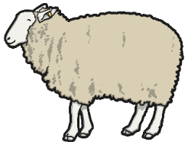
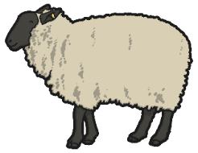
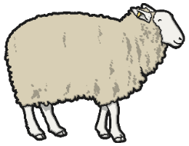
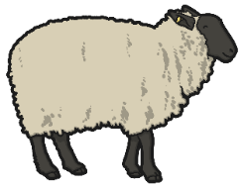
of the Sheep
1
4
How many sheep will there be in each field when they have been split into quarters?

Slide 10
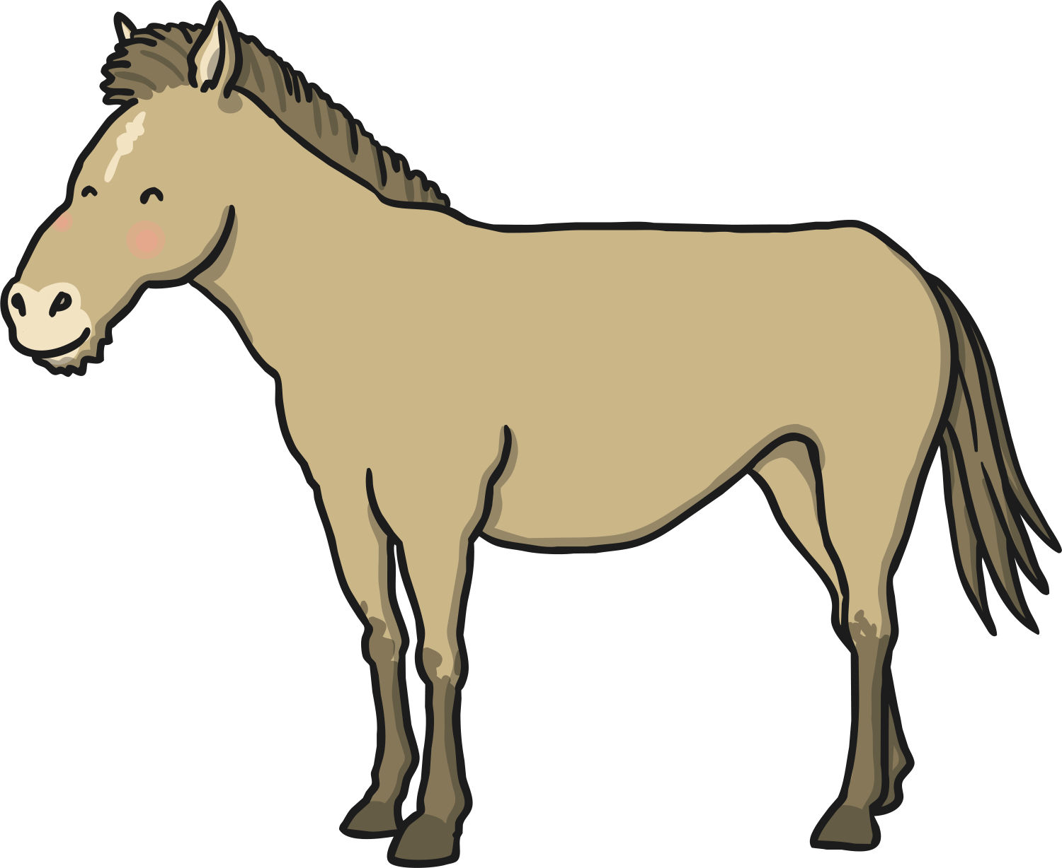
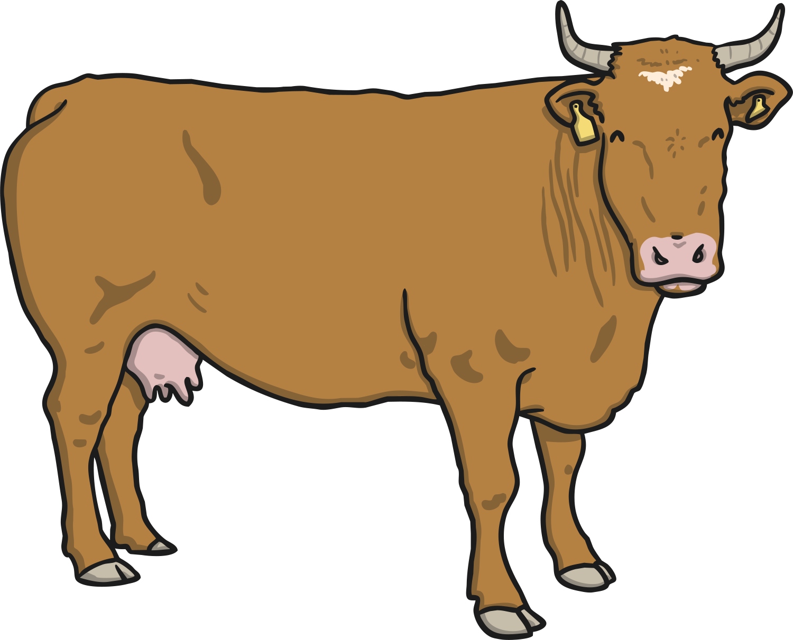
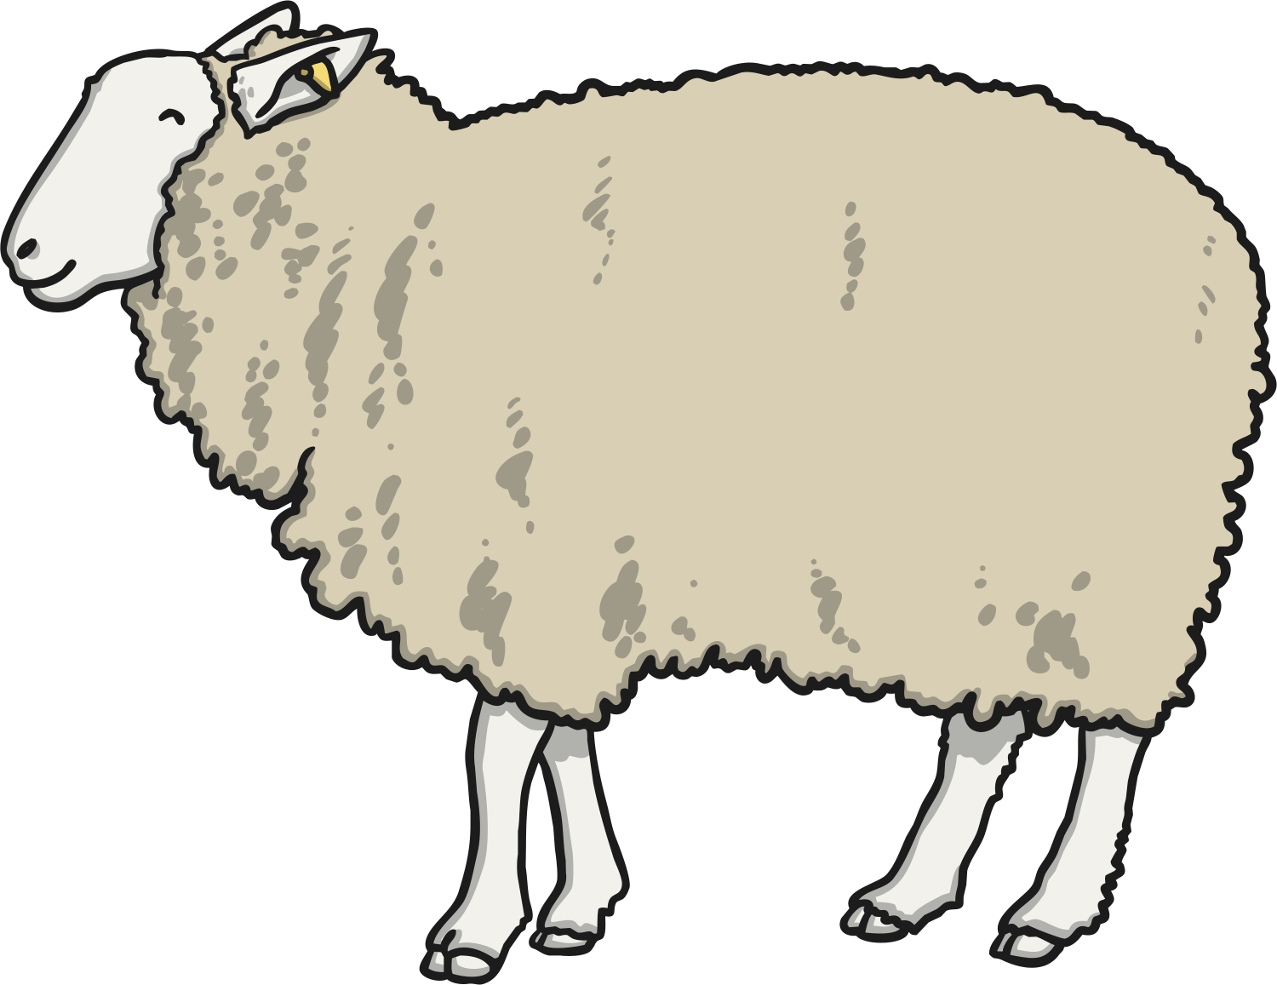
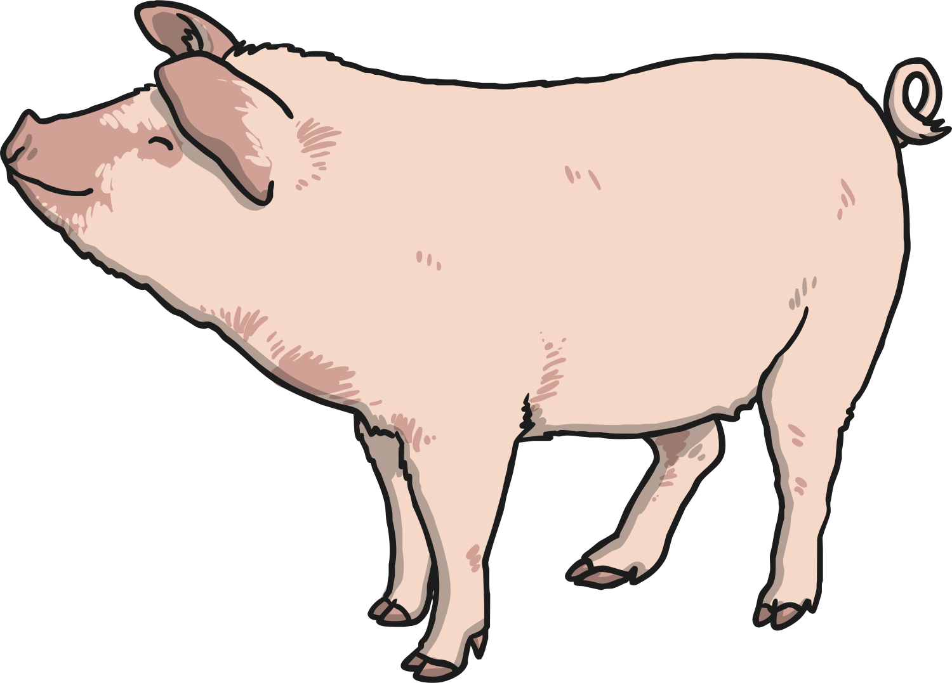
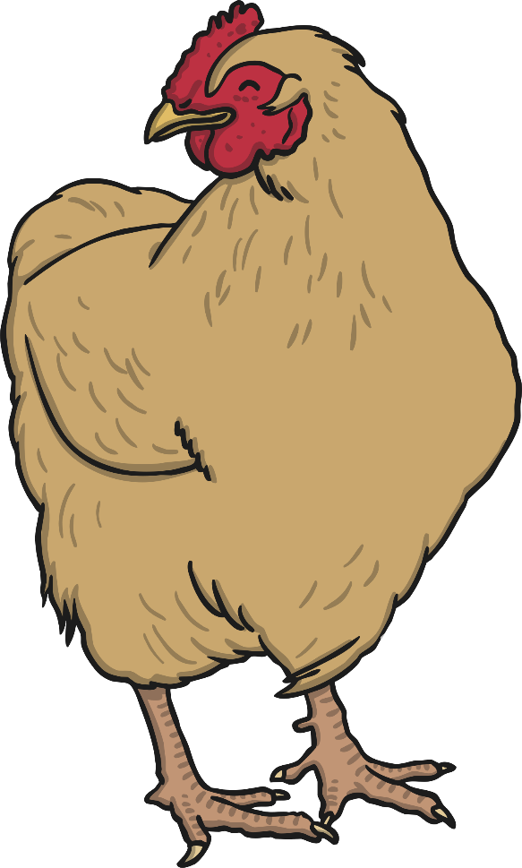
You’ve Been a Great Help!

Slide 11
Aim
I can find of a quantity.
1
4
Success Criteria
I can share into four equal groups to find .
I can explain that is one of 4 equal sized pieces.
I can name .
1
4
1
4
1
4

