Slide 1
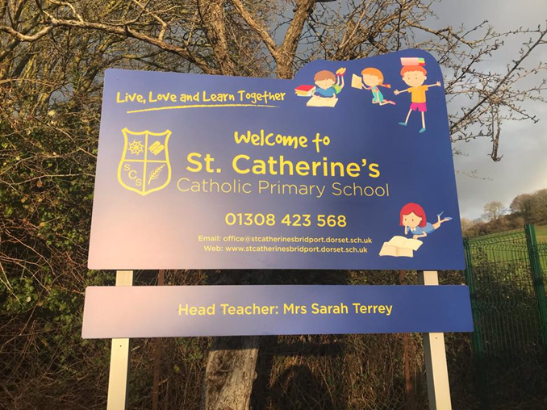
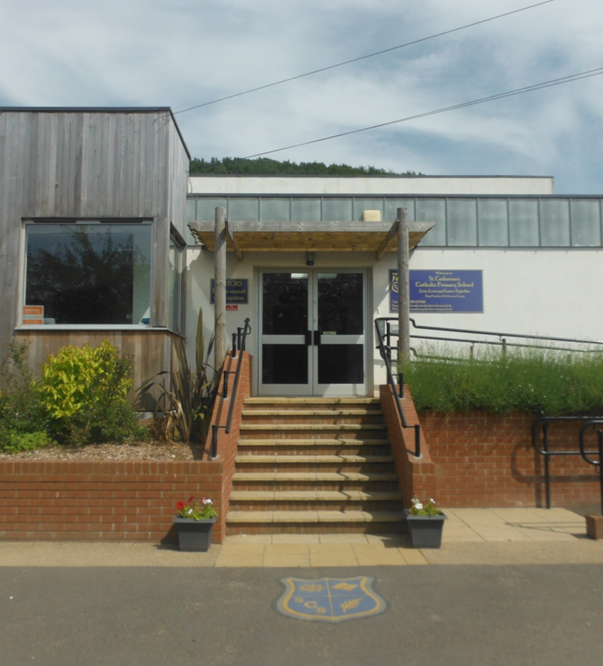
Moving to Reception Class

Slide 2
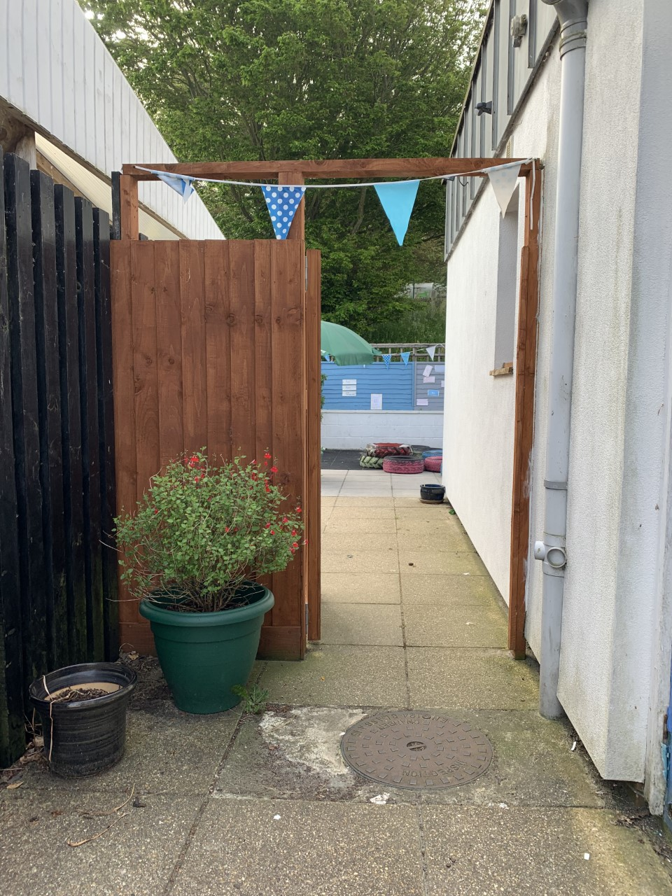
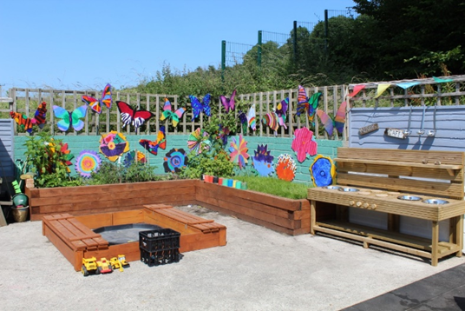
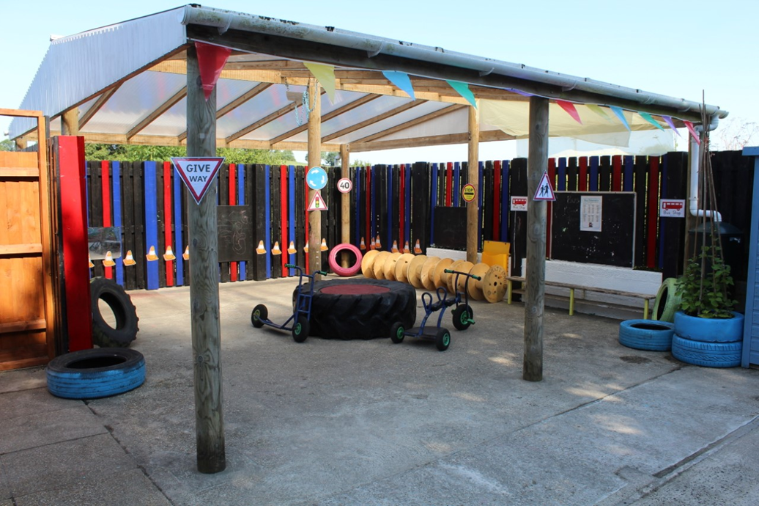
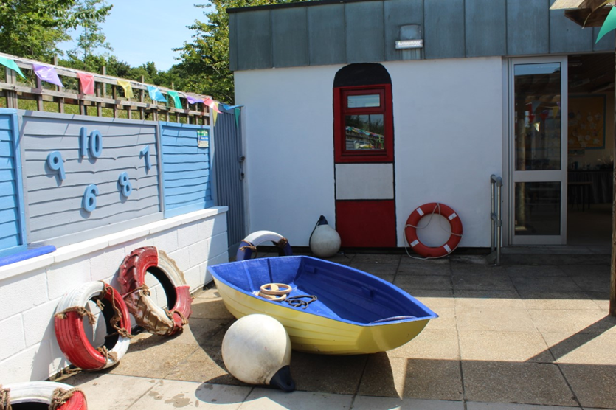
After the Summer holidays I will be going back to school. I will be in Reception.
Some things will be the same and some things will be different.
I will line up by the EYFS gate. I will wait with my Grown Ups until my teacher collects me.
I will walk through the outside area and into my classroom.

Slide 3
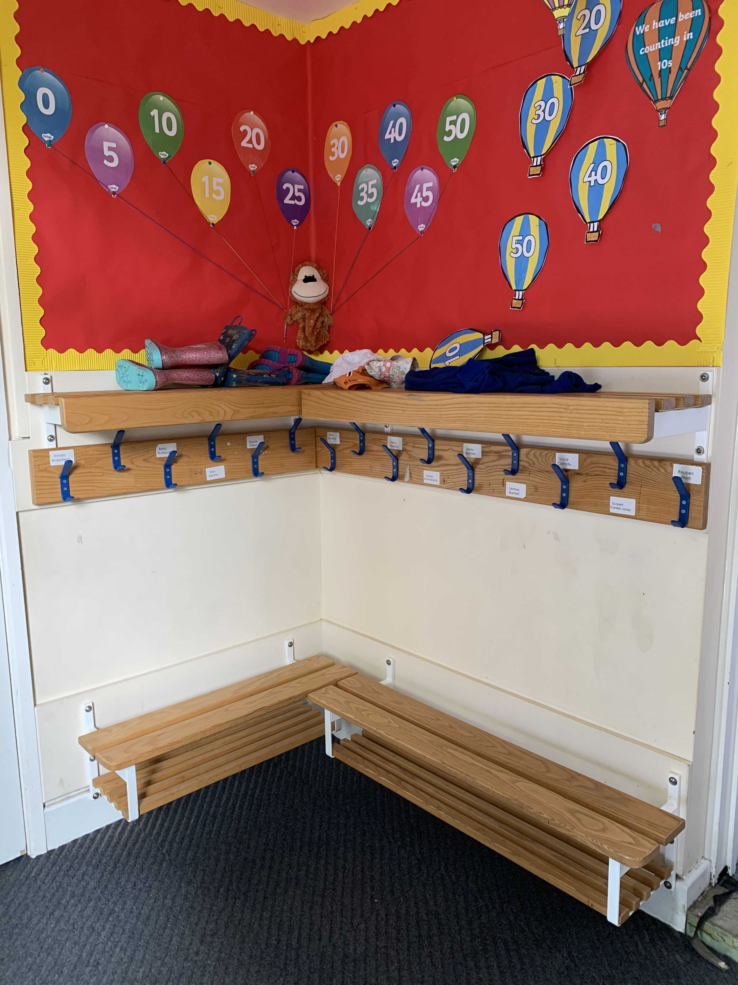
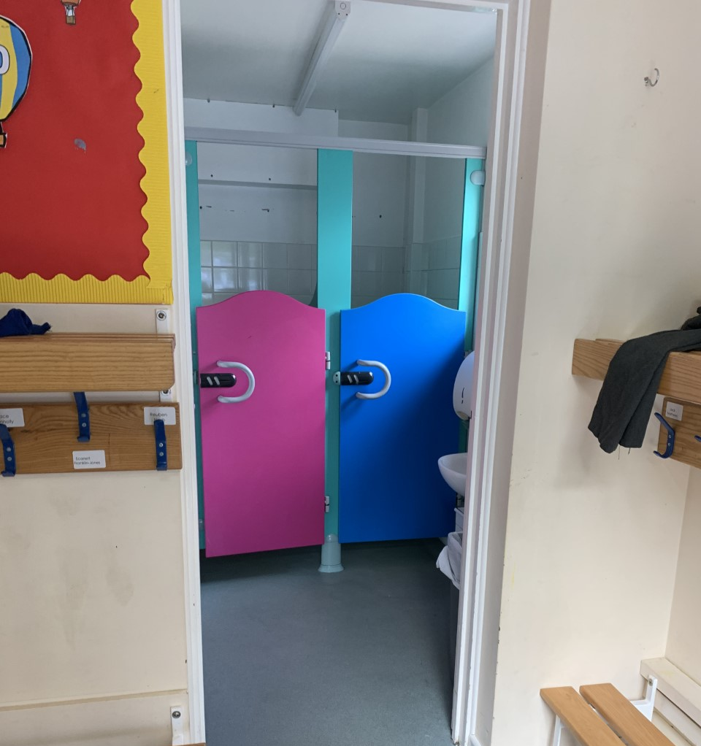
This is where we will hang up our coats.
The toilet is just next to the coats.

Slide 4
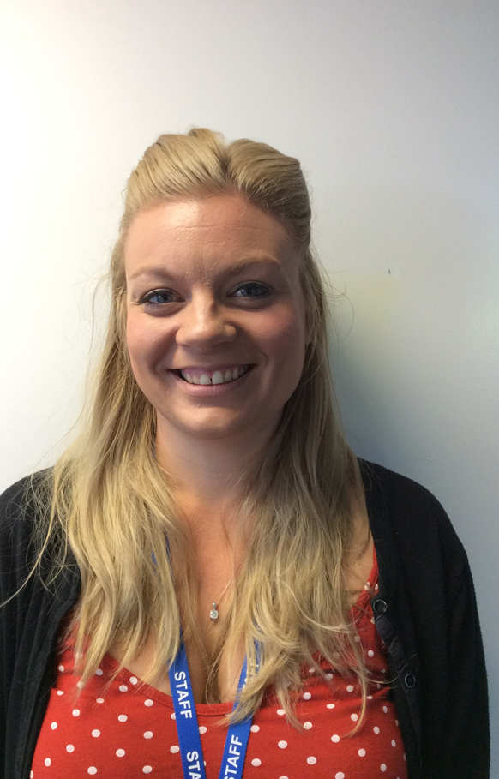
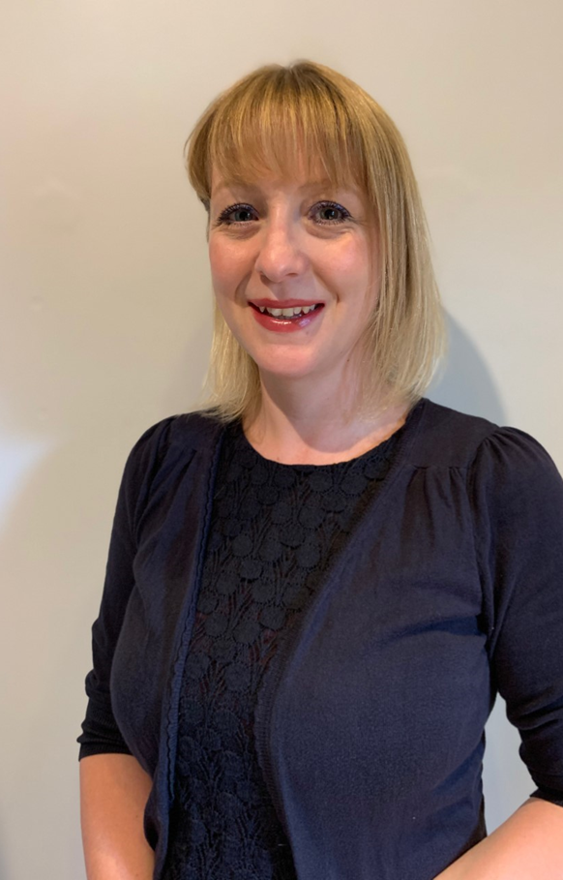
This is Mrs Treble. She is my new teacher. We will learn lots of fun things together. This is her classroom.
This is Mrs Middleton. She will be my teacher too. She is at home until Easter because she has just had a baby.

Slide 5
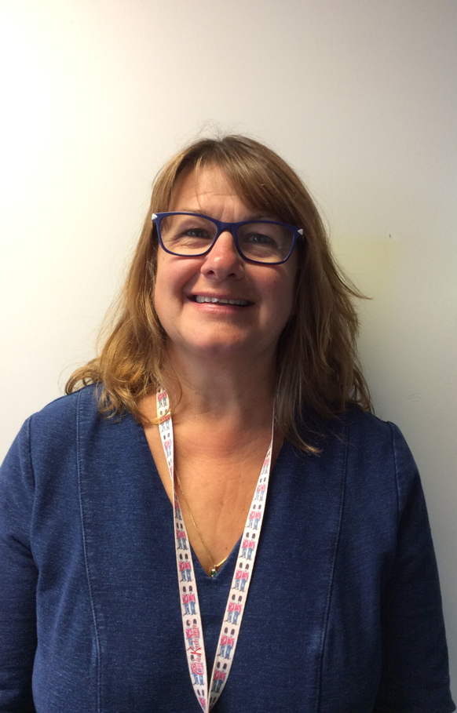
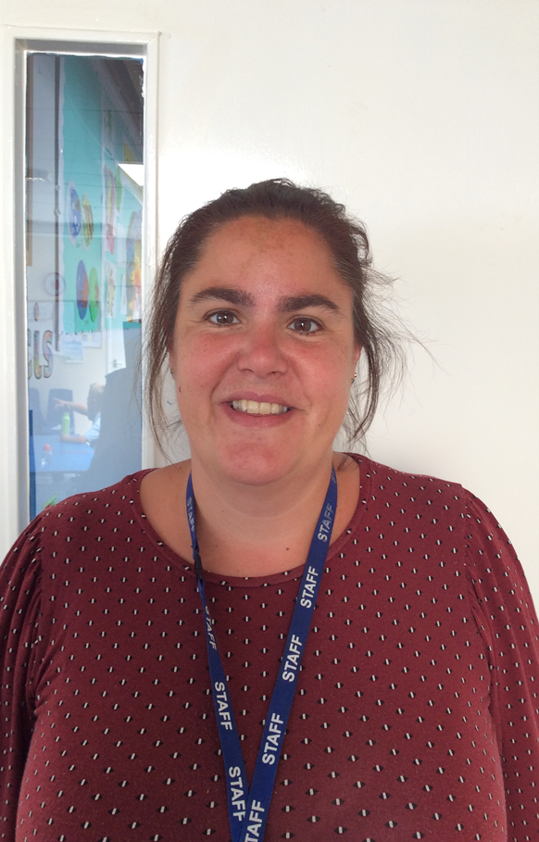
This is Mrs Pattinson-Smith she is one of my teaching assistants. She likes to have lots of fun and help me learn.
This is Mrs Pirus she is another one of my teaching assistants. She will help me with my activities.

Slide 6
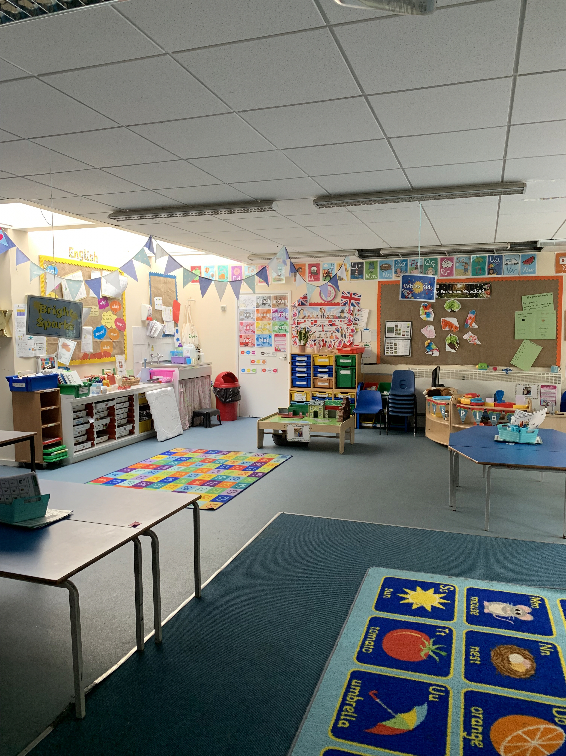
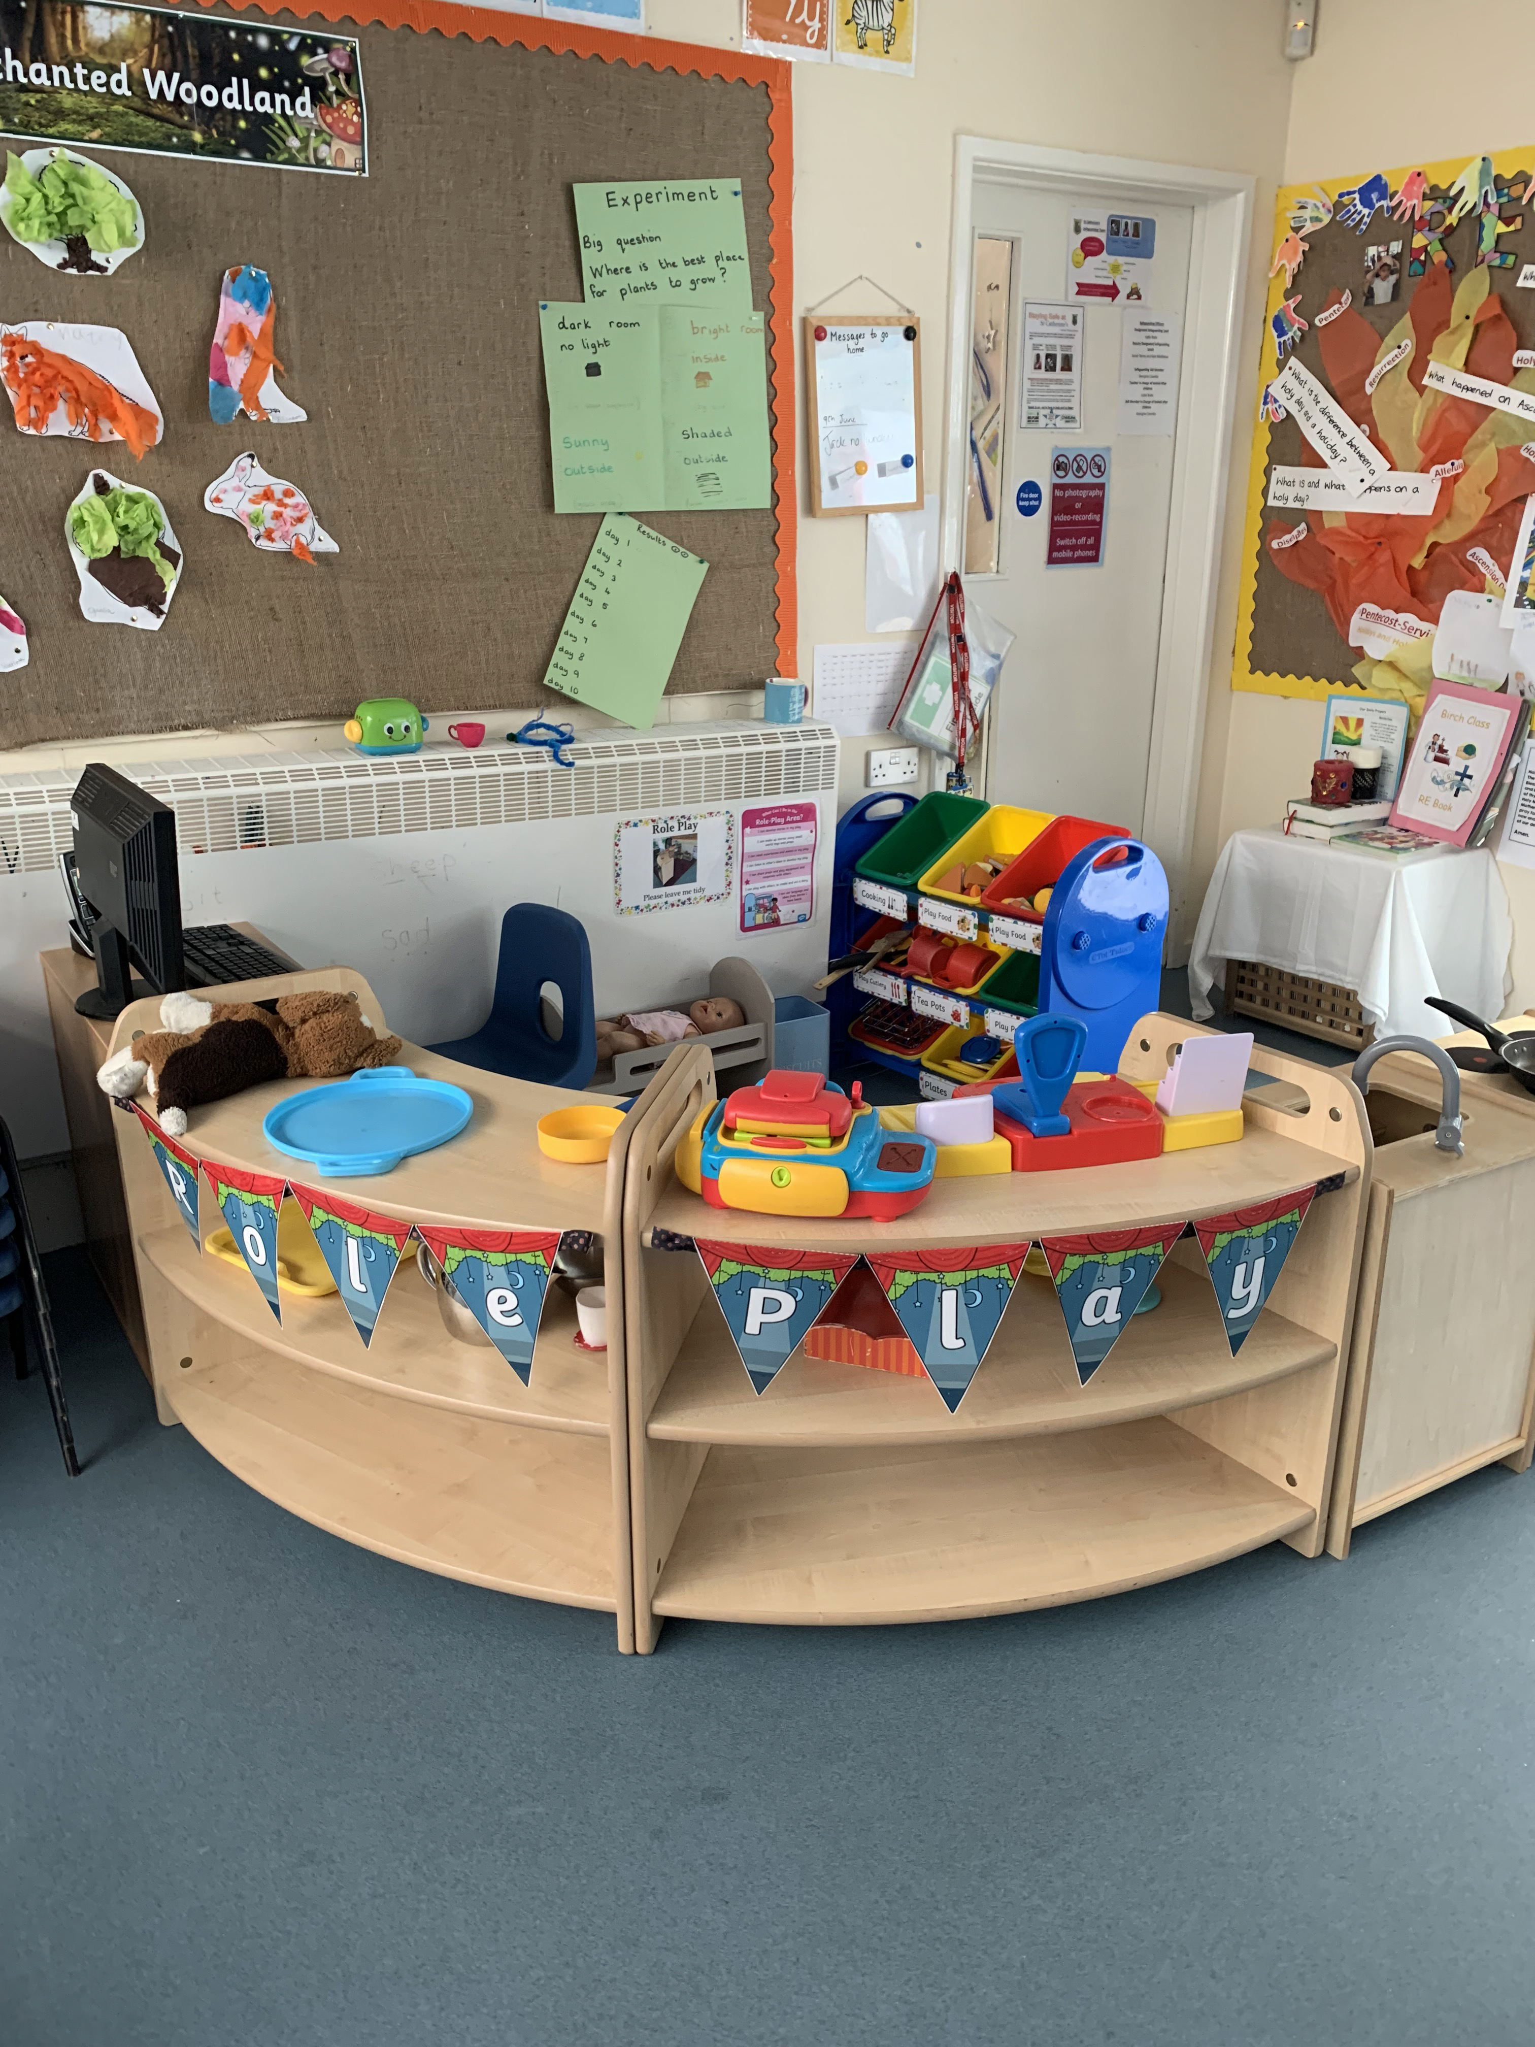
The classroom is very colourful with lots of lovely things – just like Pre-School.
There is a home corner so I can still play pretend.

Slide 7
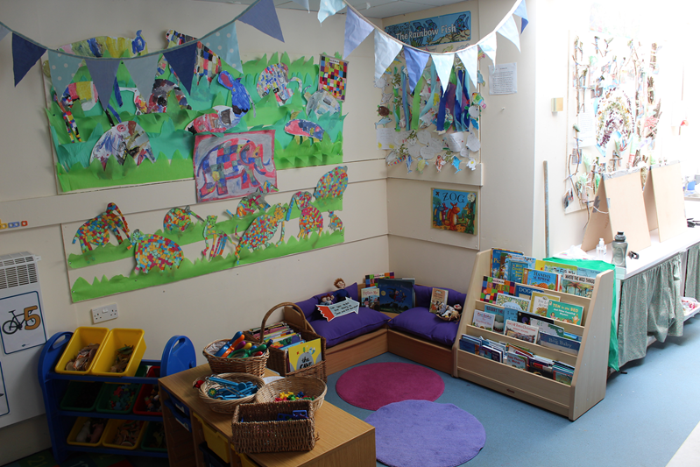
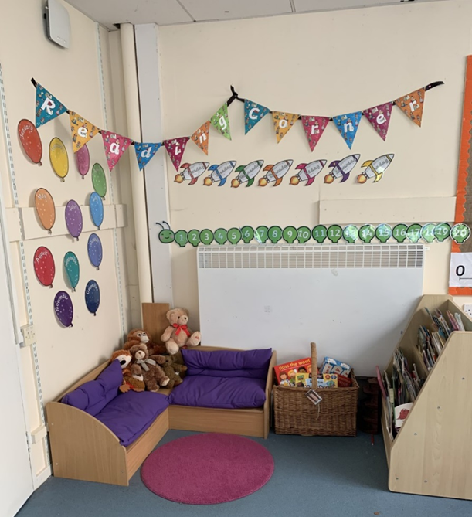
I can also choose to learn outside, just like Nursery. Things are different outside, there are new things to explore.
The book corner is full of lovely books that I can read.

Slide 8
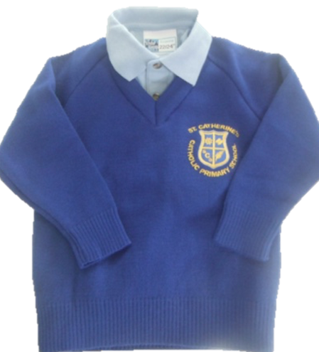
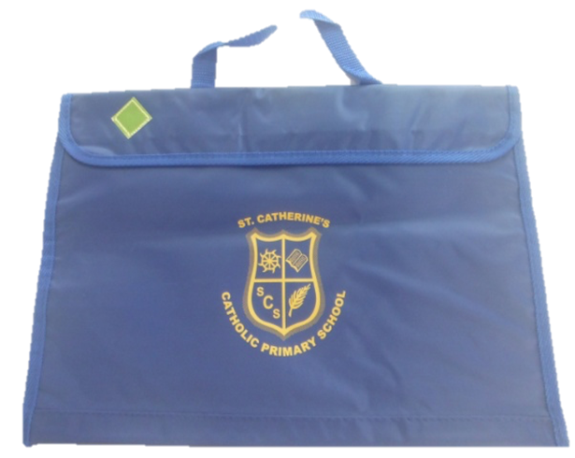
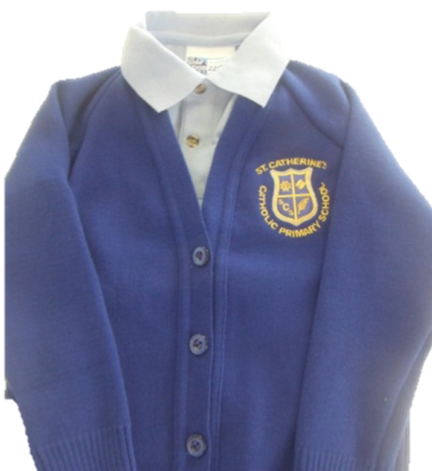
These are our school jumpers that we wear to school. Remember to put your name on them.
This is the book bag we bring to school everyday. Letters and books come home in in.

Slide 9
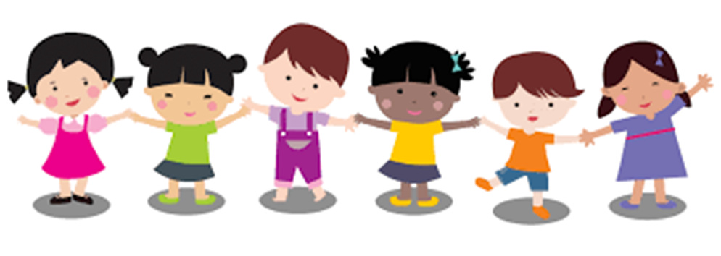
When I get back to school I will be in Reception Class. Some things will be the same and some things will be different and that’s OK!
I am very excited about coming back to school.

