Slide 1
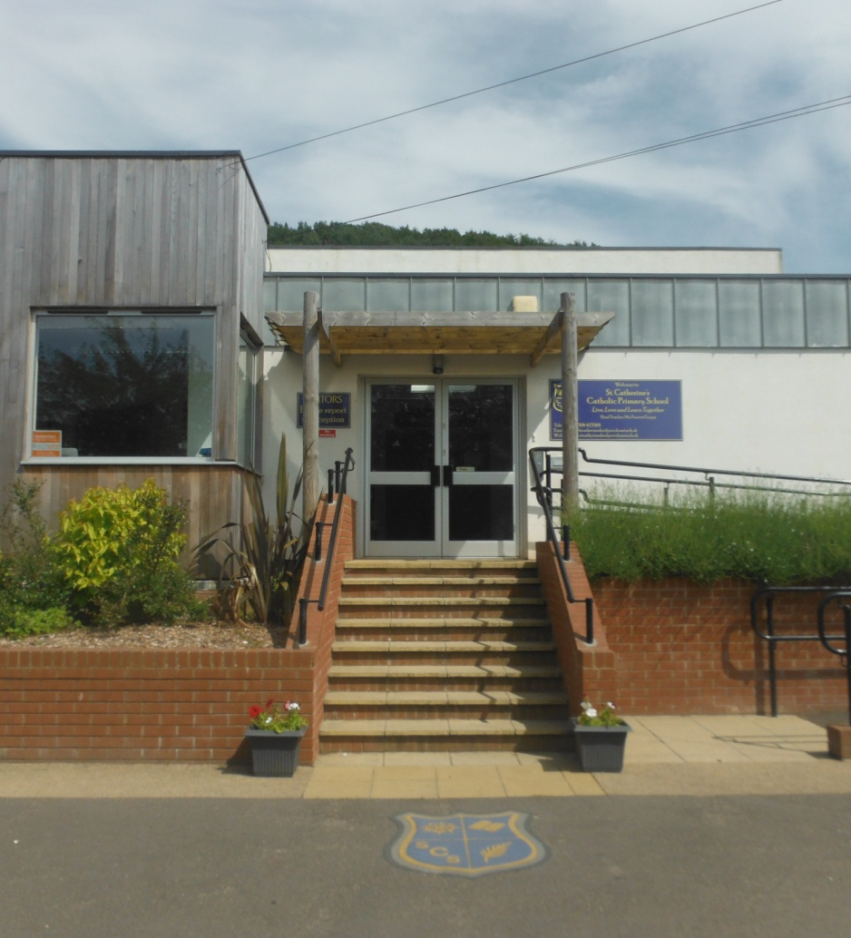
Welcome to St. Catherine’s
Catholic Primary School
2020-2021 Intake

Slide 2
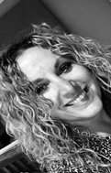
This is Mrs Terrey. Mrs Terrey is the Head Teacher of St. Catherine’s School.

Slide 3
My name is Mrs Treble. I am one of the teachers in Birch Class.

Slide 4
My name is Mrs Middleton. I am one of the teachers in Birch class.

Slide 5
My name is Mrs Blake. I am one of the teachers in Oak class.

Slide 6
My name is Mrs Best, I am one of the teachers in Oak class.

Slide 7
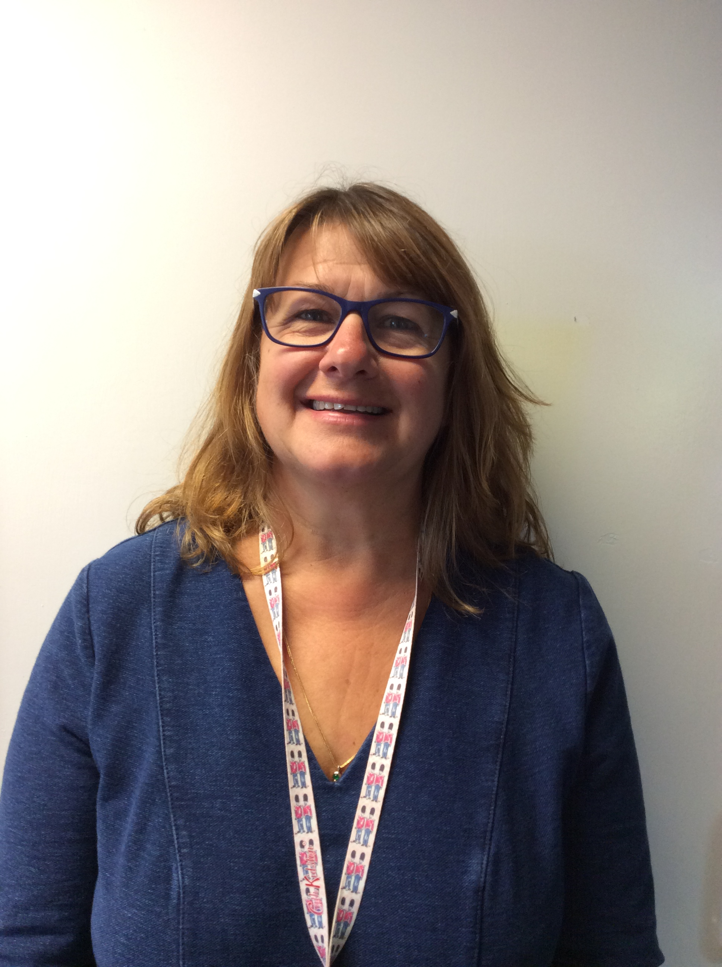
My name is Mrs Pattinson-Smith, I am one of the teaching assistants in Birch class.

Slide 8
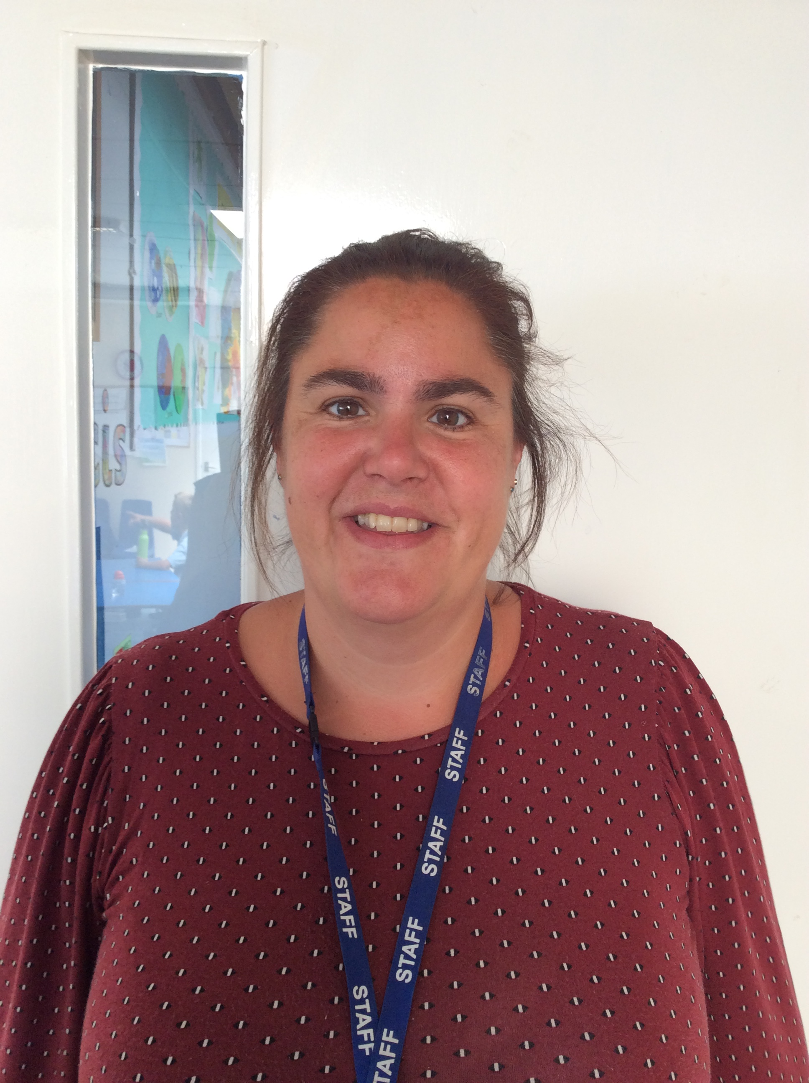
This is Mrs Pirus I am one of the teaching assistants in Oak class.

Slide 9
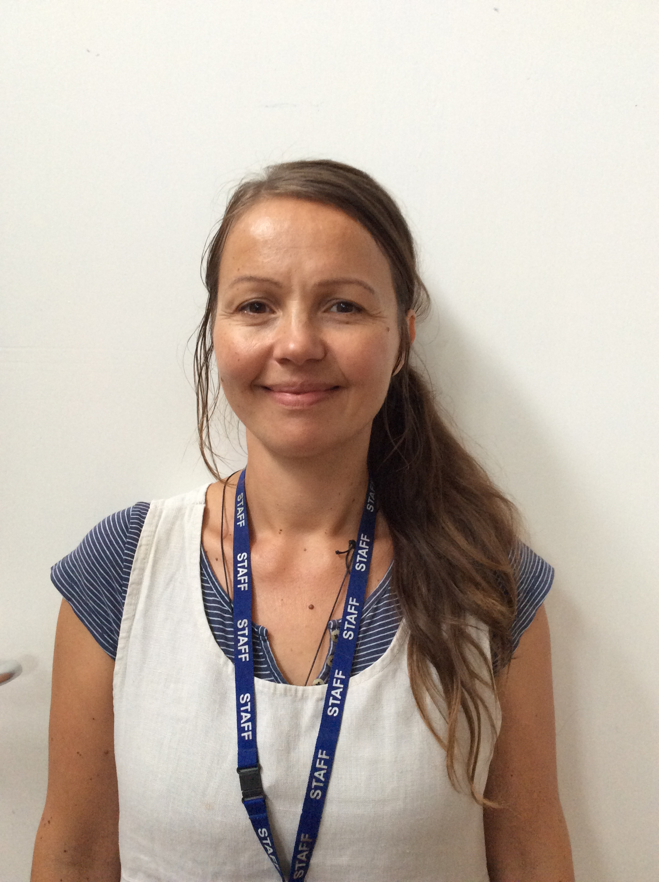
My name is Mrs Tyrrell, I am one of the teaching assistants in Oak class.

Slide 10
This is the gate to your classroom.

Slide 11
This is what it looks like in the classrooms. Reading corner

Slide 12
Writing Area

Slide 13
Role Play

Slide 14
Art Area

Slide 15
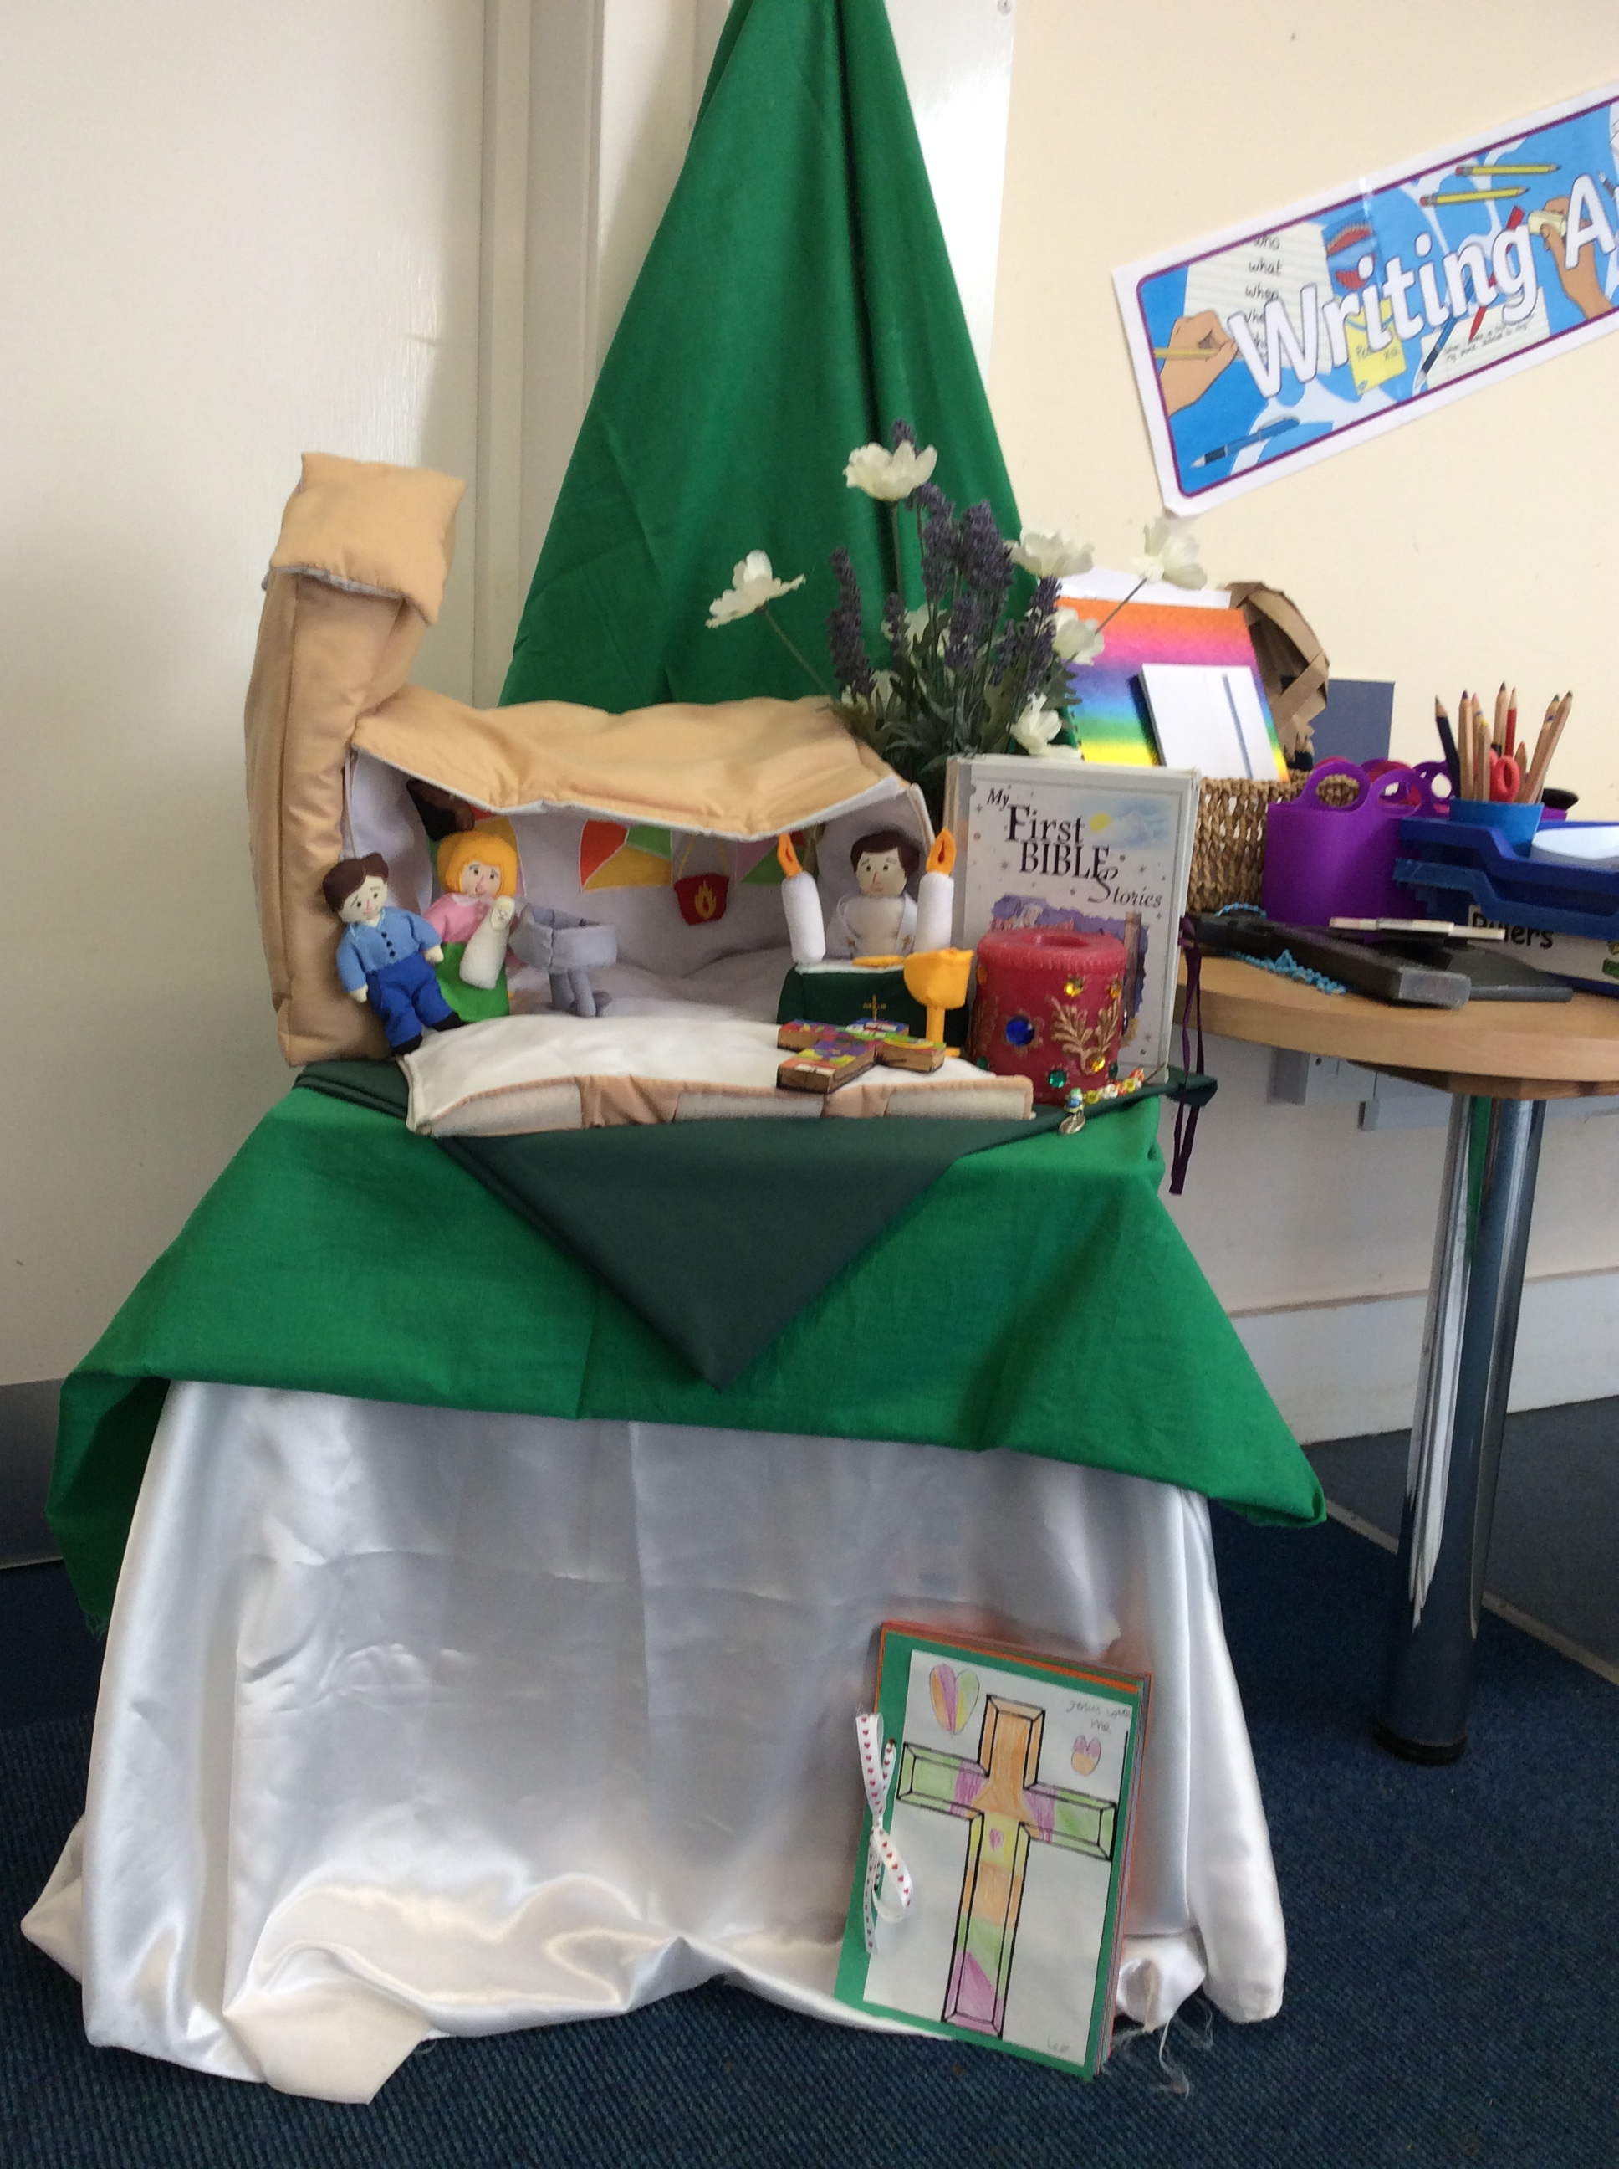
RE Area

Slide 16
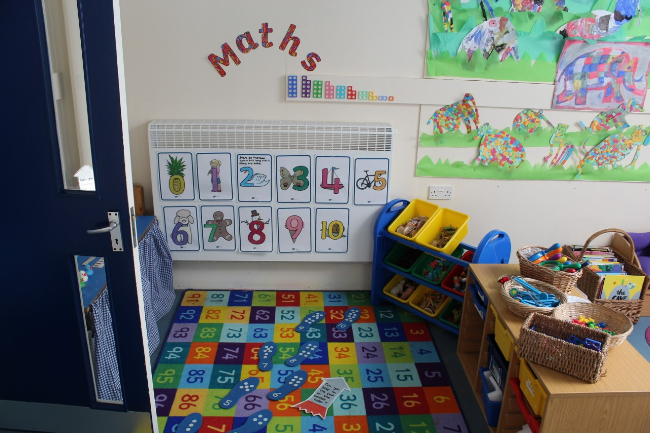
Maths Zone

Slide 17
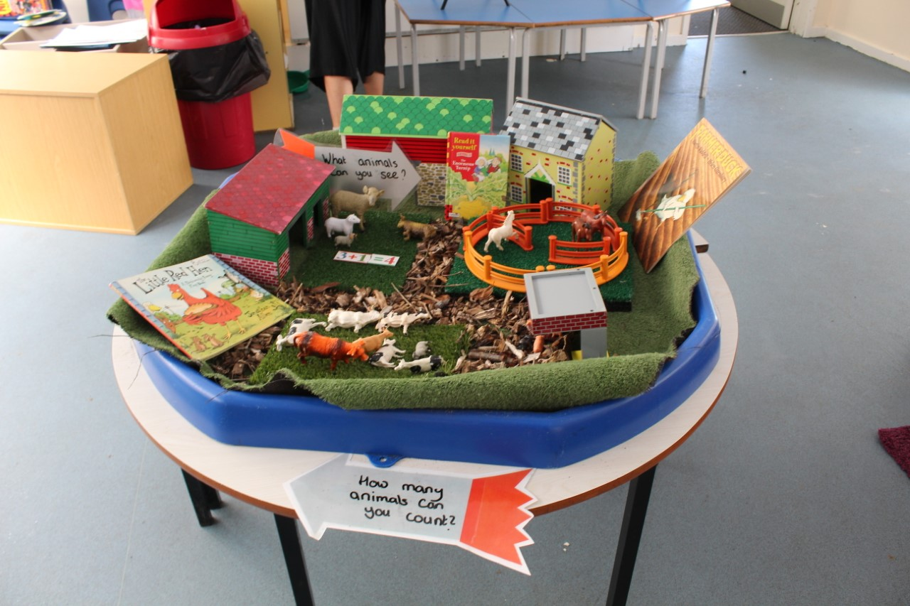
Small World

Slide 18
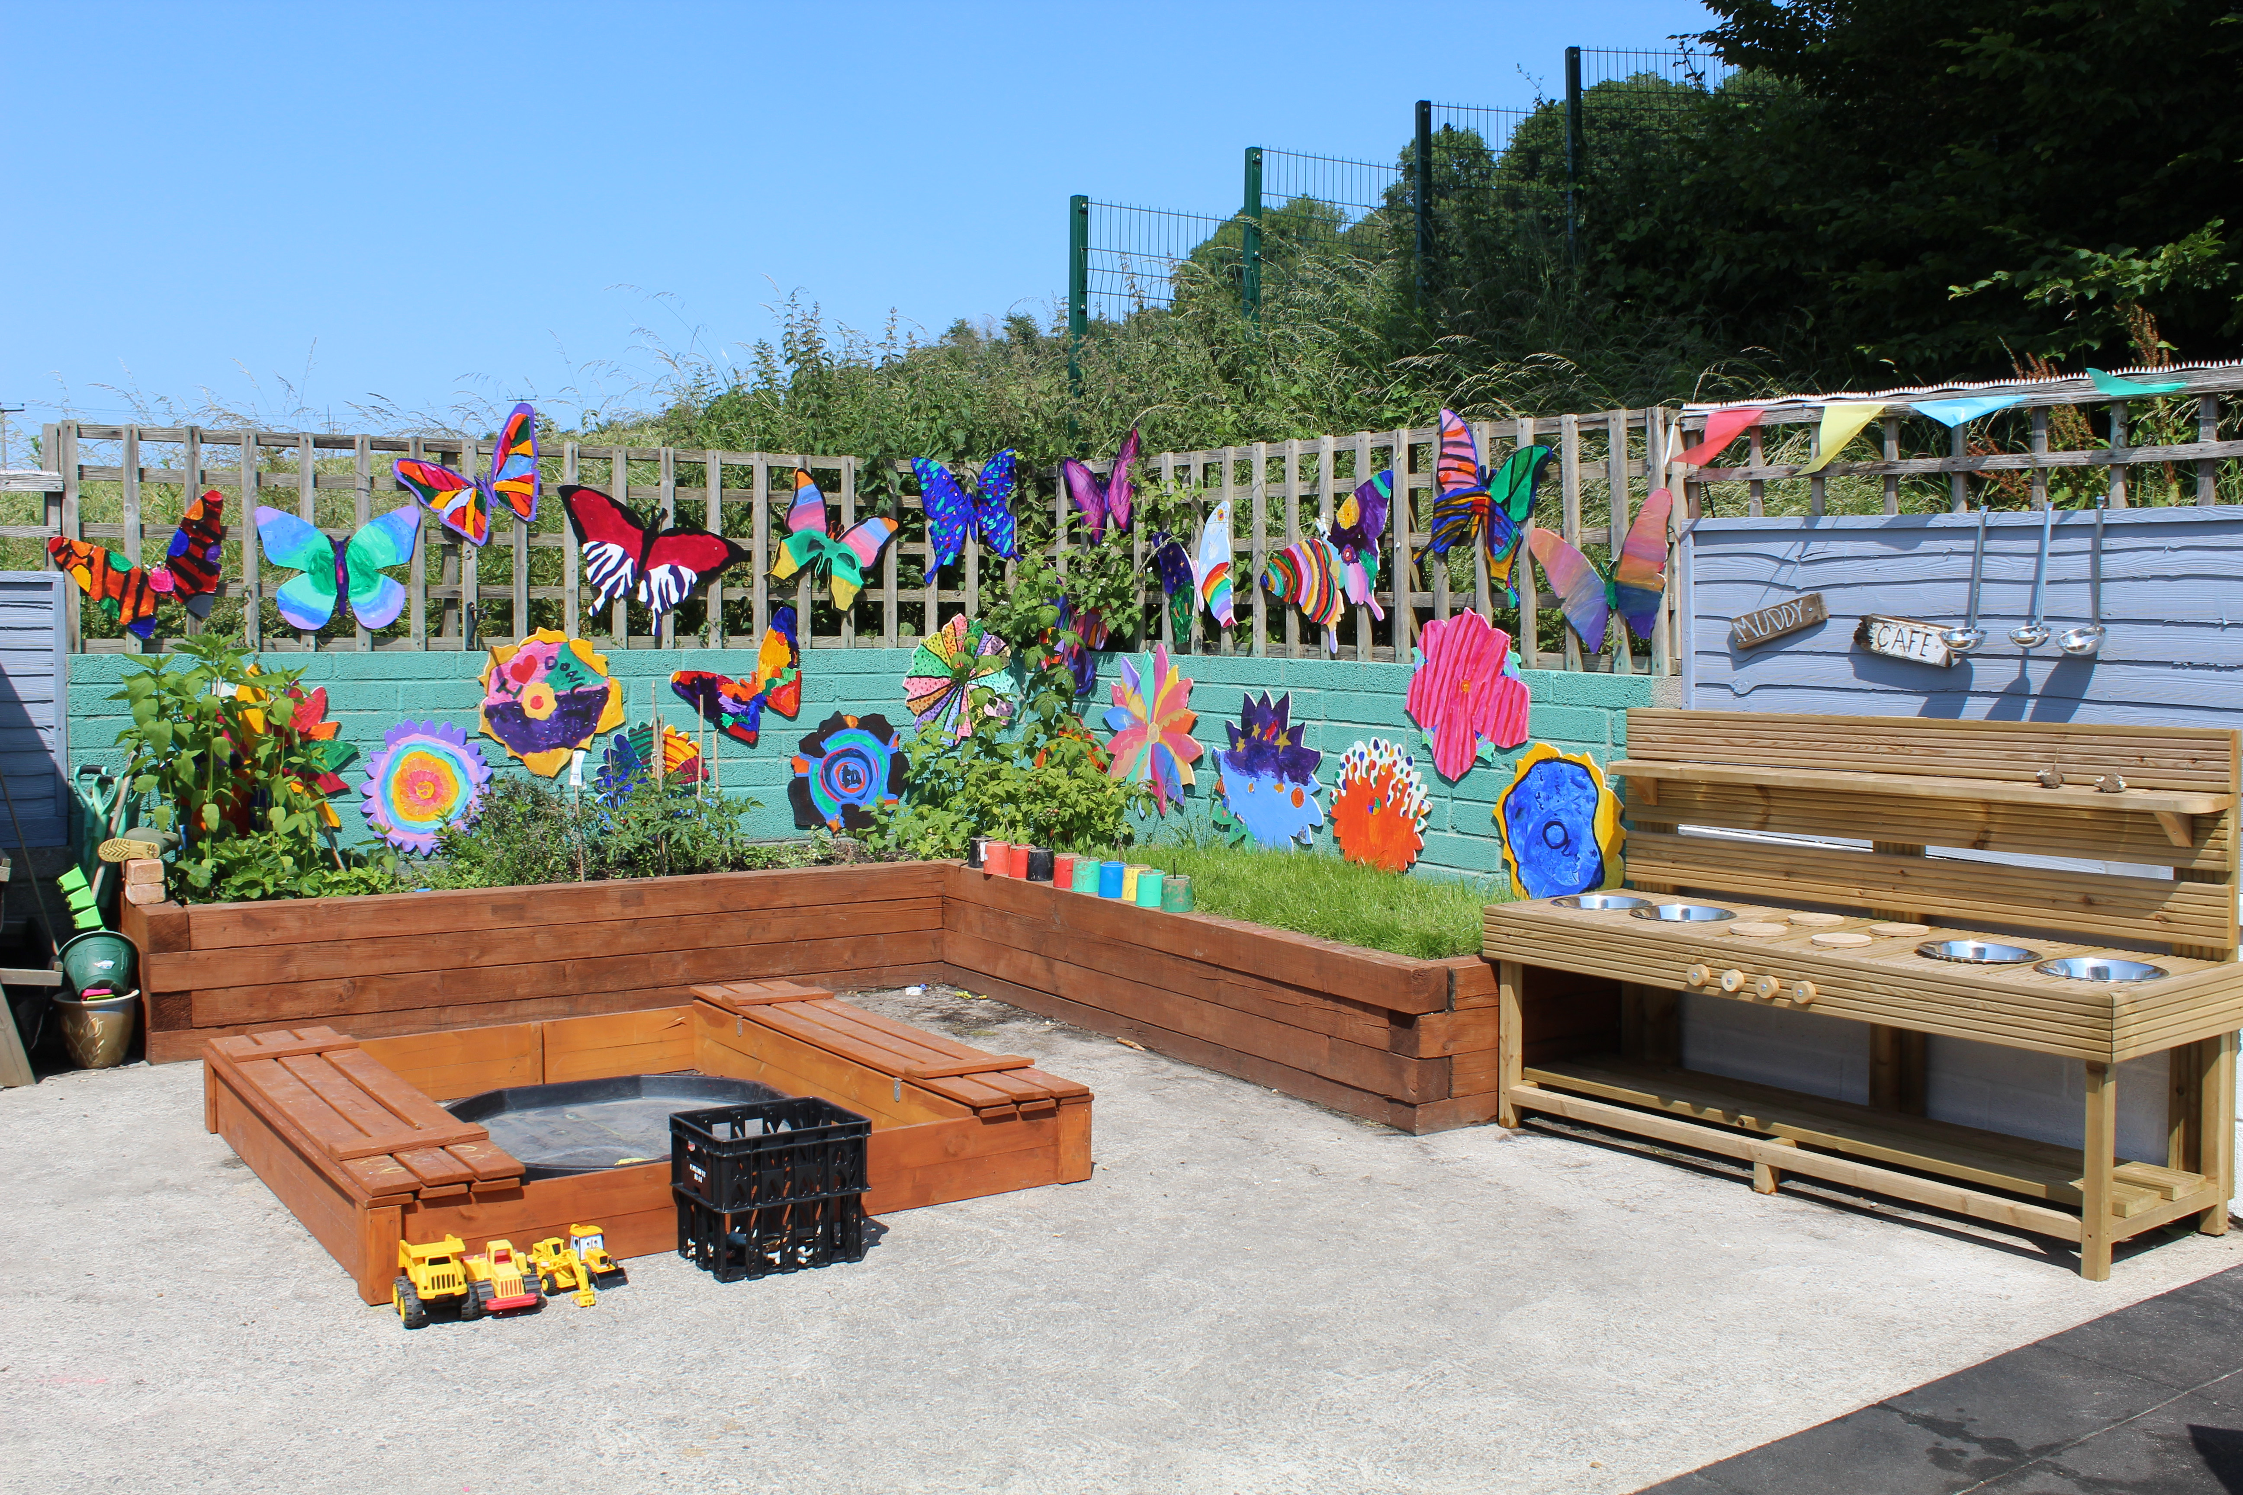
Our Outside Learning Area

Slide 19
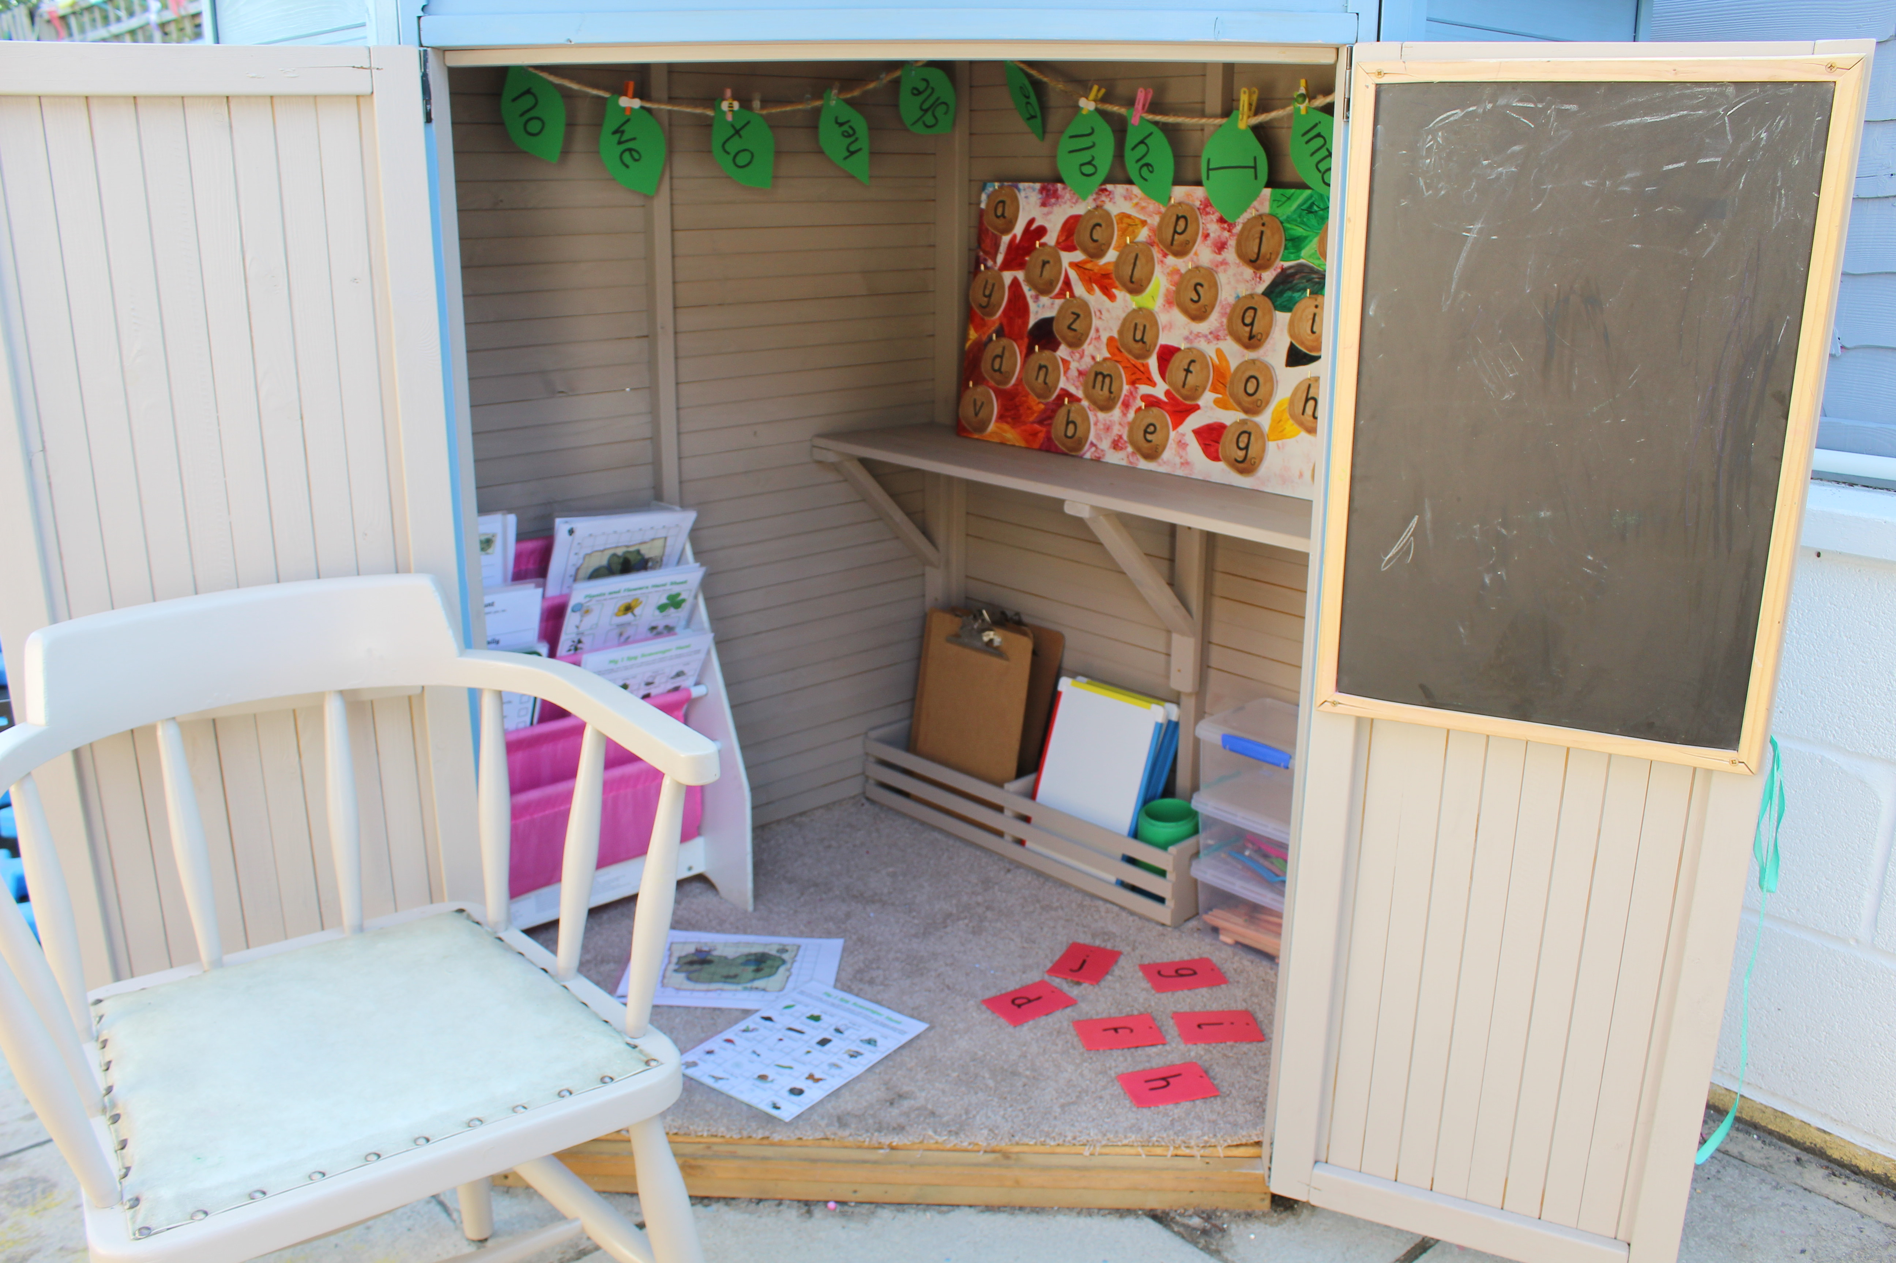
Writers Retreat

Slide 20
Watery Cove

Slide 21
Biker Den

Slide 22
Lighthouse Cove

Slide 23
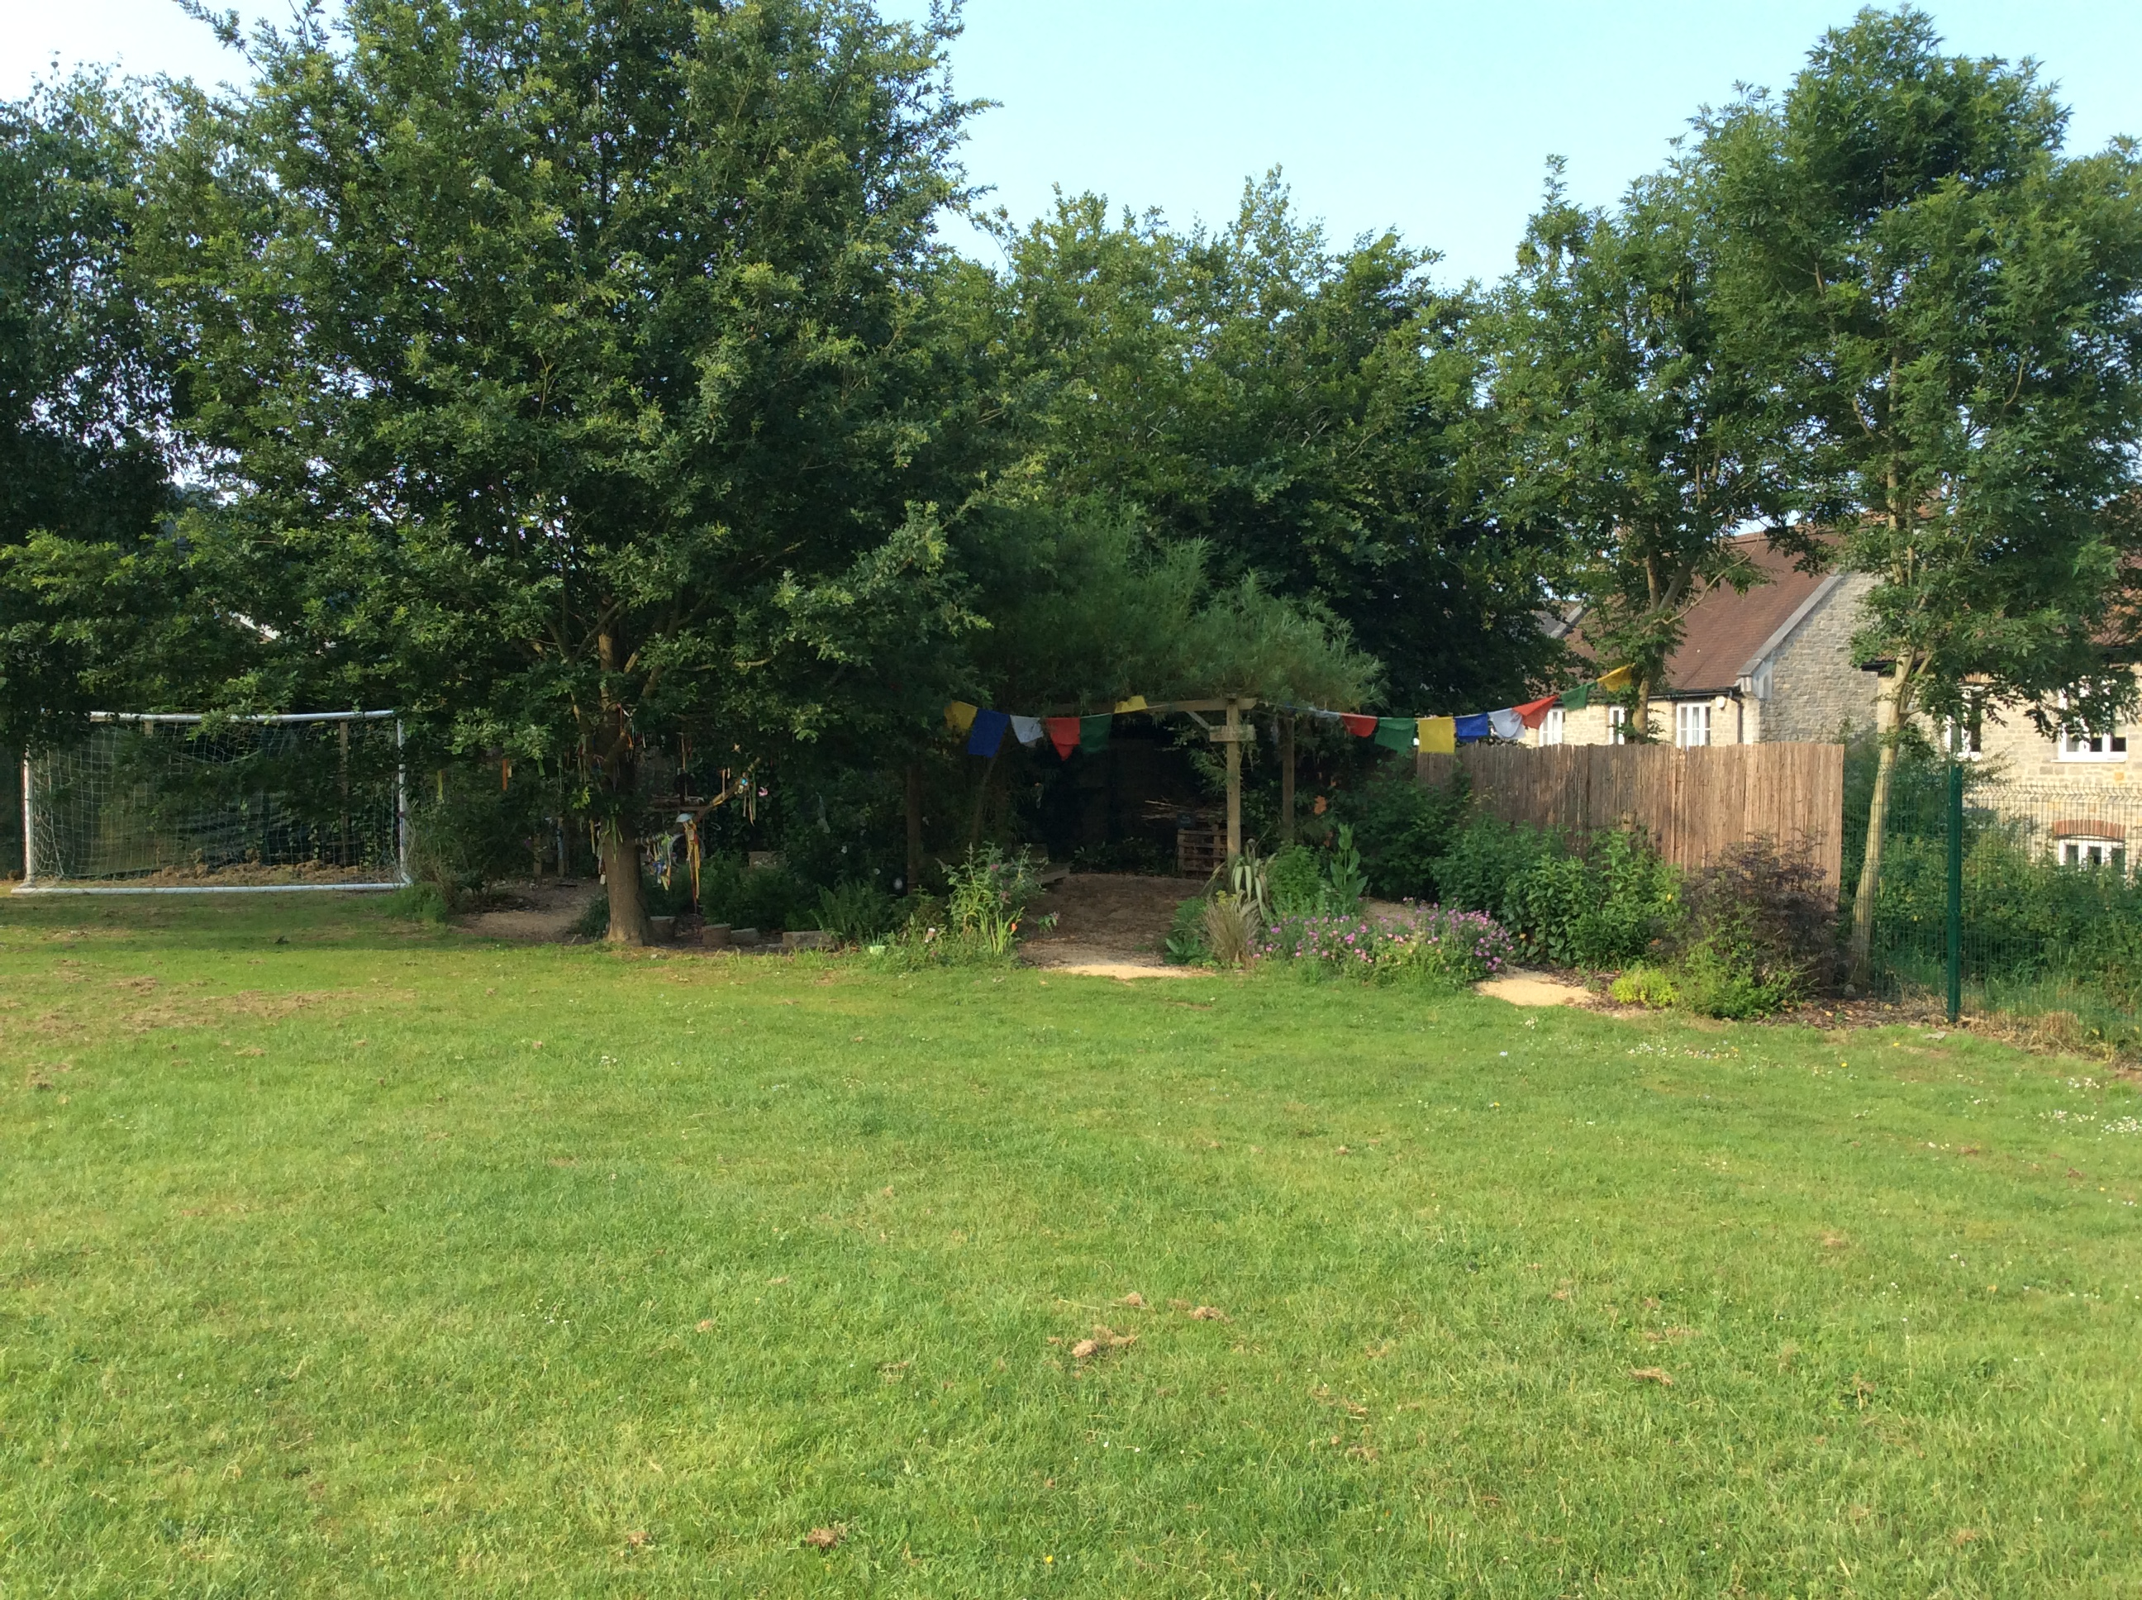
School field and Sensory Area

Slide 24
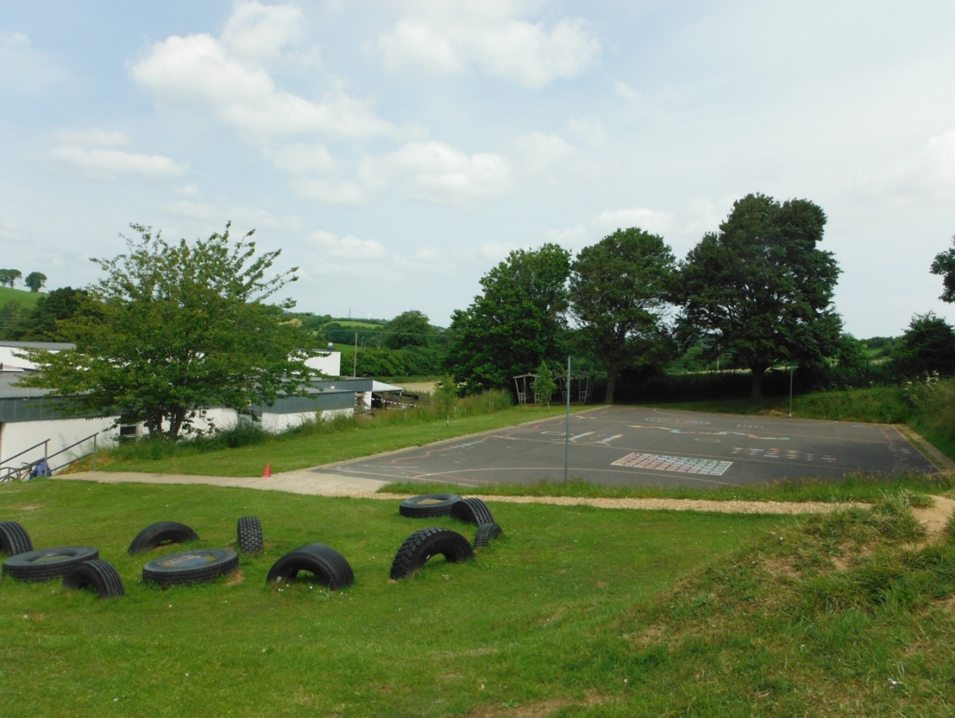
Top playground and the Tyres

Slide 25
This is the hall, where we eat our lunch, have assembly and PE.

Slide 26
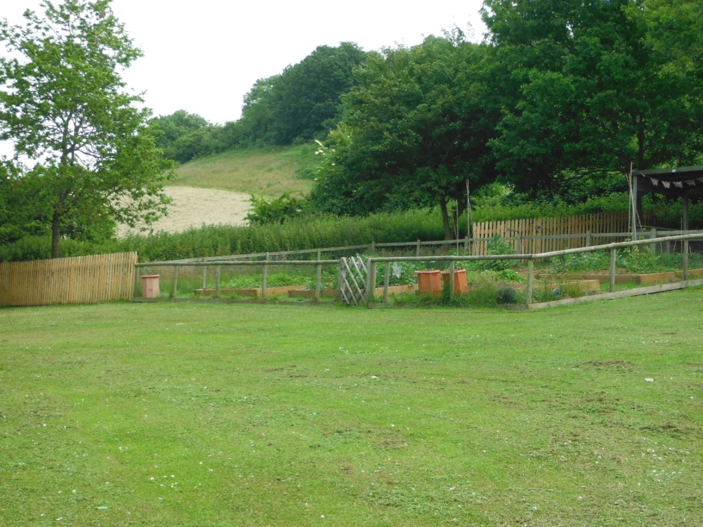
This is the garden area.

Slide 27
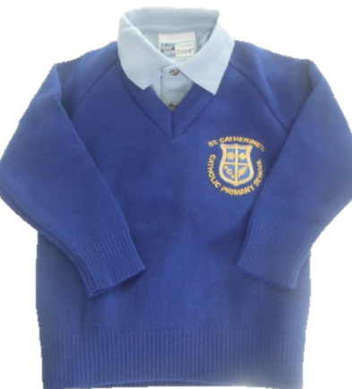
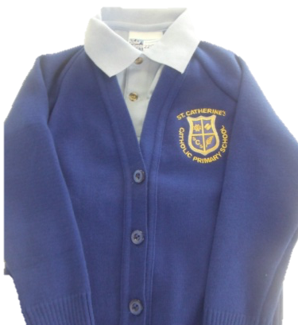
These are the jumpers and cardigans the children wear at St. Catherine’s.

Slide 28
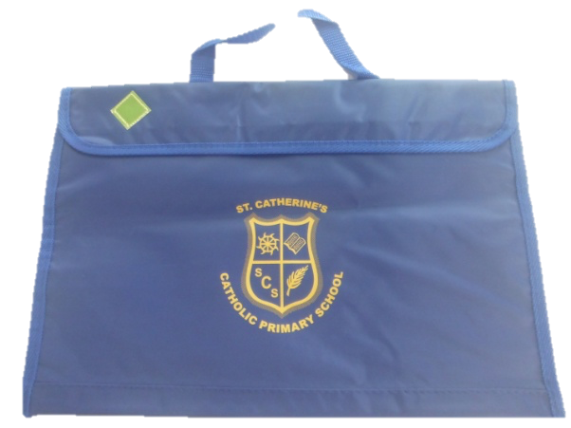
This is the book bag we bring to school every day. Letters and books go home in it.

Slide 29
We all look forward to seeing you in September!

