Slide 1
Primary Forest School
Online Learning – Music activities

Slide 2
The important bit for parents and teachers… but you can have a sneak peek at the activities too!
Activity | Resources Required | Potential Risks | Impact
Make instruments | Toilet roll tubes Tape Rice Cocktail sticks (optional) | Sharp ends to cocktail sticks | Children create their own shaker (or rainmaker) from recycled materials
Film sound effects of natural sounds | Frying bacon Shredded newspaper Carrier bag Cellophane | Hot oil/fat Please reuse objects to save the environment | Children replicate natural sounds using household objects and explore this further independently
Listen for different pitches | A stick to hit things with | Safety with sticks | Children understand about pitch
Combine sounds to make a band | Various natural items | Be aware of specific risks of hard or sharp objects | Children work collaboratively with family/bubble members to create music

Slide 3
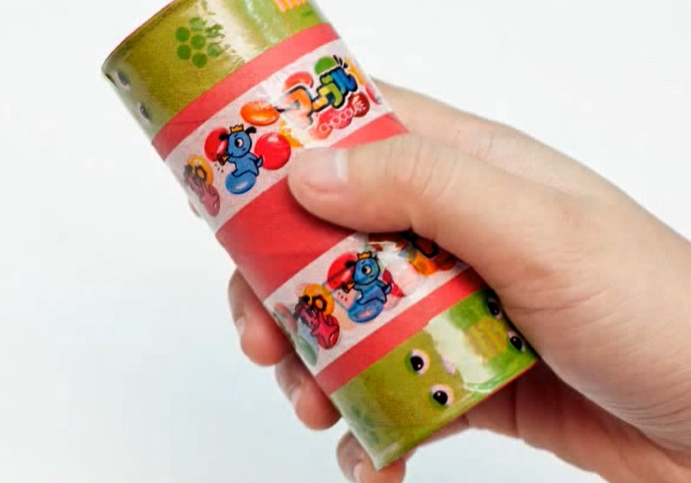
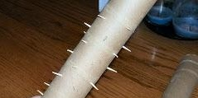
Make instruments
An instrument is anything that makes a sound, pleasing to someone’s ear.
Cut 4 short slits (about 2-3cm long) in the toilet roll equally distanced around it.
Fold the slits over to cover the end of the toilet roll and tape in place.
Half fill the toilet roll with rice and repeat to the other end.
By sticking cocktail sticks throughout the tube, they will briefly slow down the rice and you have turned your shaker into a rain maker!
Decorate your shaker!

Slide 4
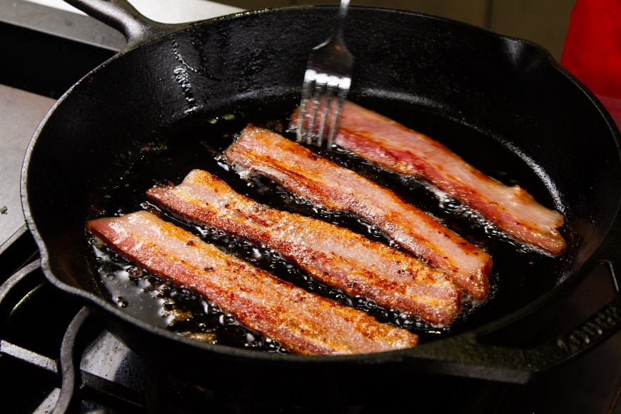
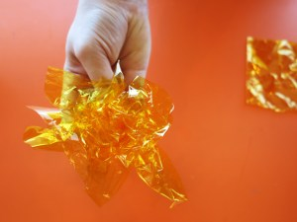
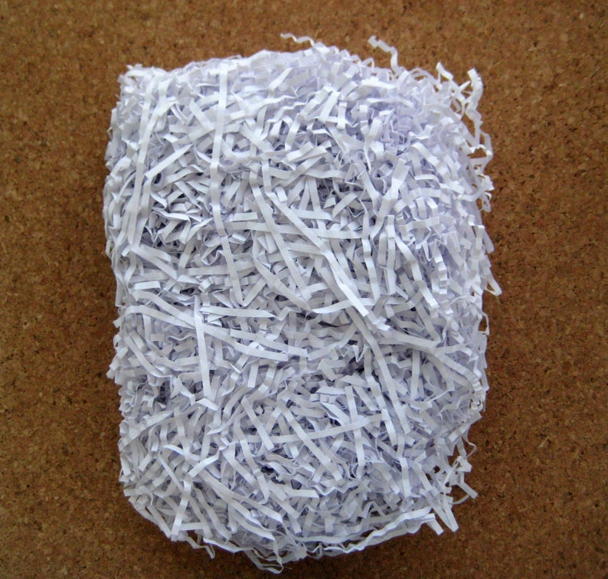
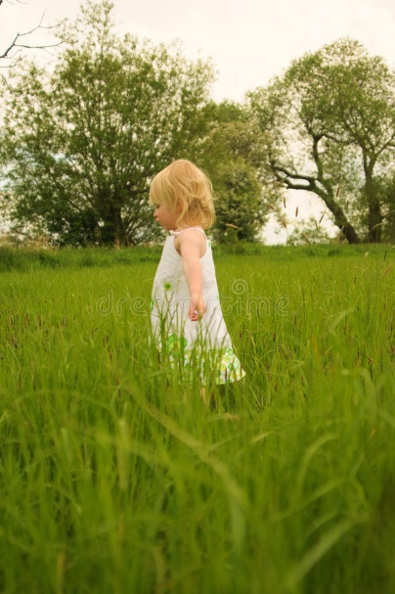
Film sound effects of natural sounds
Film don’t always use the real sound for the sound effects. Sometimes, they use something completely different! Why not try these tips to make sounds from nature
Bacon frying sounds like rainfall!
Shredded newspaper in a carrier bag, when shaken, sounds like someone walking through long grass
Crinkling cellophane sounds like crackling fires
Can you find any other household objects that can replicate the sounds of nature?

Slide 5
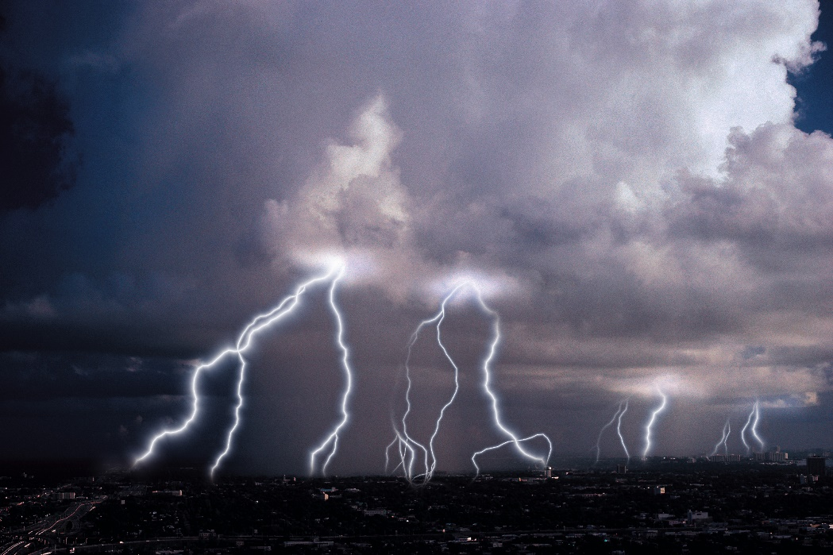
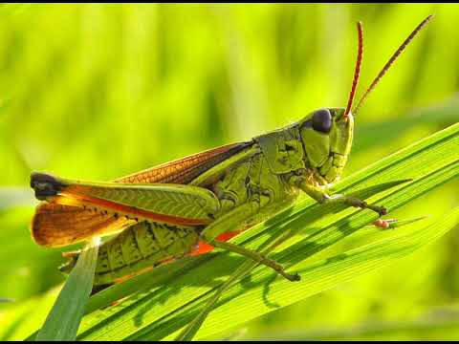
Listen for different pitches
Pitch is how high or low a sound is. Thunder has a low pitch whilst crickets chirping are a high pitch
On you next family/bubble exercise, take a stick with you and carefully hit natural objects.
Do they make high or low pitch sounds?
What is the highest pitch sound you can make?
What is the lowest pitch sound you can make?
WARNING
Be careful with sticks and do not hit any private property, people or animals!

Slide 6
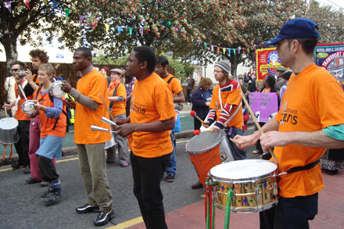
Combine sounds to make a band
Now that you have explored creating lots of different sounds, work with your family/bubble to make a band
Try and work together to play at the same time
Explore the different pitches of your natural instruments
Can you create a samba band vibe together by playing different rhythms at the same time that complement each other?

Slide 7
How did you get on?
What was your favourite activity from this pack?
Share your feedback by:
Emailing - ellen.blackwood@primary-forest-school.co.uk
Find us Facebook or Instagram @PrimaryForestSchools

