Slide 1
Primary Forest School
Online Learning – KS2 History Activities

Slide 2
The important bit for parents and teachers… but you can have a sneak peek at the activities too!
Activity | Resources Required | Potential Risks | Impact
Neolithic Era – Make an axe from flint or stone | Stick Twine/Ribbon Flint or stone | USE EXTREME CAUTION – eye goggles, dust mask and gloves must be worn Shards of stone/flint will fly off Sharp edges Contact with fingers | Children will understand the difficulty of creating what appears to be a simple tool and the effort required to complete this task
Victorians – Make a catapult | Y-shaped stick Elastic bands or inner tube Paper | ENSURE CHILDREN ARE NOT USING THIS TOWARDS PEOPLE OR ANIMALS Friction burns Firing in the wrong direction | Children create a fun toy that will help with their understanding of physics
Romans – Create a mosaic | Leaves of different colours and shapes | Germs on the leaves | Children develop their creativity while understanding about Roman art
Anglo-Saxons – Build a mini mud hut | Sticks (preferably bendy like willow) Mud | Germs in mud Safety with sticks | Children understand the difficulty of making homes before automation

Slide 3
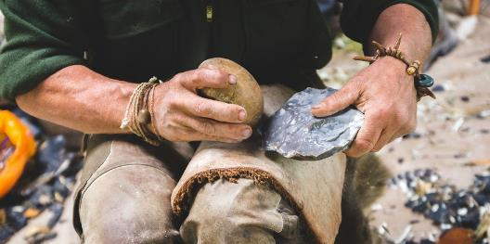
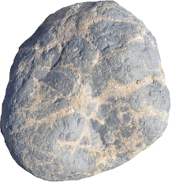
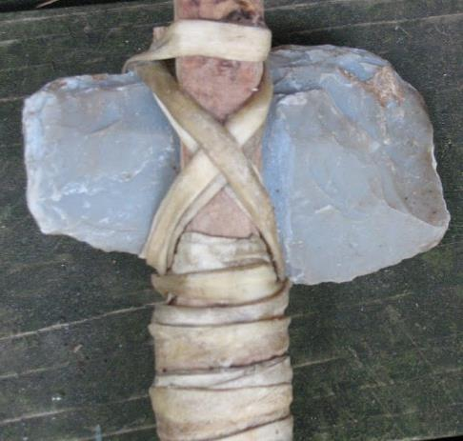
Neolithic Era – Make an axe from flint or stone
Knocking small bits of flint off a larger piece is called ‘knapping’.
Any stone can be knapped but flint is perfect as small shards come off at a time
Use a strong stone (a hammer stone) to knap the flint by hitting near the edge
Please don’t do it on your leg This man is a professional!
Tie your axe head to a strong stick using strong ribbon, twine, string or rope
This axe is not suitable for use and should be a display item only.
Please do not try to chop anything with it!
You could use natural twine from hibiscus!
Do you think Neolithic Man had it easy making their own tools?

Slide 4
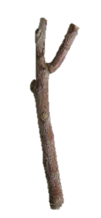
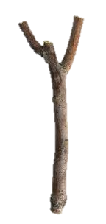
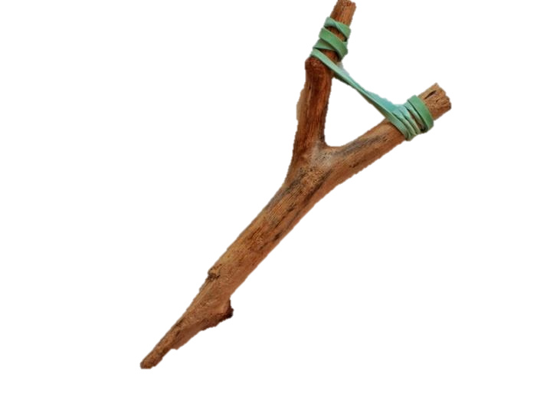
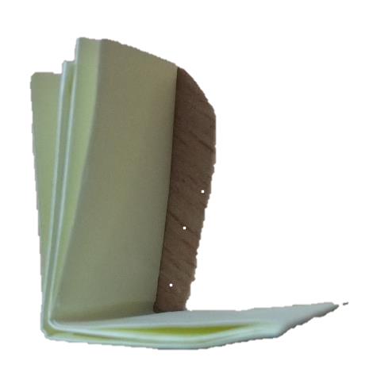
Victorians – Make a catapult
Victorian children had toys made by hand. One such toy was a wooden catapult.
DO NOT FIRE A CATAPULT AT ANY PEOPLE OR ANIMALS
Find a y-shaped stick when you are next out and about. Cut any long ends.
Using elastic bands or a cut up section of inner tube (or any other elasticated material, make a loop over each of the top 2 parts.
The postman may be happy to bring you some elastic bands
Fold a piece of paper length ways and one final width way fold. Place the fold on the elastic, pull back and fire!

Slide 5
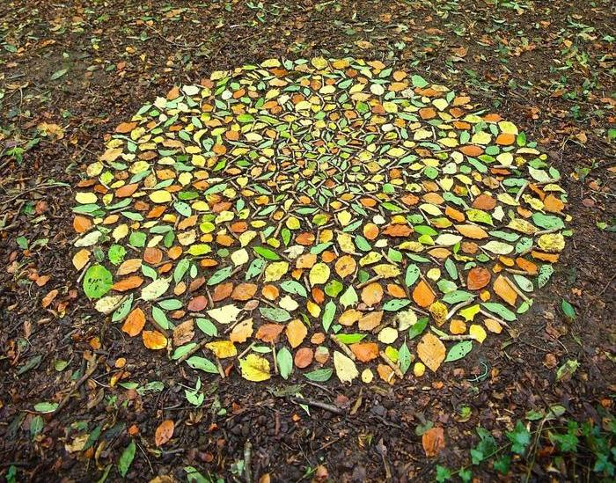
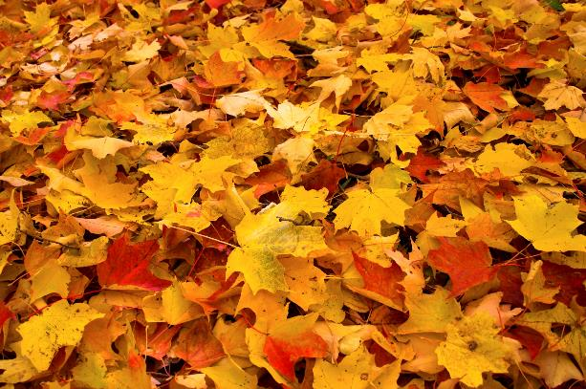
Romans – Create a mosaic
Mosaics were patterns and pictures, made using small pieces of stone, tile and pottery.
Can you collect lots of different leaves and make your own mosaic?
The pieces making up a mosaic were called tesserae

Slide 6
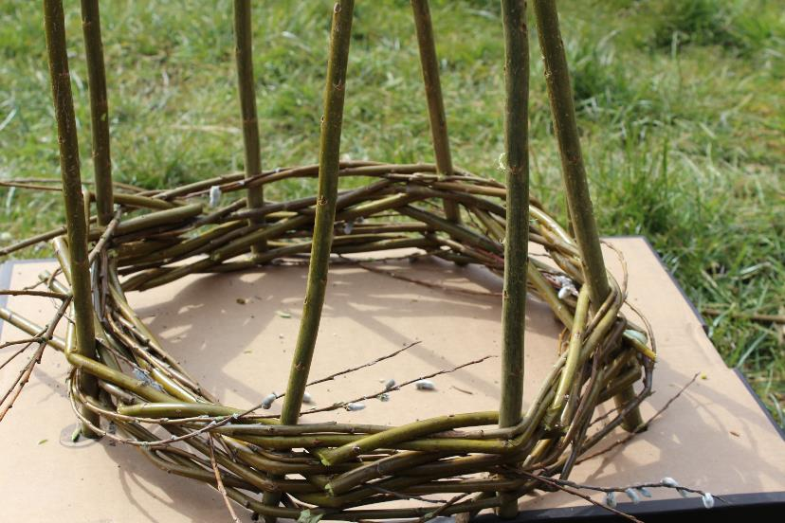
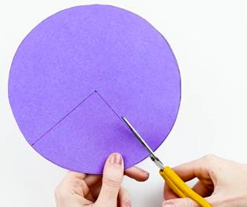
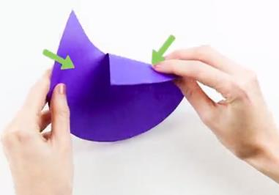
Anglo-Saxons – Build a mini mud hut
Find some sturdy short sticks and place them in the ground in a circle
1
2
Using willow, or some other young, bendy twigs, start weaving in and out of the upright sticks, around the circle.
Continue all the way to the top of the sticks. Make sure your weaving is tightly packed
3
4
Pat wet mud all over the outside of the willow until it is completely covered
The roof can be made with a circle of cardboard
This activity can also be completed with lolly sticks and raffia
5
Lay dry grass or raffia on the roof to finish your hut!

Slide 7
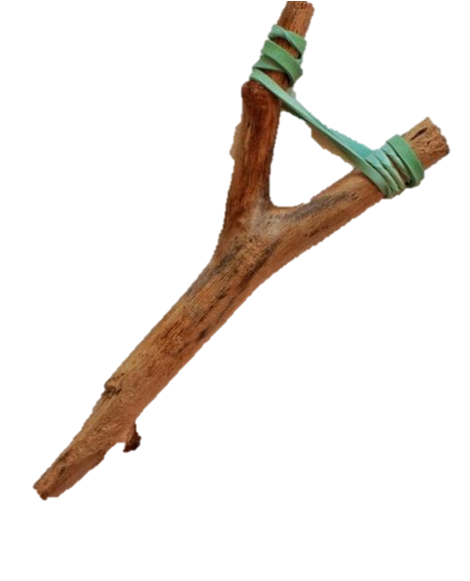
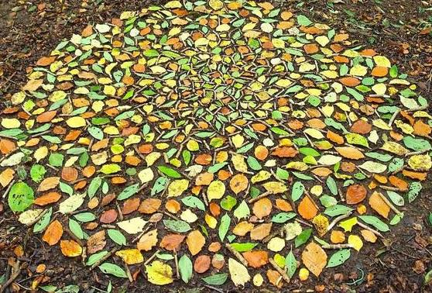
How did you get on?
What was your favourite activity from this pack?
Share your feedback by:
Emailing - ellen.blackwood@primary-forest-school.co.uk
Find us Facebook or Instagram @PrimaryForestSchools

